Slide 1
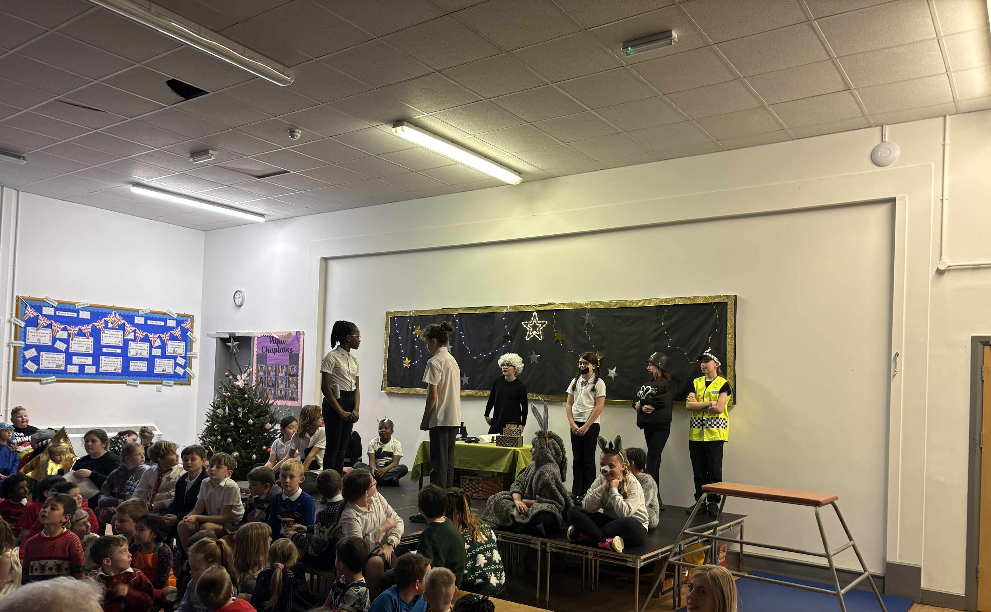
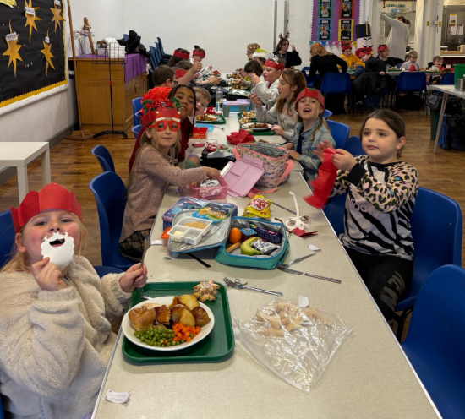
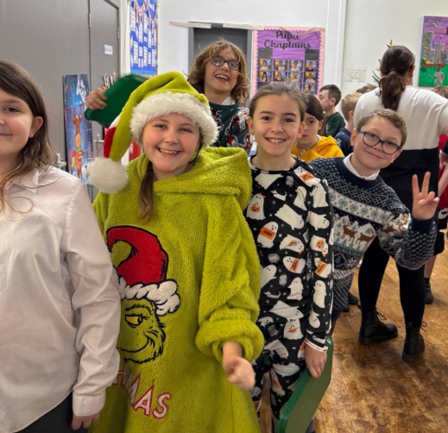
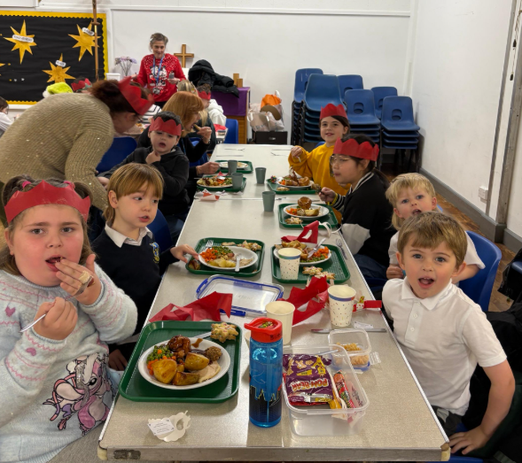
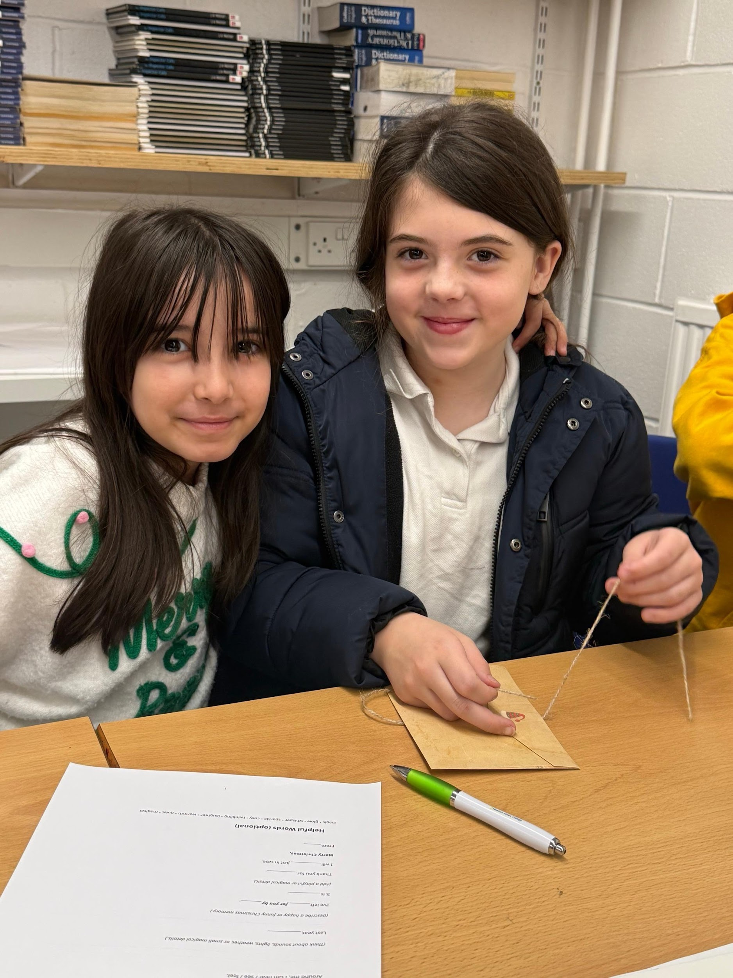
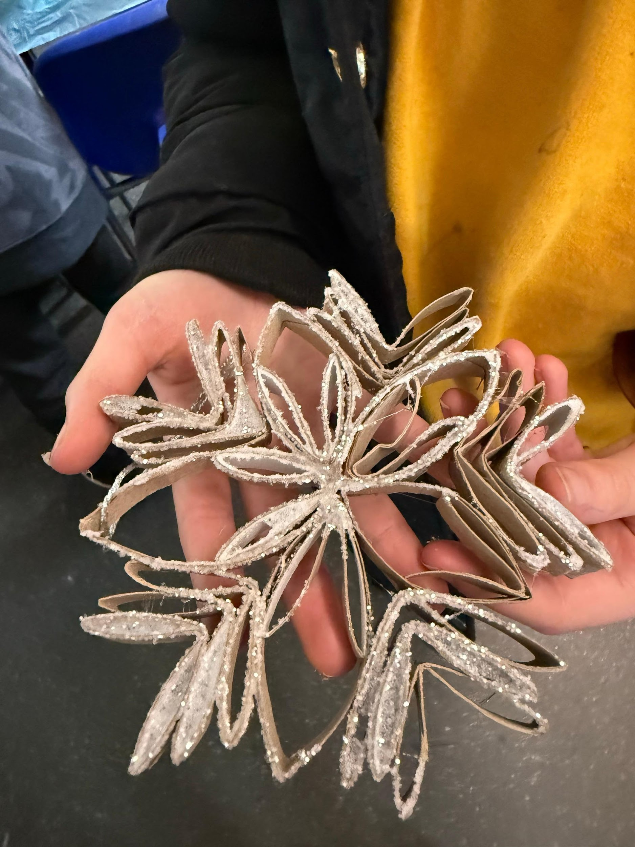
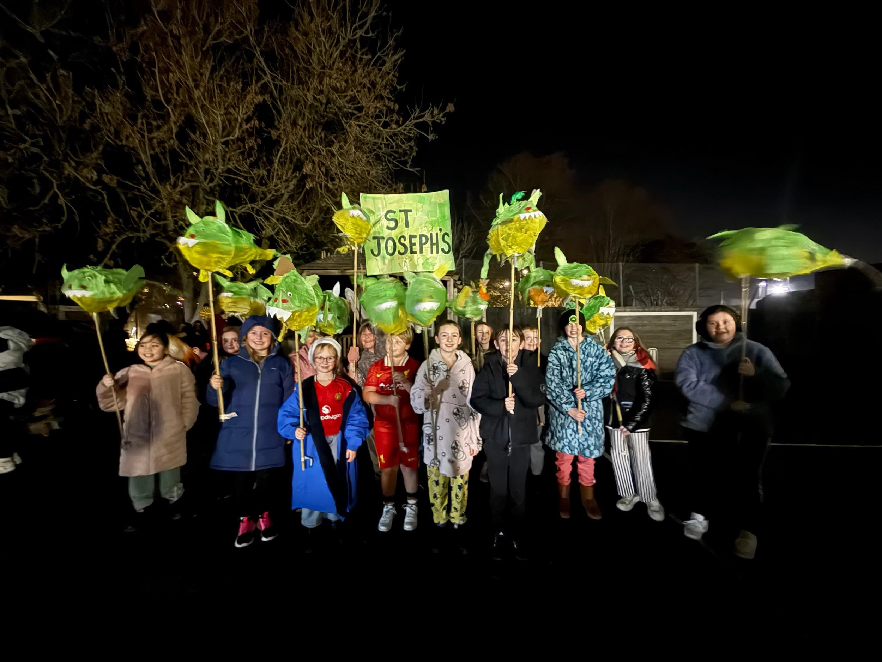
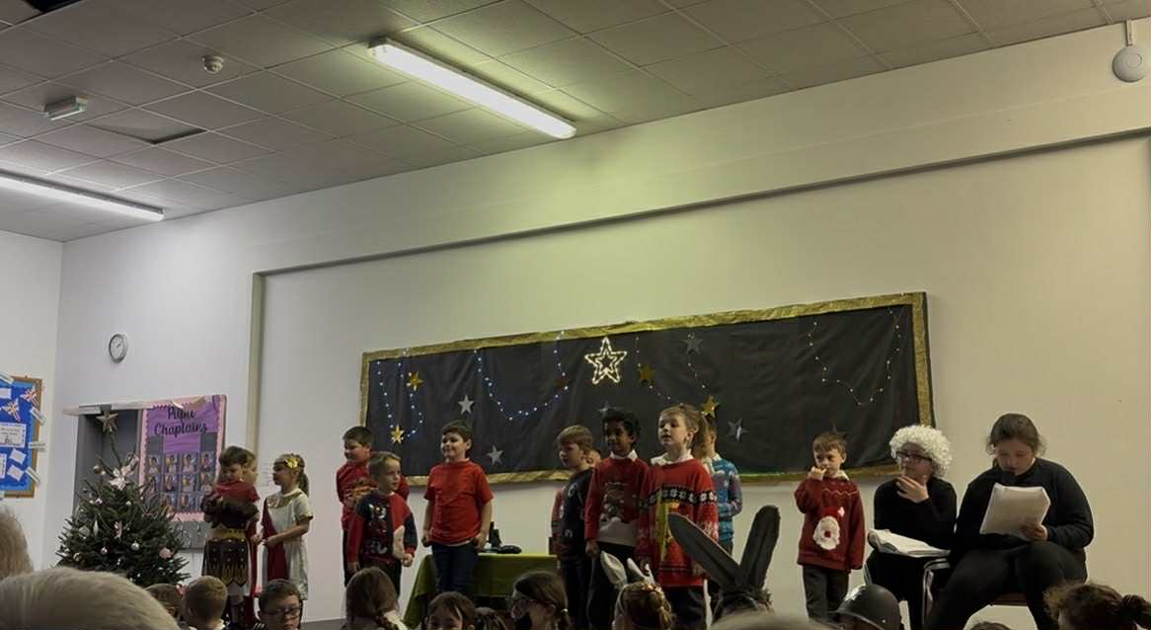
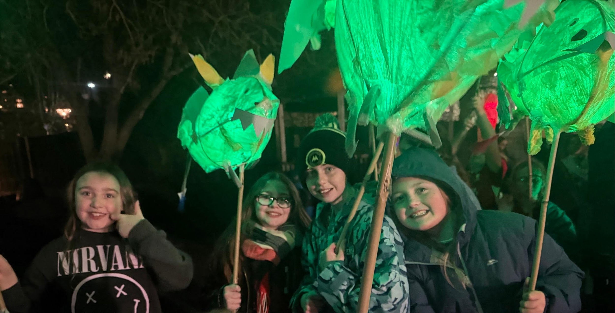
Christmas 2025

Slide 2
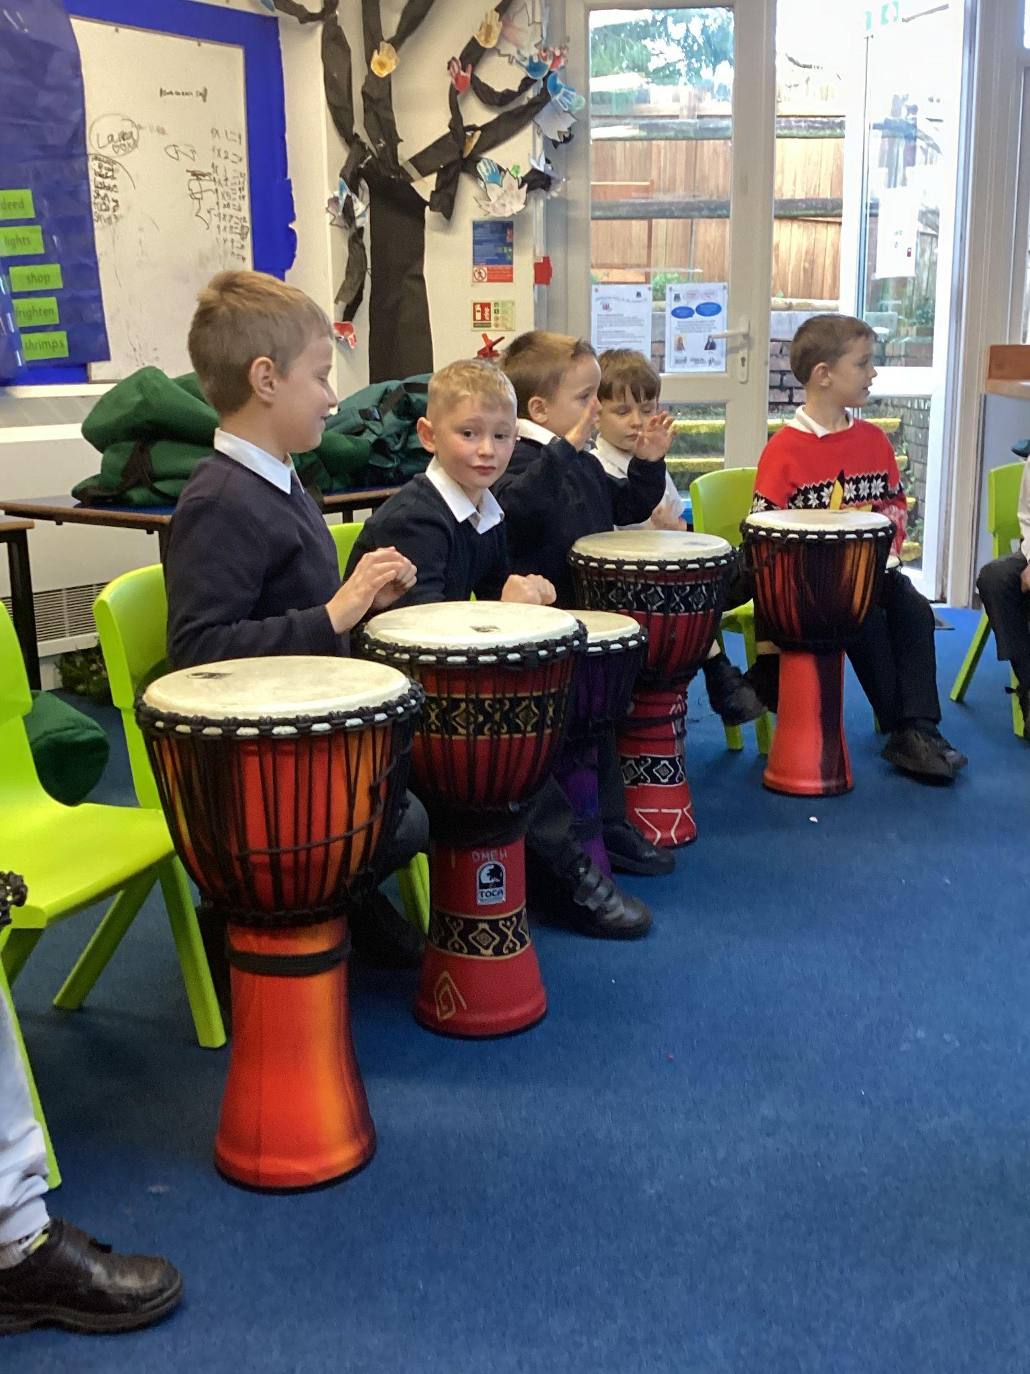
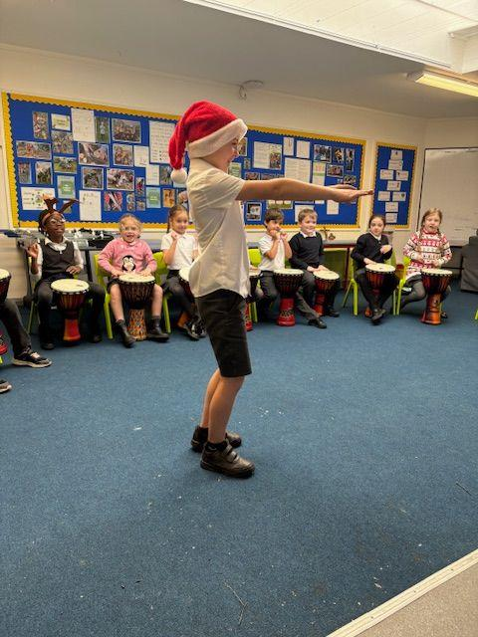
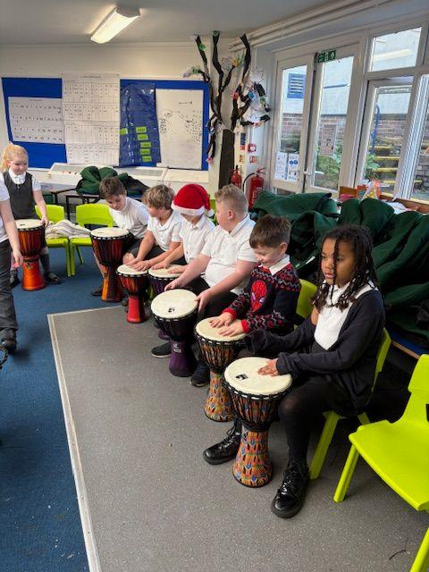
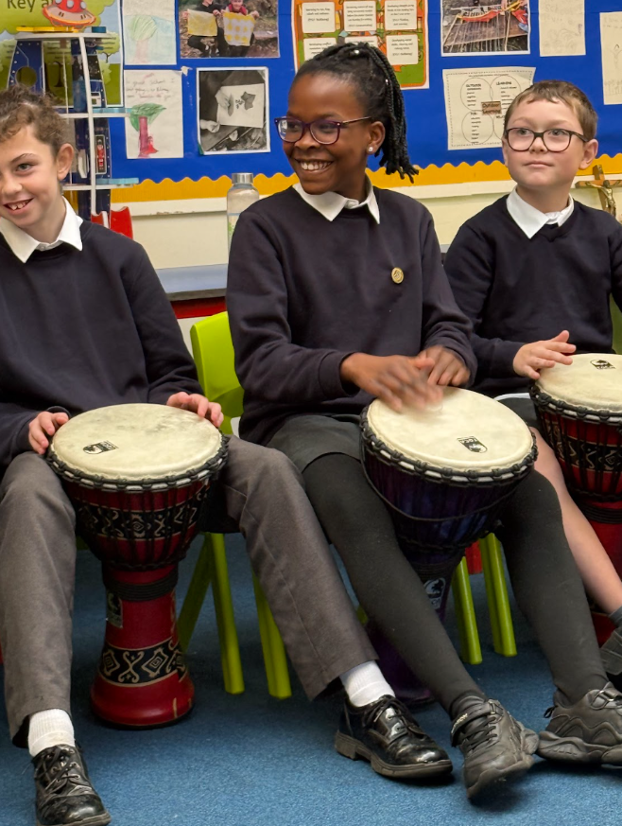
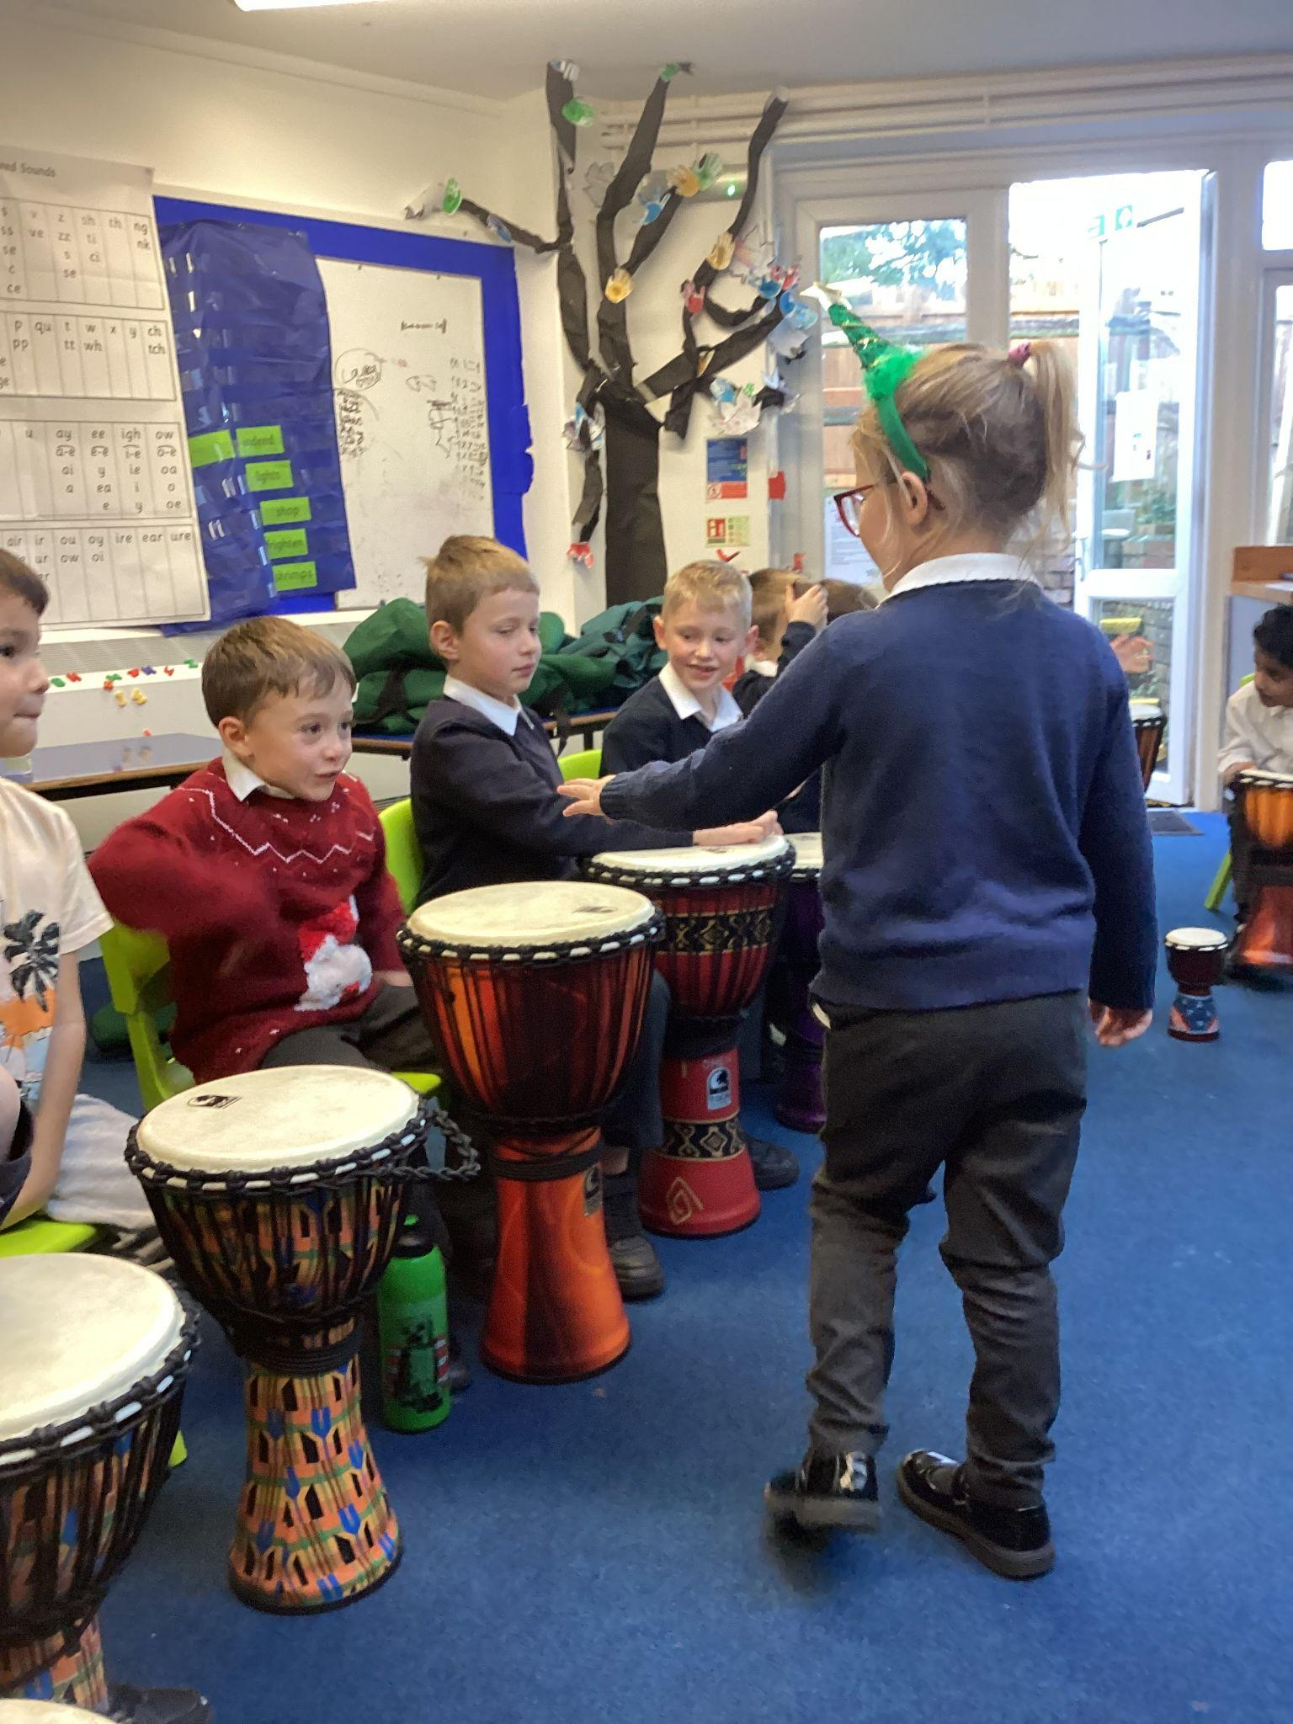
Djembe Workshop
We had an amazing Djembe workshop full of energy, laughter, and loud beats! Everyone got stuck in, learning how to play the drum and trying out different rhythms together. The room was buzzing as we played, made mistakes, and improved along the way. It was fun, exciting, and impossible not to smile while making so much noise together. 🥁😄

Slide 3

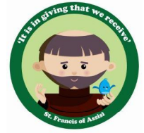

Stars of the week
Value Guardians
Zoey Noah M Whole Class |  | Brianna Noah R Bentley
Alfie Vianney Caleb |  | Isaac H-M Heather-Bobbi Thaaragan

Slide 4

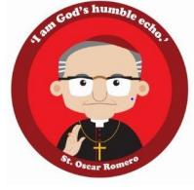
Stars of the week
Value Guardians
Amelia Violet Jayda |  | Arlo Noah Oliver J Arabella Freddie
Leo Frankie Gracie |  | Bella Nicolas

Slide 5
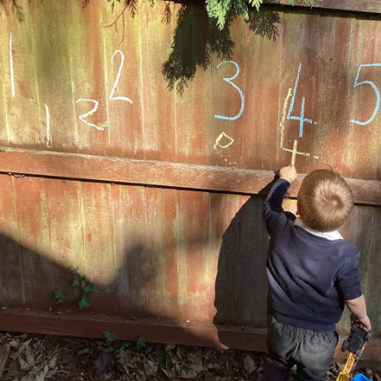
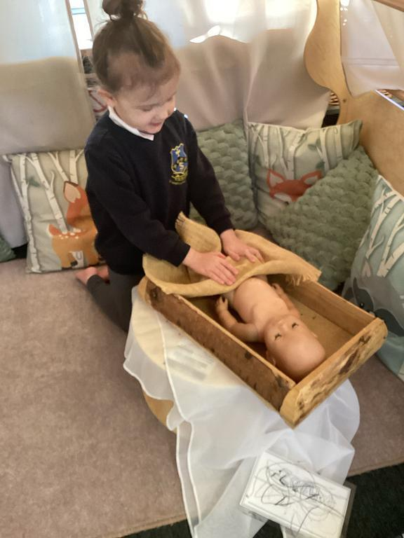
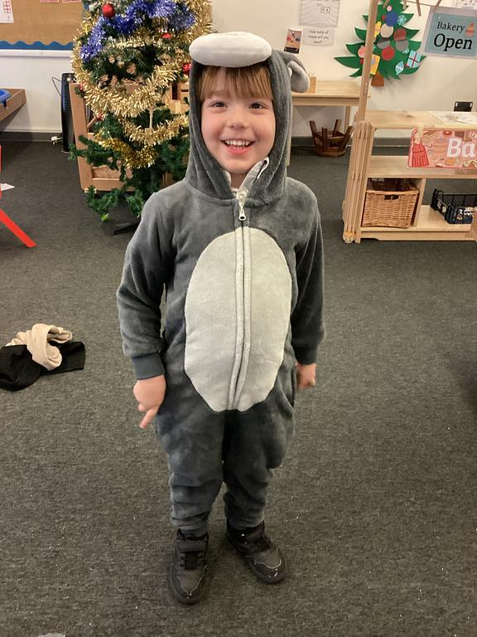
Curriculum
Highlights
🌟 December in St Francis 🌟
We have had a very busy December, practising for our very first Nativity and taking part in our first Carol Service at church. We have been truly blown away by the resilience, confidence, and courage the children have shown throughout.
The children have shown a real interest in Advent and have loved learning about Jesus’ birth and the journey to Bethlehem. We are sure they would be delighted to share the story with you at home!
As we come to the end of another wonderful half term, we would like to wish you all a fantastic Christmas and a Happy New Year. Wishing you health, happiness, and a joyful festive season.

Slide 6
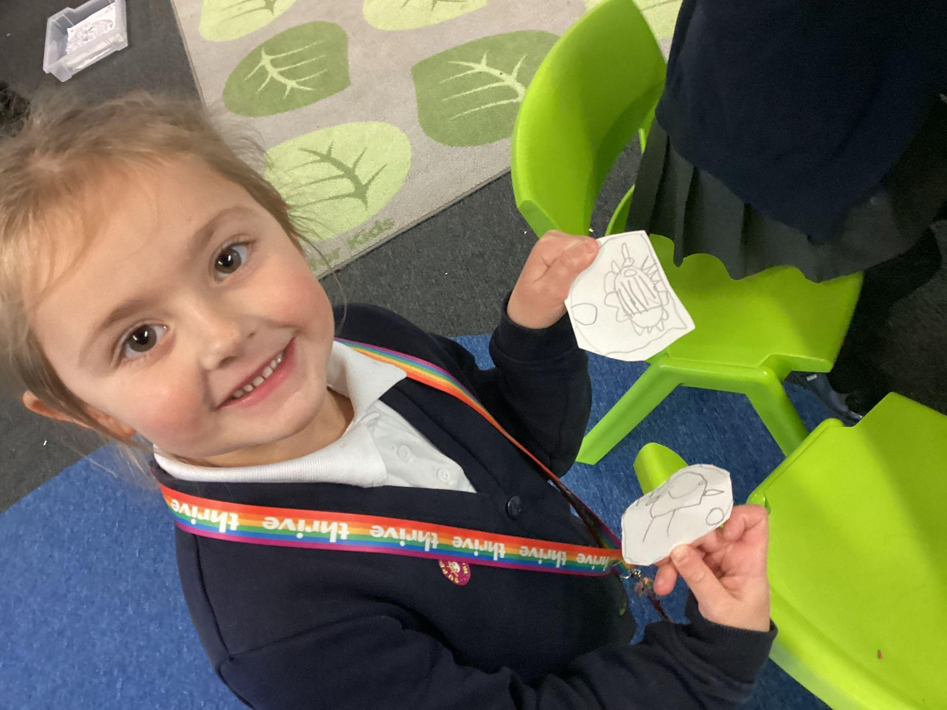
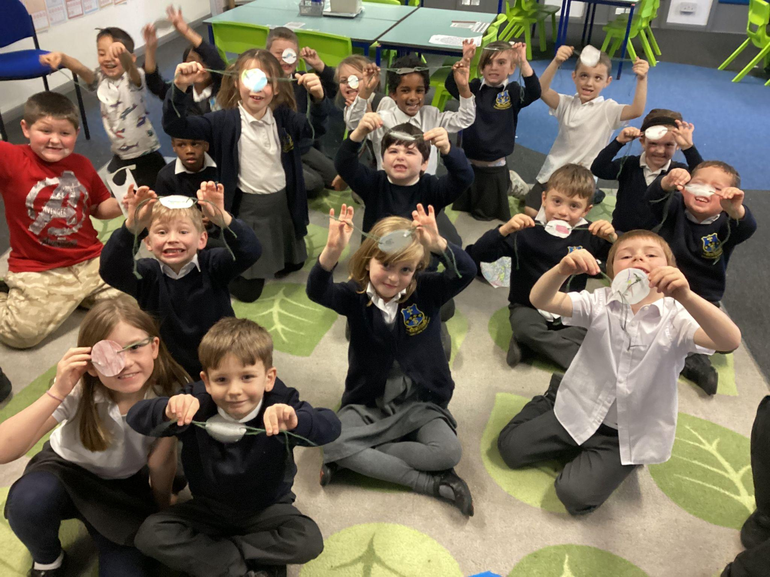
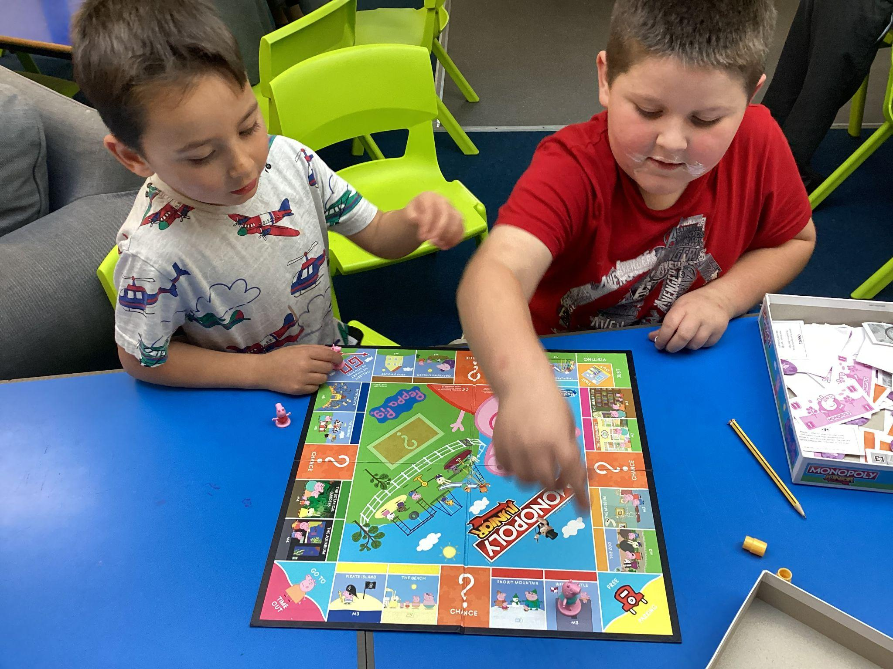
Curriculum Highlights
What a busy and exciting month we’ve had in Year 1/2! The children have been working incredibly hard and have had lots of fun along the way.
In History, we have been learning all about toys from the past. The children explored how toys have changed over time and thought carefully about what children might have played with many years ago. As part of this topic, we designed and made our own toys that could have been used in the past. The creativity, teamwork and problem-solving skills on display were fantastic. We also enjoyed playing traditional games that children would have played in the past, which sparked lots of discussion and laughter!
We also took part in our Reindeer Run for charity, and what an achievement it was! The children showed amazing enthusiasm, determination and kindness as they ran to support a good cause. We are so proud of their efforts and the generosity they showed.
To top off a brilliant month, the children absolutely smashed it in our Nativity performance. They sang beautifully, spoke clearly and showed so much confidence on stage. Thank you to all the families who came along to support and celebrate with us, it really meant a lot to the children.
Thank you for your continued support. We are so proud of everything Year 1/2 have achieved this term and can’t wait for all the exciting learning still to come!

