Slide 1


St. Joseph’s Catholic
Primary School
Coombeshead Road, Newton Abbot TQ12 1PT
Tel: 01626 352559
e-mail: admin@sjna.uk
Newsletter
October 2025

Slide 2
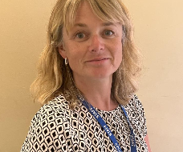
Message from Head of School
Dear Parents and Guardians,
As we reach the end of our first half term, I want to take a moment to reflect on what has been a truly wonderful start to the school year. The children have shown their usual amazing learning attitudes and brilliant learning behaviours, making fantastic progress across all areas. Their enthusiasm, curiosity, and kindness continue to shine through every day.
We’ve had so many exciting opportunities for learning already this term. Our partnership with local secondary schools has provided wonderful chances for our pupils to take part in sporting festivals and develop their teamwork and confidence. Every child will have opportunities like these throughout the year, helping them to grow not only in skill but also in experience and enjoyment.
Our swimming offer also continues to be a real highlight. While the national curriculum states that children need only one swimming experience during Key Stage 2, we’re proud to go further—offering swimming lessons every year from Year 2 onwards, free of charge. This gives all our children the chance to build vital water safety and swimming skills over time.
This half term also saw our Harvest Festival, which was a special opportunity for our children to give back to some of the most vulnerable members of our community. Their generosity and understanding of the importance of helping others made us all very proud.
We were also delighted to welcome local author Jennifer Davy who brought her book ‘Chloe and the Bright Idea’ to life during her visit. The children were captivated by her story and loved the chance to meet a real-life author—a truly inspiring experience that encouraged many budding writers in our school.
None of this would be possible without our dedicated and hard-working staff, who go above and beyond to create engaging, meaningful learning experiences, and the wonderful support of our parents and carers, whose partnership makes such a difference to every child’s journey.
As we head into the half-term break, I hope everyone enjoys a well-earned rest. Thank you for all that you do to make our school such a special and vibrant community. We look forward to another half term of amazing learning and brilliant progress ahead.
Best Wishes and God Bless Sarah Pascoe and all the St. Joseph’s team

Slide 3
The Catholic life of our school
Harvest Festival Mass
We were delighted to celebrate our Harvest Festival Mass, led by Deacon Tim and Father George. It was wonderful to see the children so engaged throughout the service, sharing their prayers and songs with such enthusiasm. We were equally pleased to welcome so many parents and carers who joined us for this special occasion. A heartfelt thank you for all the generous contributions donated to St. Joseph’s Church Food Bank — your kindness will make a real difference to those in need.
Our Chaplaincy Team
Introducing our new Chaplaincy Team! Our current year 6 members will be supporting the new year five members. They will be working alongside Deacon Tim and Deborah to support spiritual activities and lead Collective Worship. We can’t wait to see the positive impact they’ll have on our school community.

Slide 4
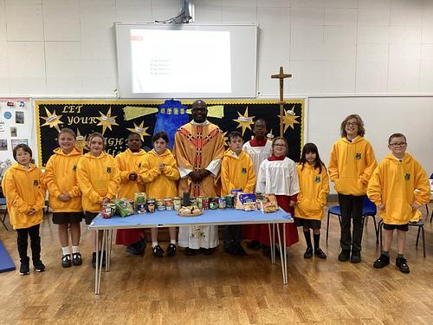
Our chaplaincy team - Harvest Festival 2025

Slide 5

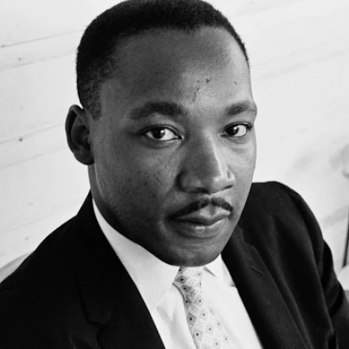
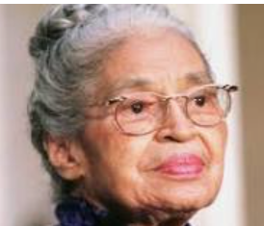
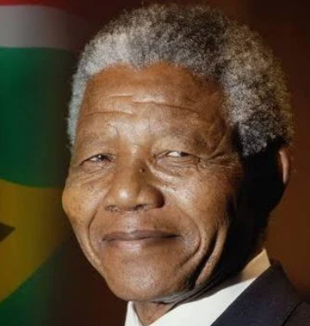
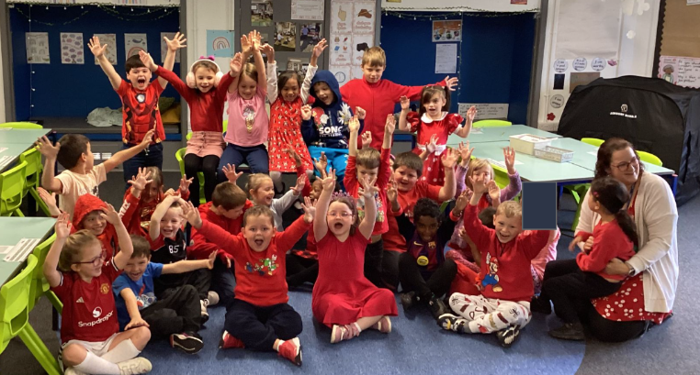
The British Values of our school
During Black History Month, the children learned about three inspirational people — Nelson Mandela, Rosa Parks, and Martin Luther King Jr. They discovered how each of them worked hard to stop racism and unfair treatment so that everyone could be treated equally. The children also enjoyed wearing red on Anti-Racism Day to show their support. We talked about Nelson Mandela’s message: “No one is born hating another person… People must learn to hate, and if they can learn to hate, they can be taught to love.” This reminds us all to be kind, fair, and welcoming to everyone.

Slide 6
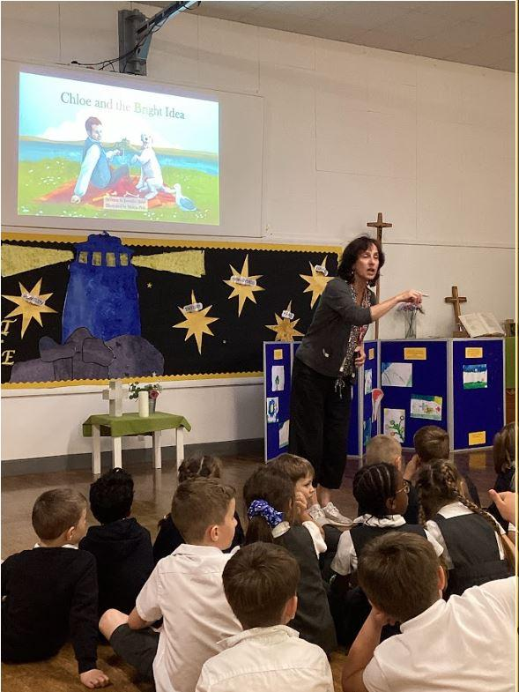
Author Visit
Author Visit
We were delighted to welcome author Jennifer Davey, who shared a wonderful reading of her book Chloe and the Bright Idea. Jenny told us all about her ancestor, Sir Humphry Davy, the inventor of the miner’s lamp in 1815. She really captured the children’s imagination with her amazing reading and fascinating discussion about both her ancestor and the process of writing a book. The whole school was inspired and excited to become writers themselves — which links perfectly to our current focus on writing across the school.

Slide 7

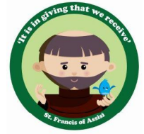

Stars of the week
Value Guardians
Brianna Bentley Zoey |  | Noah R Brianna Noah M
Violet Isaac H-M Elijah |  | Alfie Isaac H-M Vianney Violet

Slide 8


Stars of the week
Value Guardians
Willow Laura Gracie |  | Harry Amelia Wilbur Theo Layla Freddie
Frankie Tori Jason |  | Elouise Michelle Evan

Slide 9
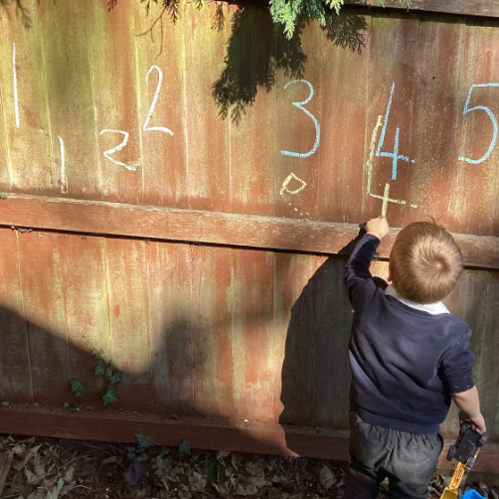
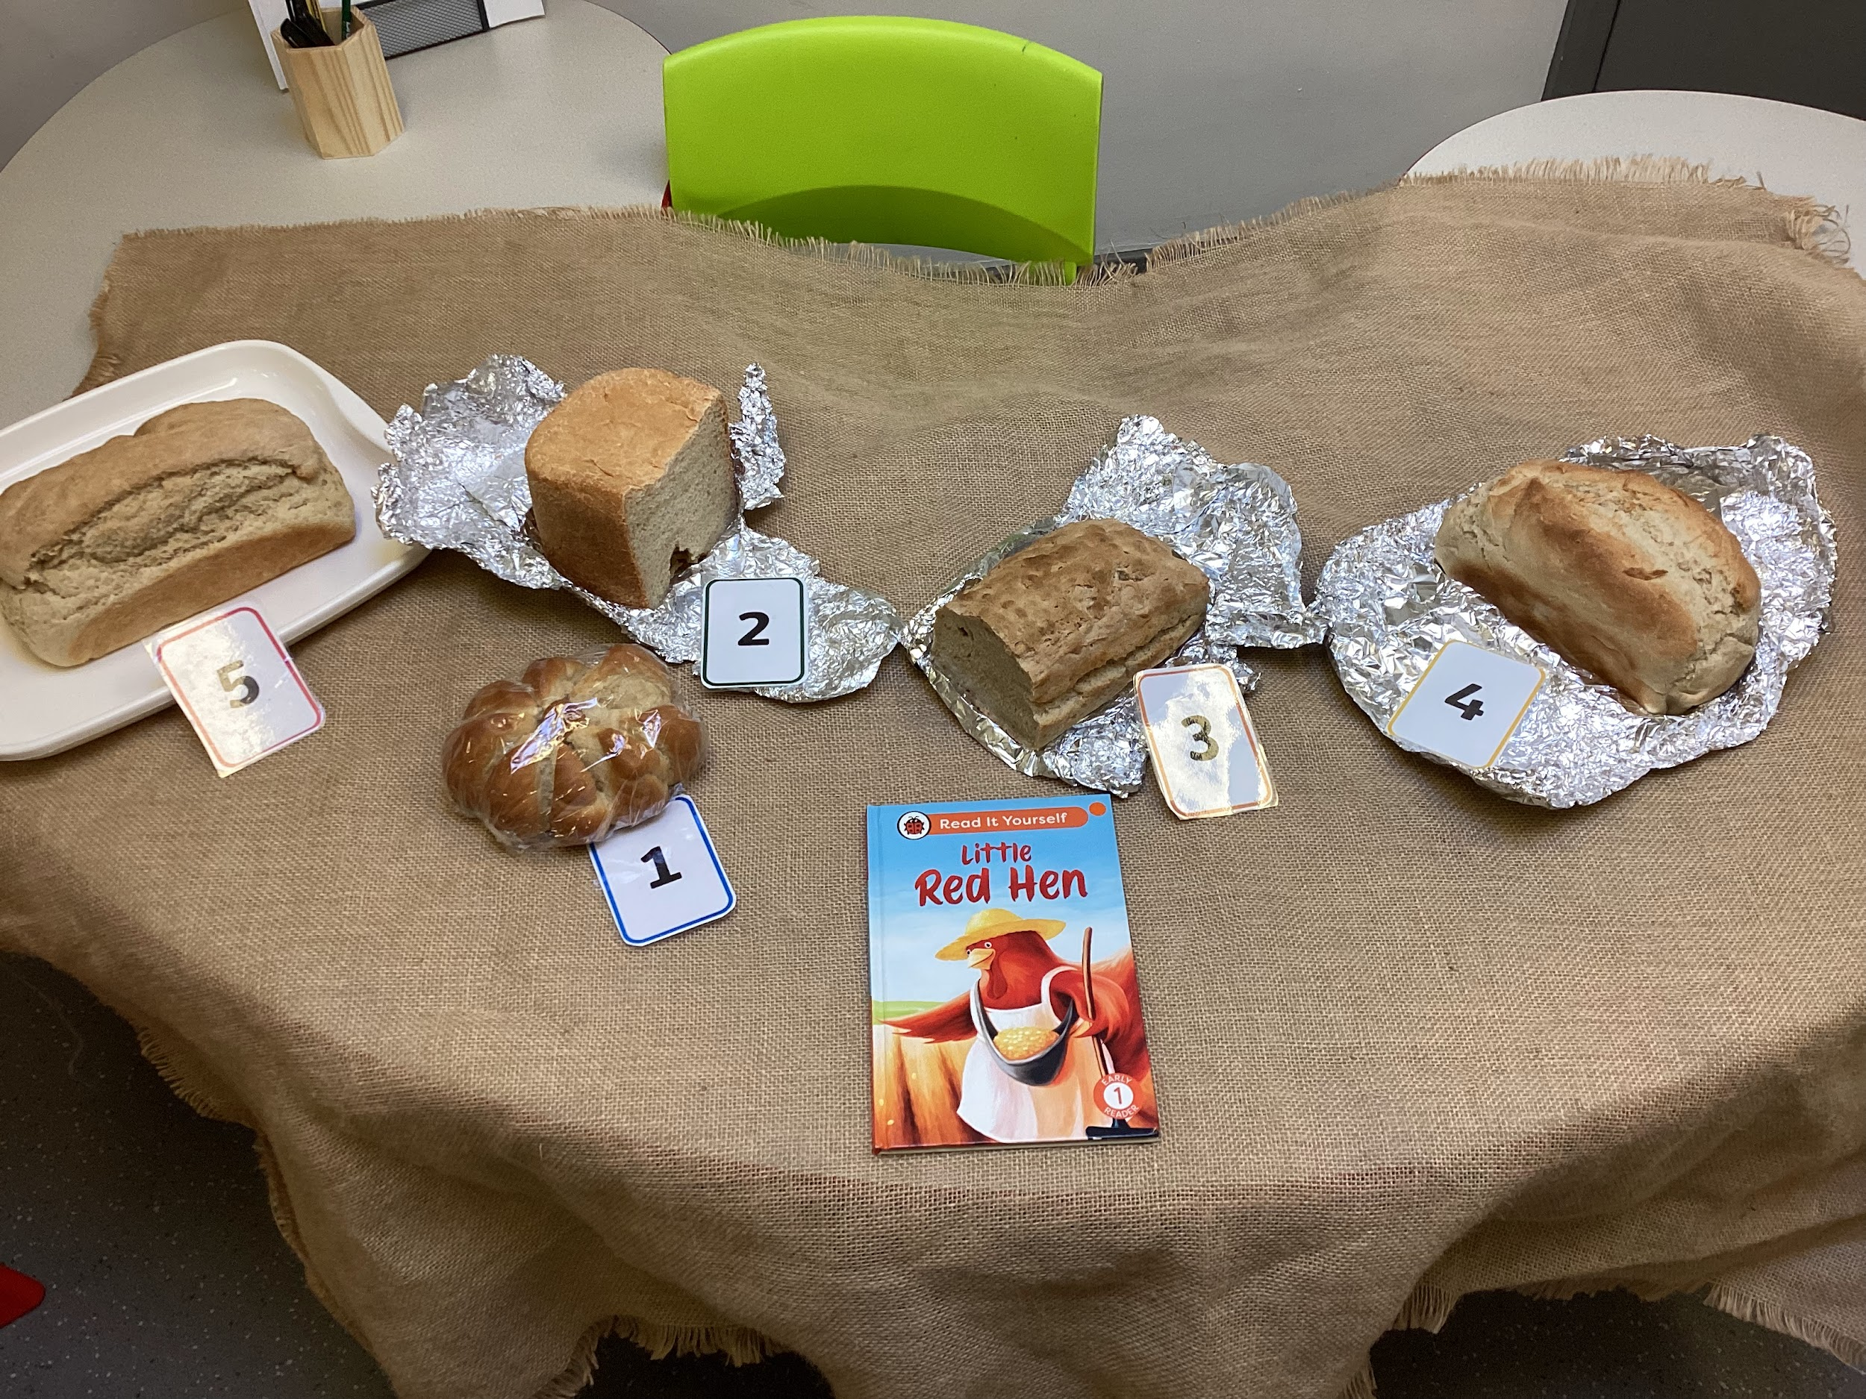
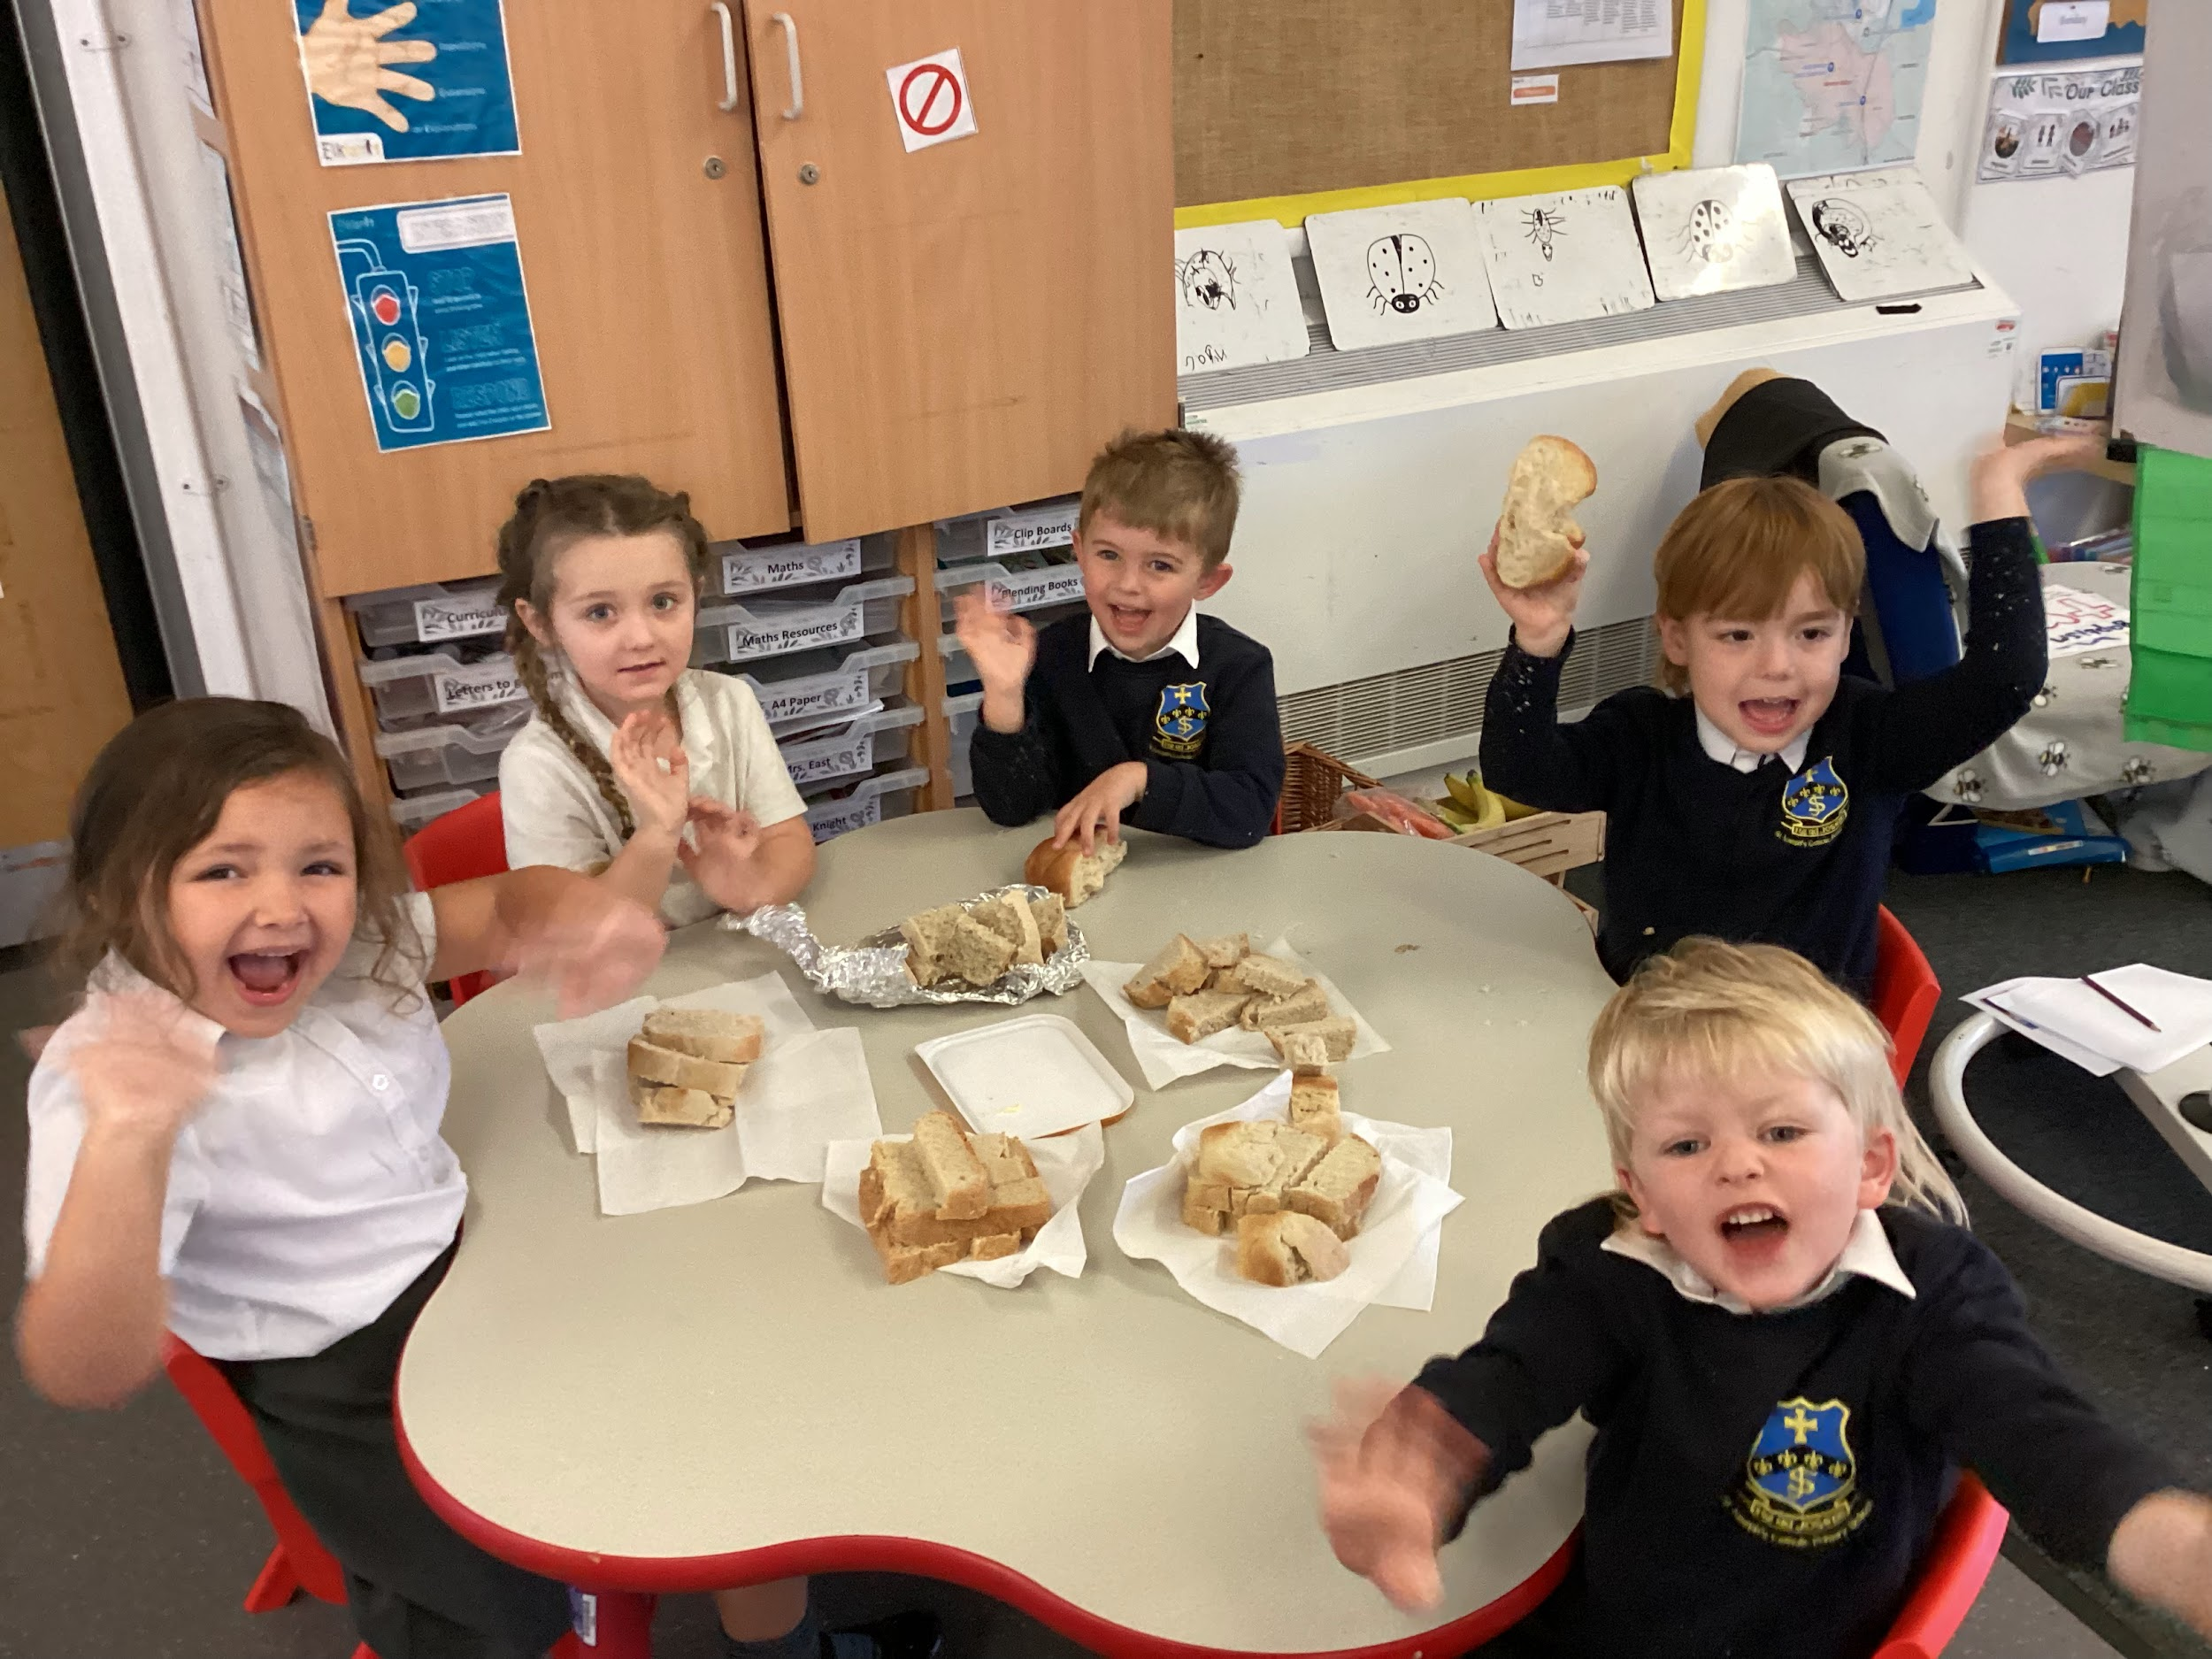
Curriculum
Highlights
October has brought us lots of learning opportunities. We have enjoyed seeing the change of season in our Forest school, noticing the leaves falling, changing colour and the colder weather. We have also been toasting marshmallows and creating our own fire using flint and steel sticks.
Our focus story has been “The Little Red Hen”, we have been acting out the story and the children will be able to recite it to you at home. Who knew home learning could be so fun? We challenged the children to bake some bread at home with their families and we have been blown away by their efforts.
Deborah came to visit us and we talked about Baptism. We created our own font within our classroom and the children enjoyed Baptising the dolls.
The children have been working so hard during phonics and we soon will have some early readers!

Slide 10
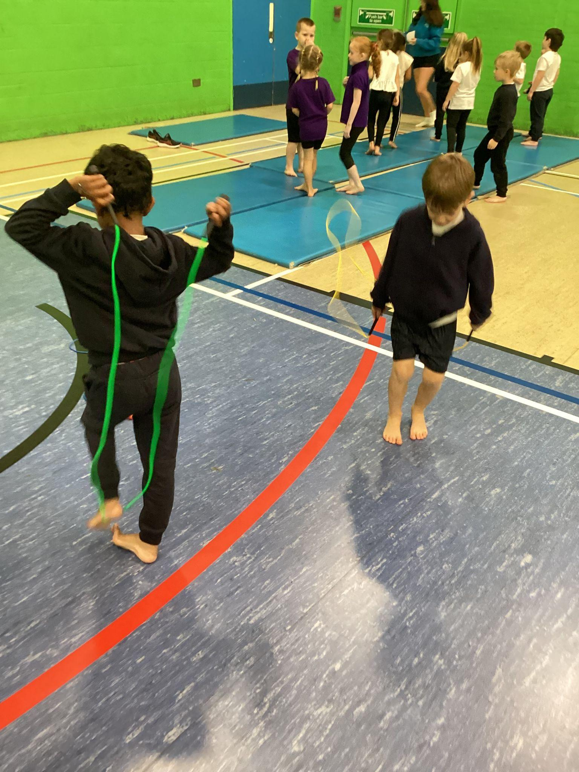
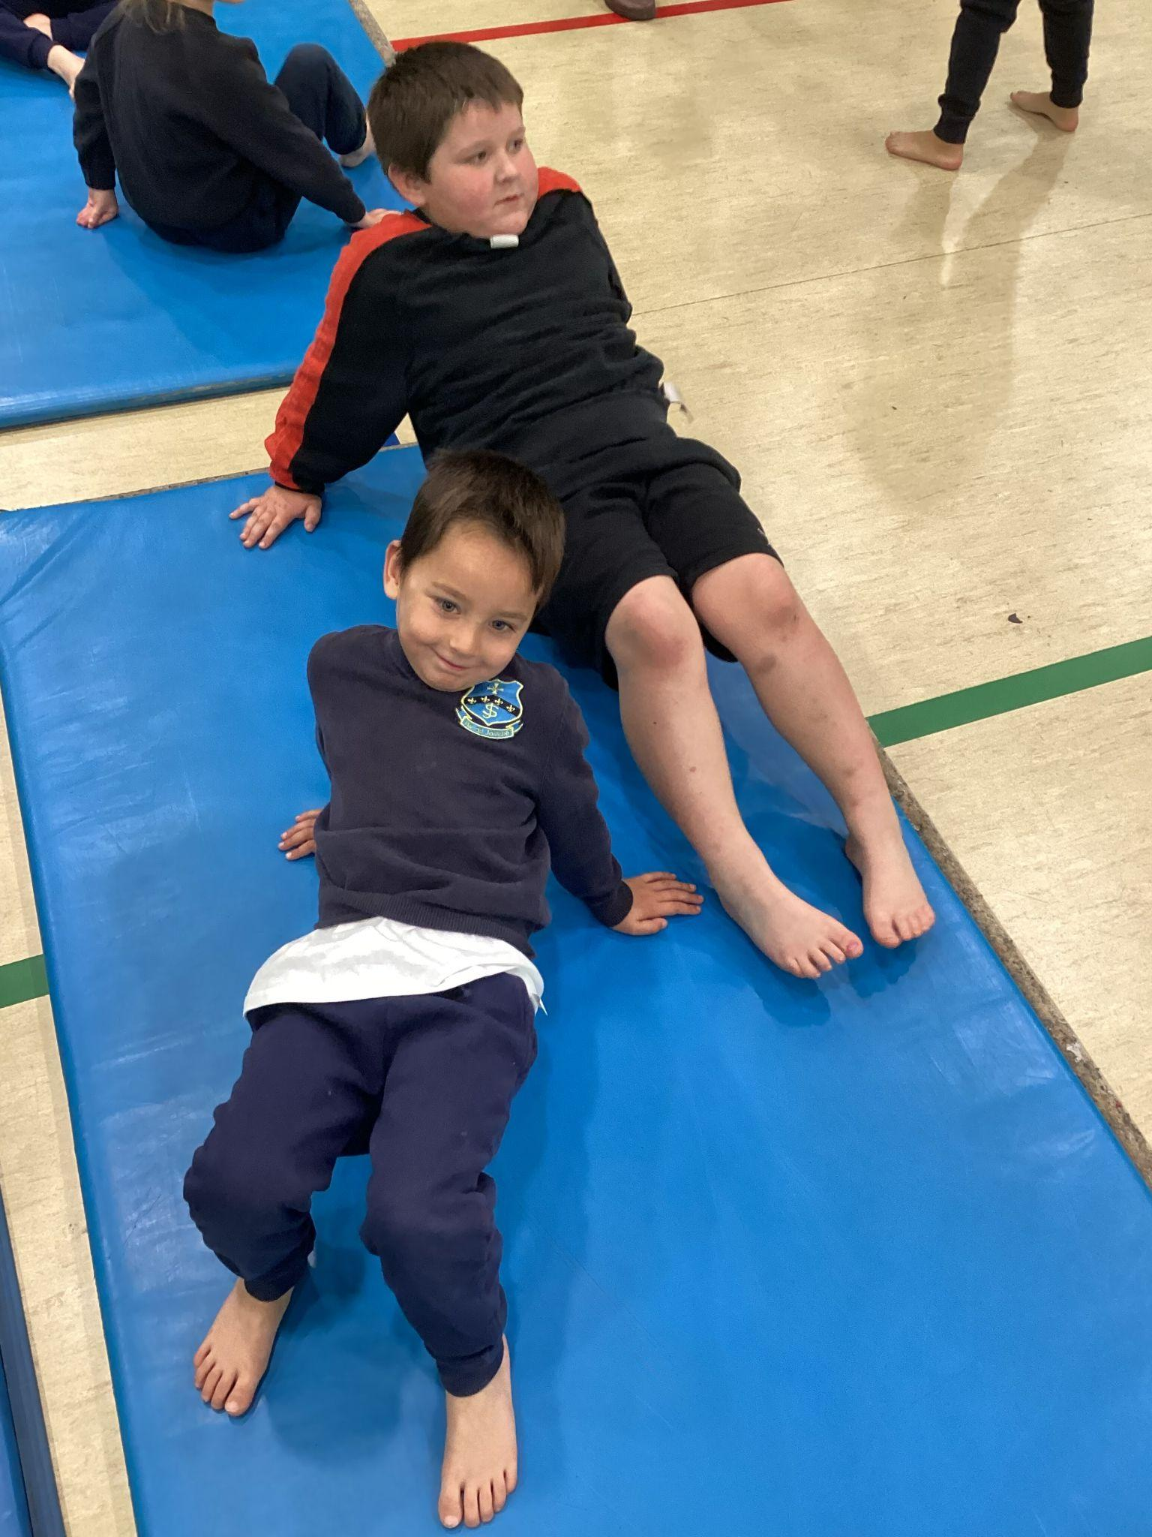
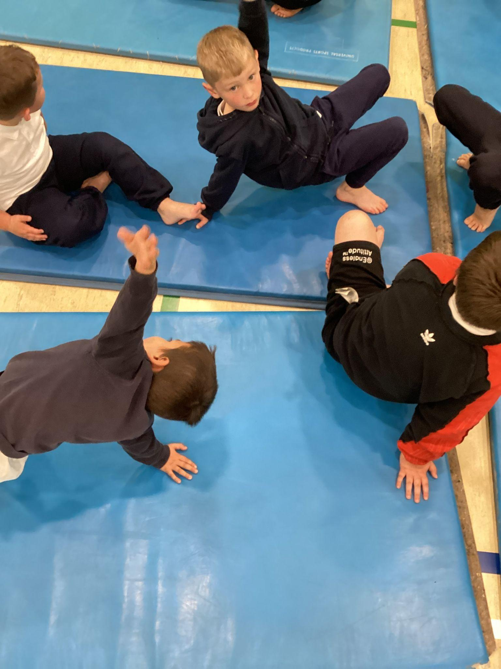
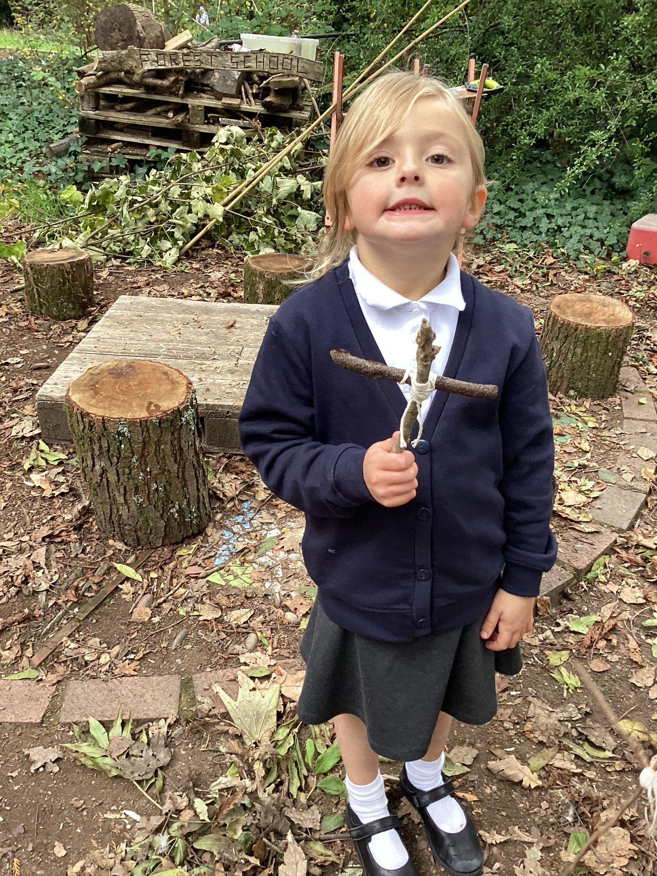
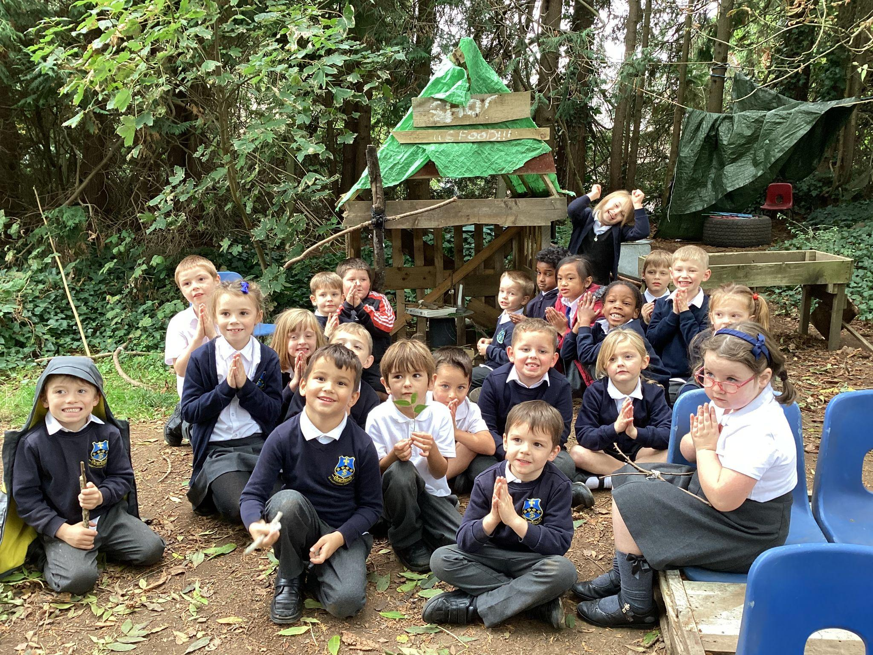
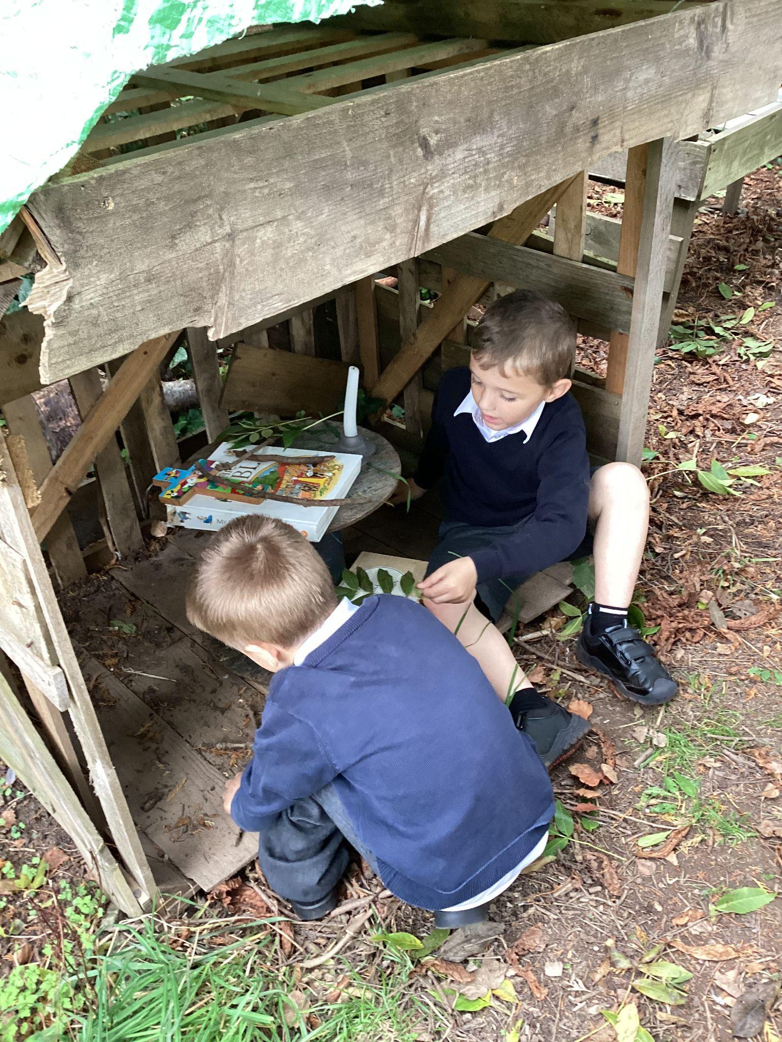
Curriculum Highlights
This month, we celebrated Black History Month by learning about the inspiring lives of Rosa Parks, Martin Luther King Jr., and Nelson Mandela. The children created thoughtful posters, took part in assemblies, and engaged in meaningful discussions about equality and fairness. To mark Anti-Racism Day, everyone wore red to show our commitment to standing up against racism. In addition, we created a peaceful worship area in our Forest School, where we reflected on the things we talk to God about. We also enjoyed an exciting gymnastics session at Newton Abbot College, where the children had the chance to develop their balance, coordination, and teamwork skills. It has been a wonderful month full of reflection, learning, and activity!

Slide 11
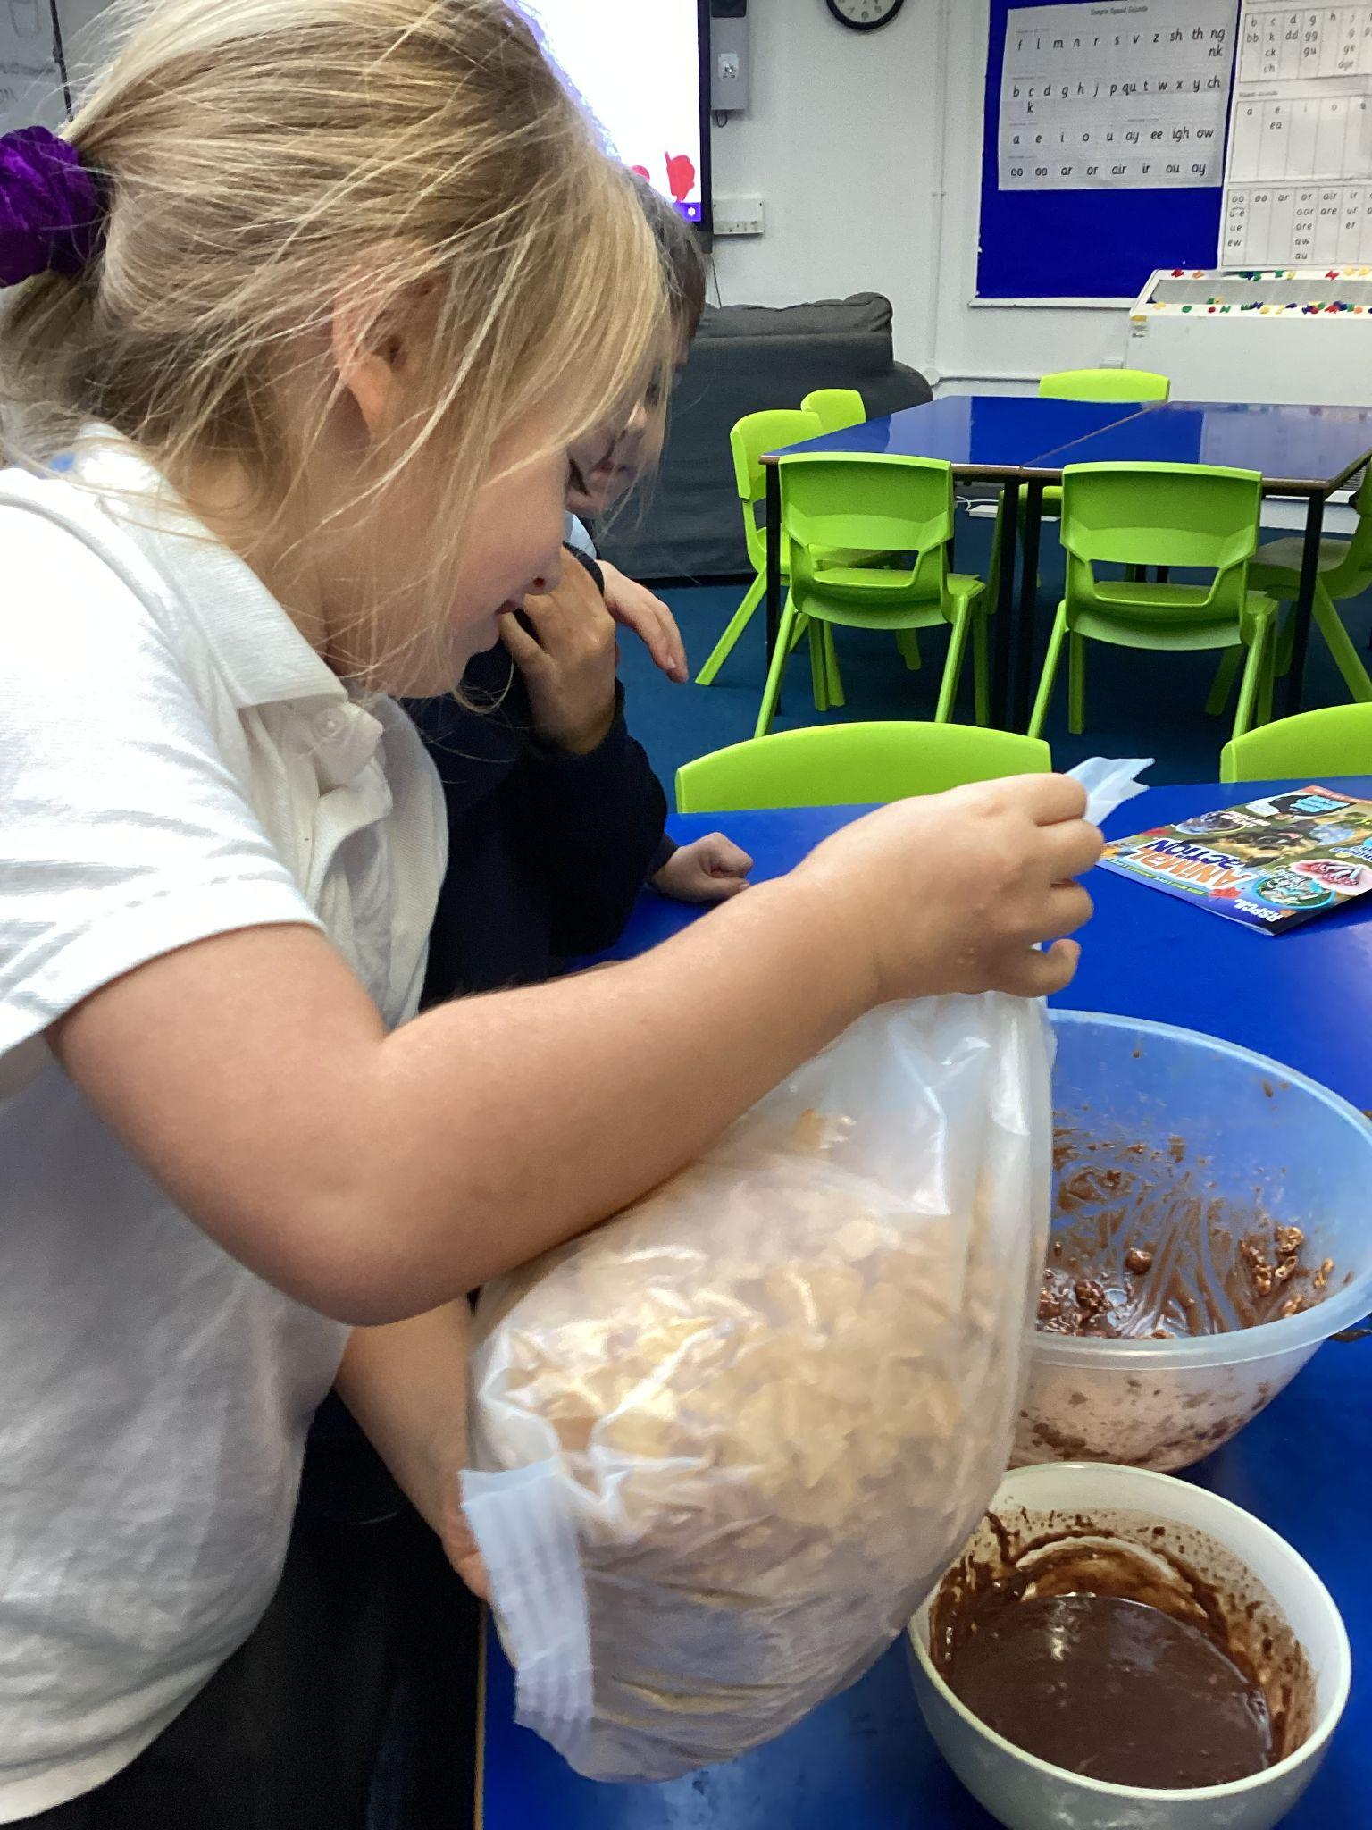
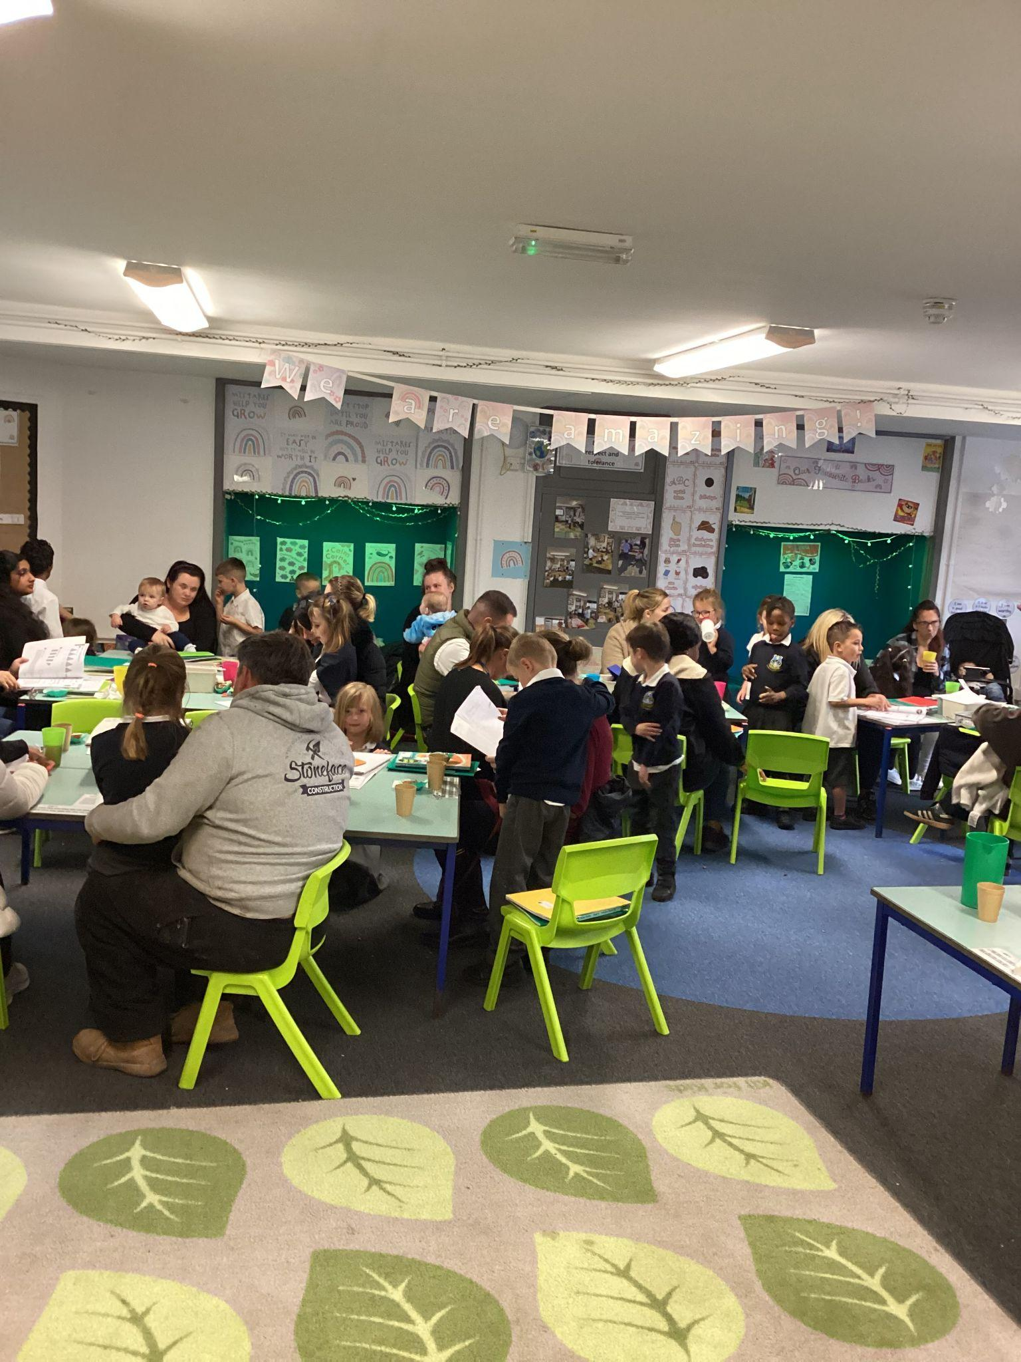
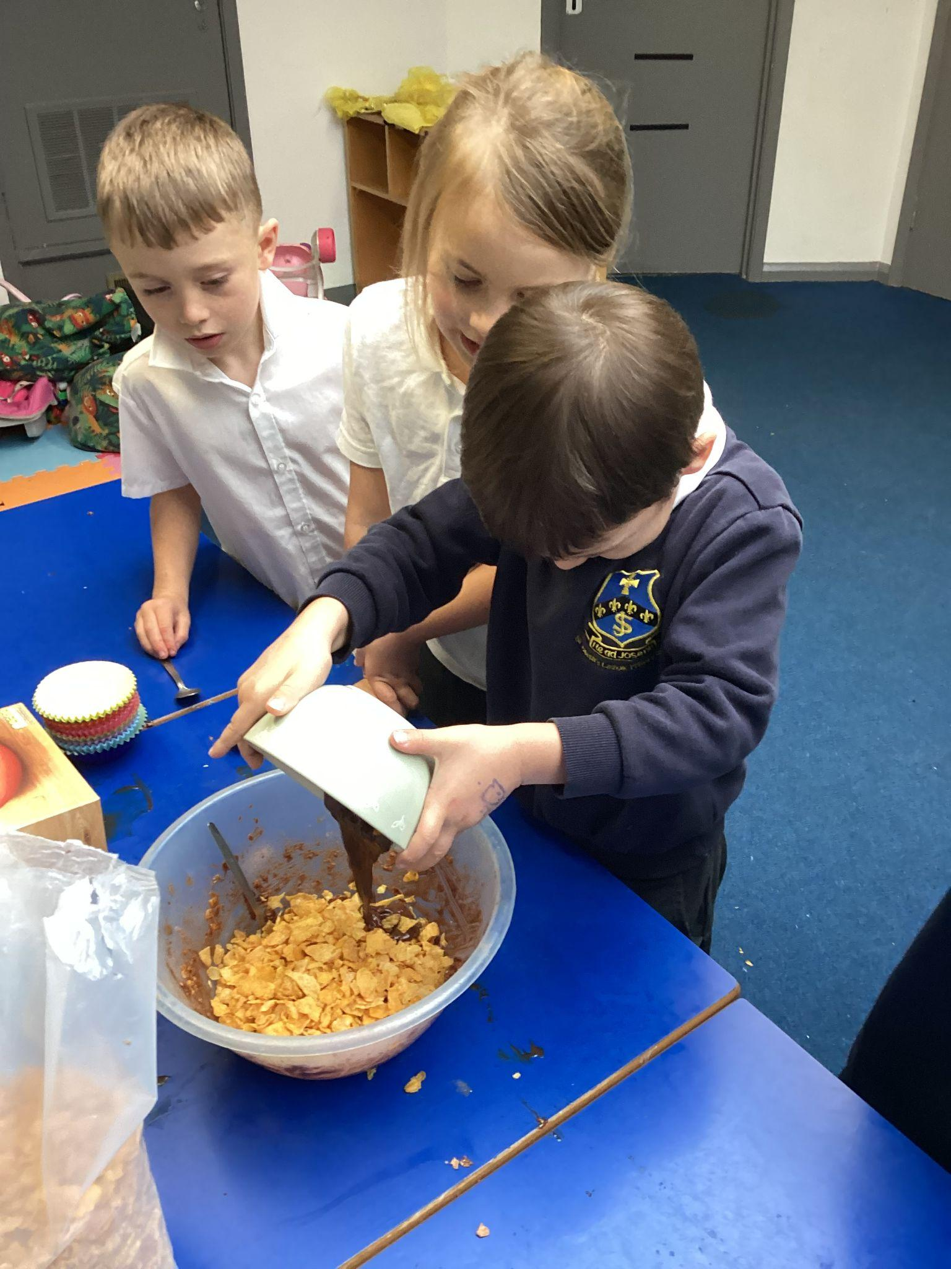
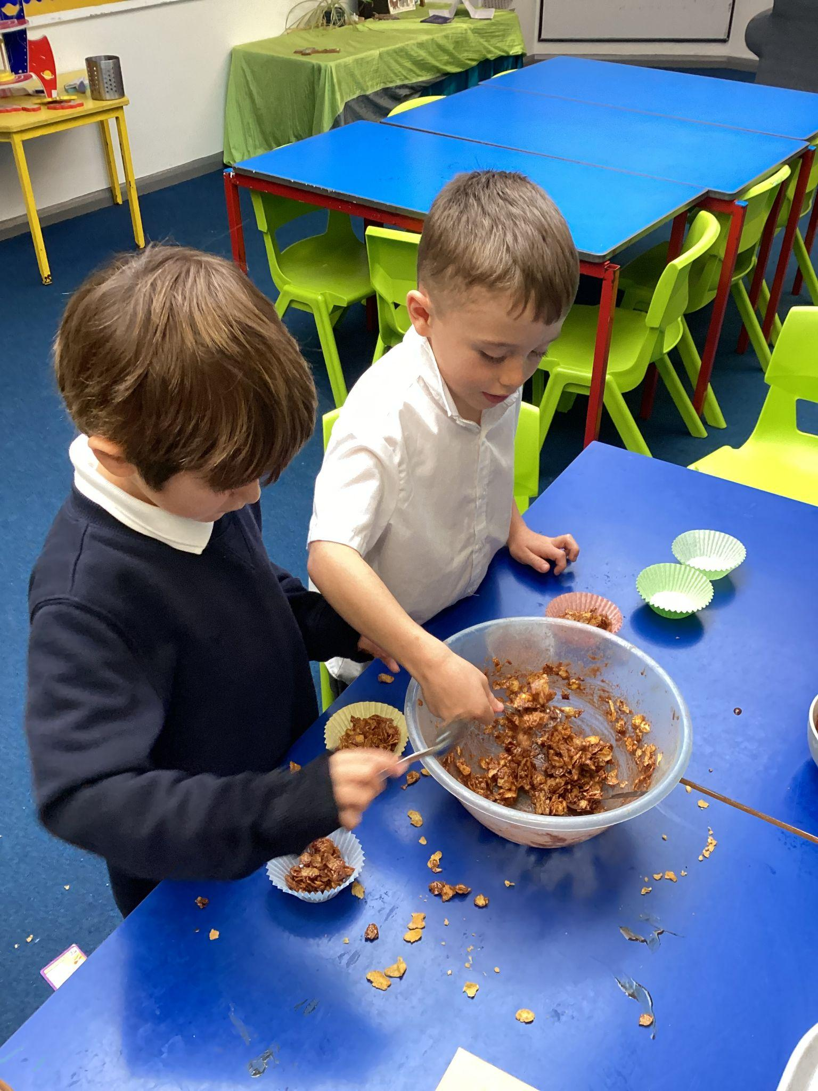
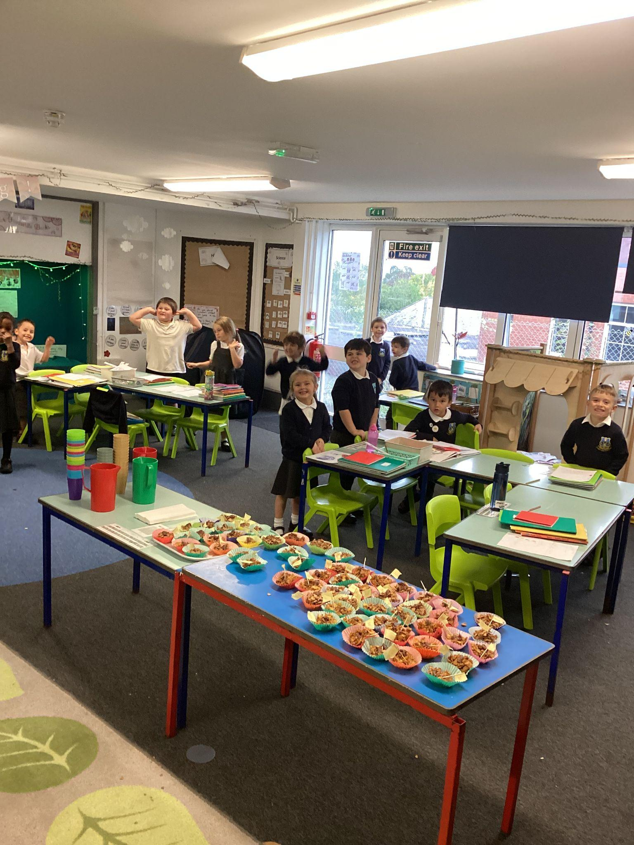
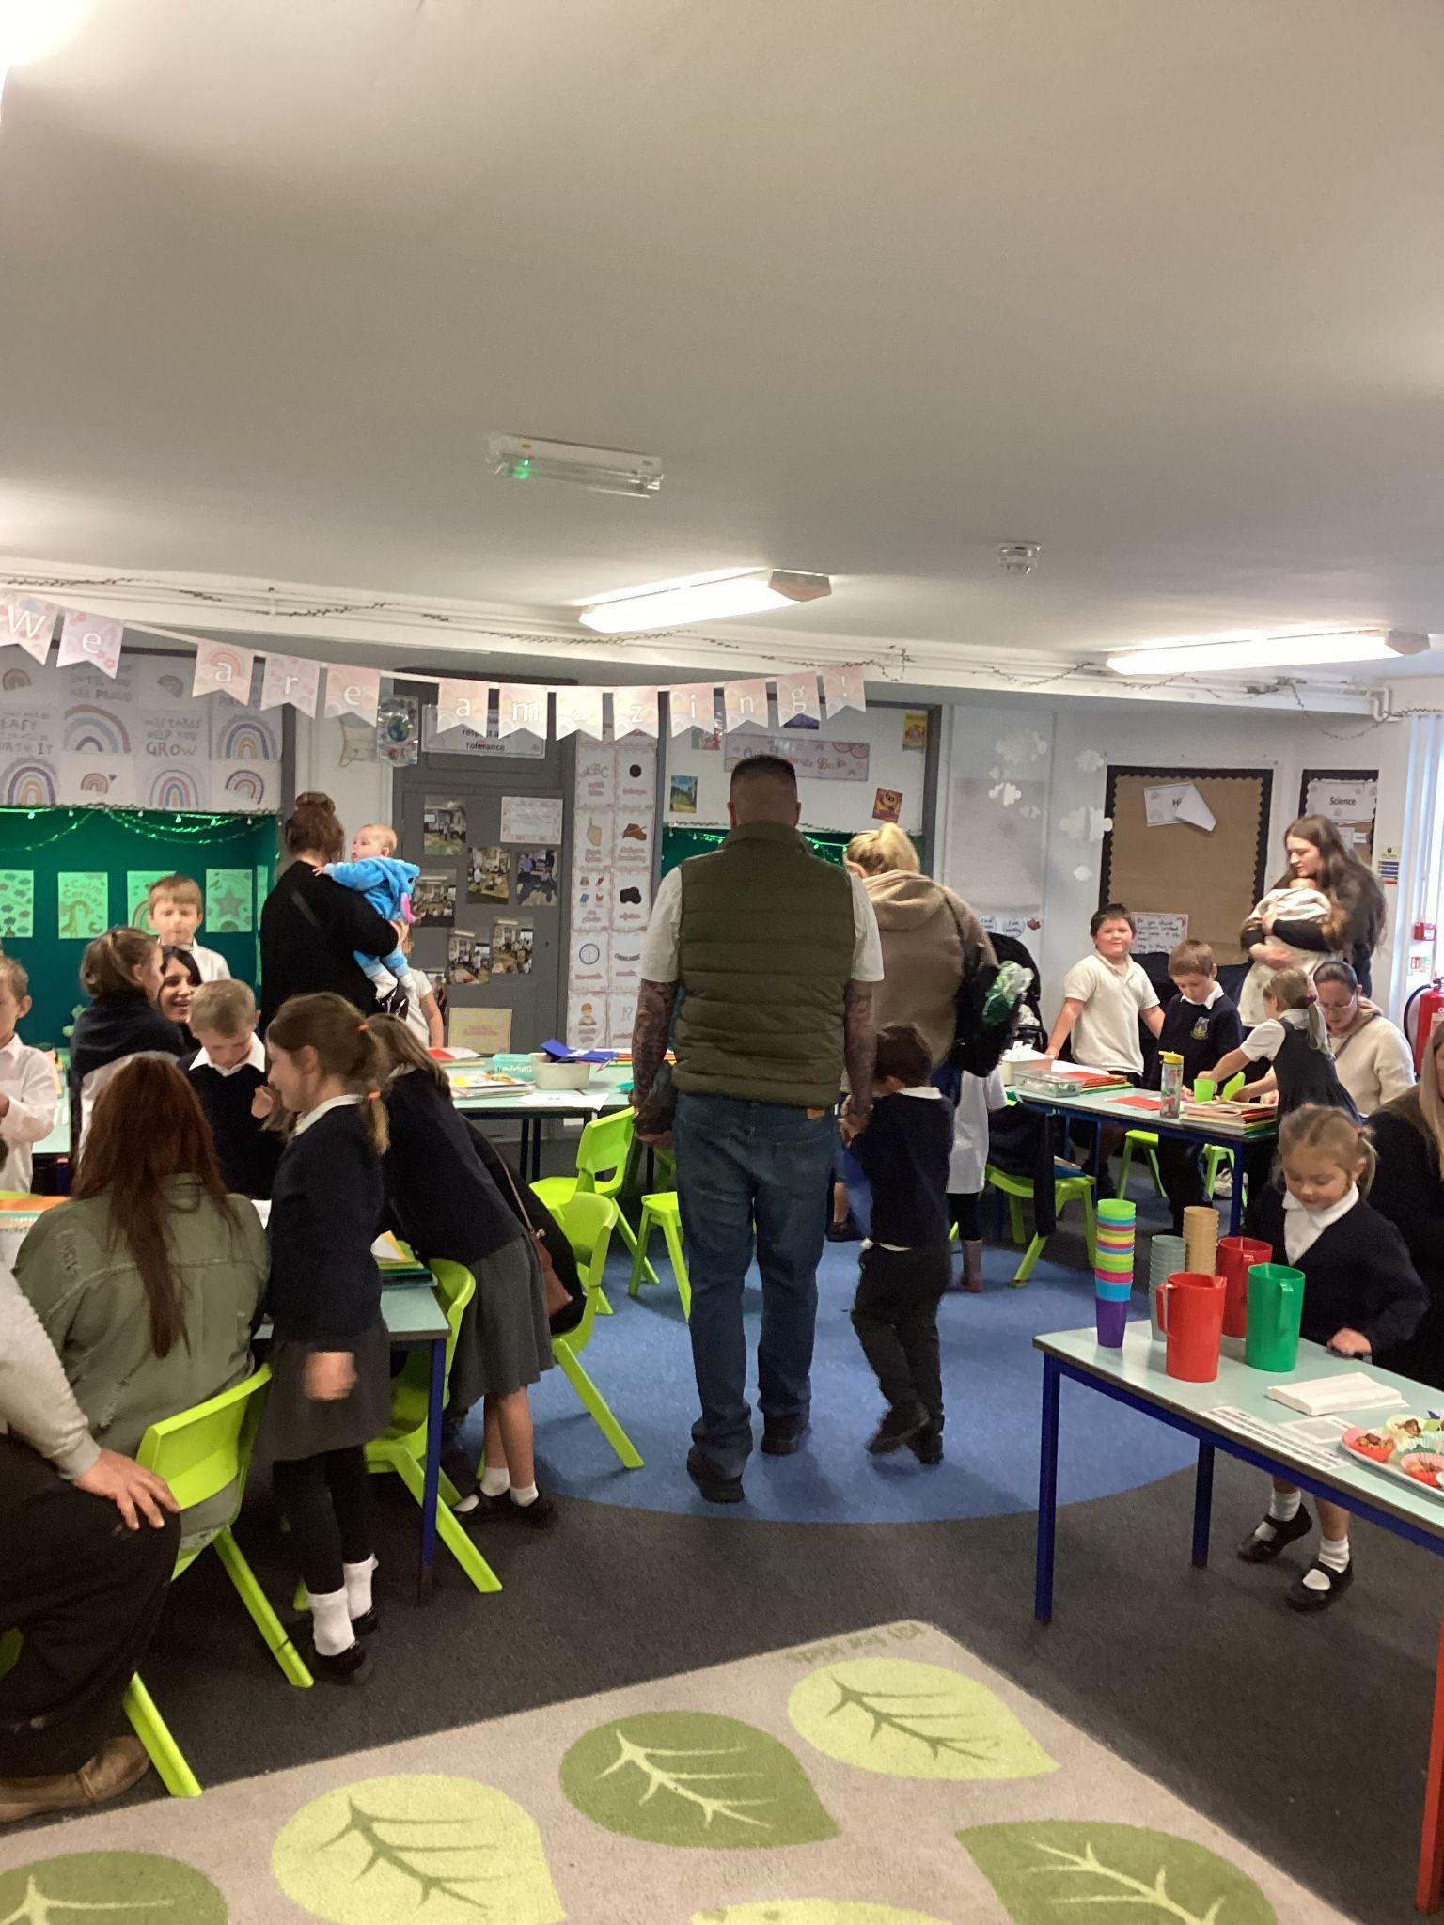
Curriculum Highlights - our big question
This term, our Big Question has been “How can we make people in our community feel welcome?” Using our British Value of democracy, the children voted on what they wanted to do. They decided to invite adults into class to share the work they are most proud of. To make everyone feel welcome, the children thought carefully about including things our visitors would enjoy—cakes, juice, friendly eye contact, and plenty of compliments! A big thank you to all the adults who came in; the children had a wonderful time. They worked hard making their crispy cakes and felt very grown-up and responsible serving food and drinks to our guests.

