Slide 1


St. Joseph’s Catholic
Primary School
Coombeshead Road, Newton Abbot TQ12 1PT
Tel: 01626 352559
e-mail: admin@sjna.uk
Newsletter
December 2025

Slide 2
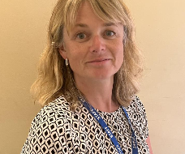
Message from Head of School
Dear Parents and Guardians,
As we reach the end of term, December has once again been a wonderfully busy and exciting month in school. The children have embraced the season with enthusiasm, particularly as we have journeyed through Advent together, taking part in a range of thoughtful, creative and joyful activities.
I am incredibly proud of our pupils for their hard work, positive attitudes and the kindness they continue to show one another. They have risen to every challenge and truly made this a special time of year.
I would also like to extend my sincere thanks to our dedicated staff, who have worked tirelessly to provide such rich experiences for the children. In addition, I am very grateful to our parents and carers for your continued positivity, support, and partnership with the school. Your kind good wishes and generous gifts have been very much appreciated by the staff.
As the term comes to a close, I hope everyone enjoys a restful and peaceful holiday. May it be a time to relax, recharge and enjoy time together, returning refreshed and ready for the new term ahead.
Best Wishes and God Bless
Sarah Pascoe and all the St. Joseph’s team

Slide 3
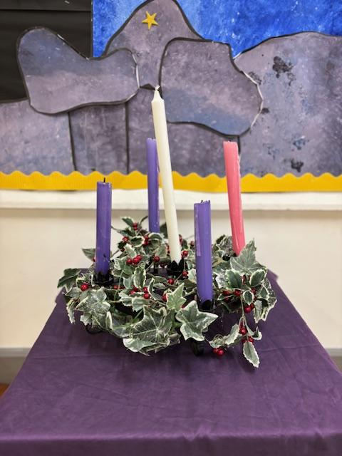
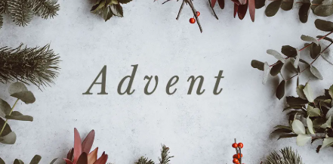
The Catholic life of our school
Throughout Advent, the children have taken time to reflect on its true meaning through prayer, assemblies and classroom activities. It has been a special opportunity for them to think about kindness, generosity and hope, and to prepare their hearts during this season. These moments of quiet reflection alongside the excitement of Christmas have been a valuable and meaningful part of our school life.

Slide 4

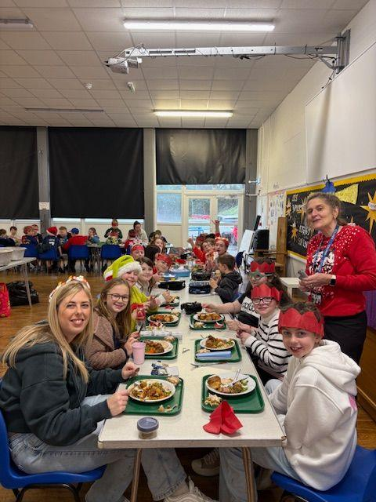
The British Values of our school
December is a time for the children to explore traditions within their own lives and families, particularly those linked to Christmas. Alongside this, they have also been learning about the traditions and celebrations of others, including festivals such as Diwali and Eid. These discussions and activities have helped to foster understanding, respect and appreciation for the diverse faiths and cultures that make up modern Britain, encouraging the children to celebrate both what makes us unique and what brings us together.

Slide 5
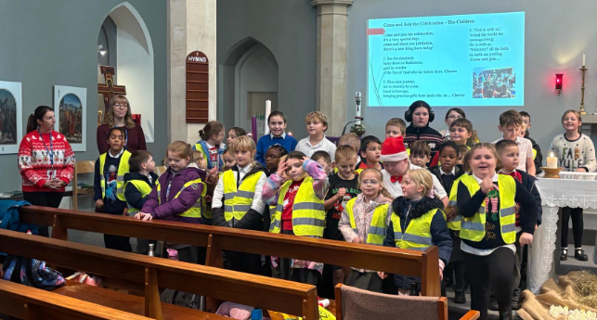
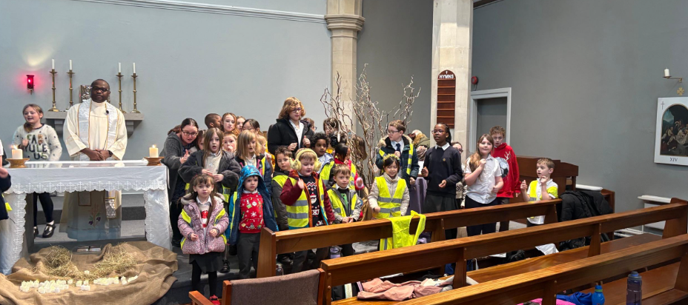
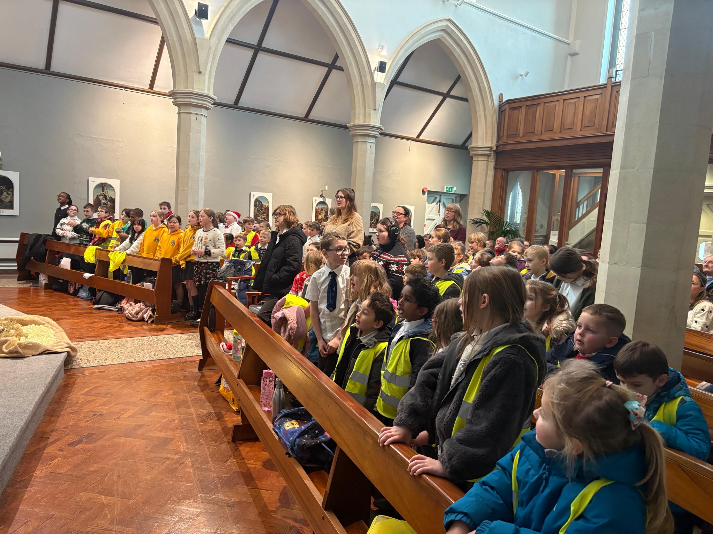
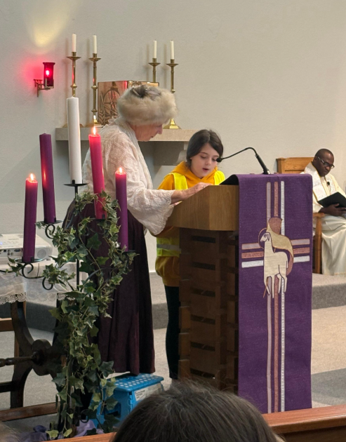
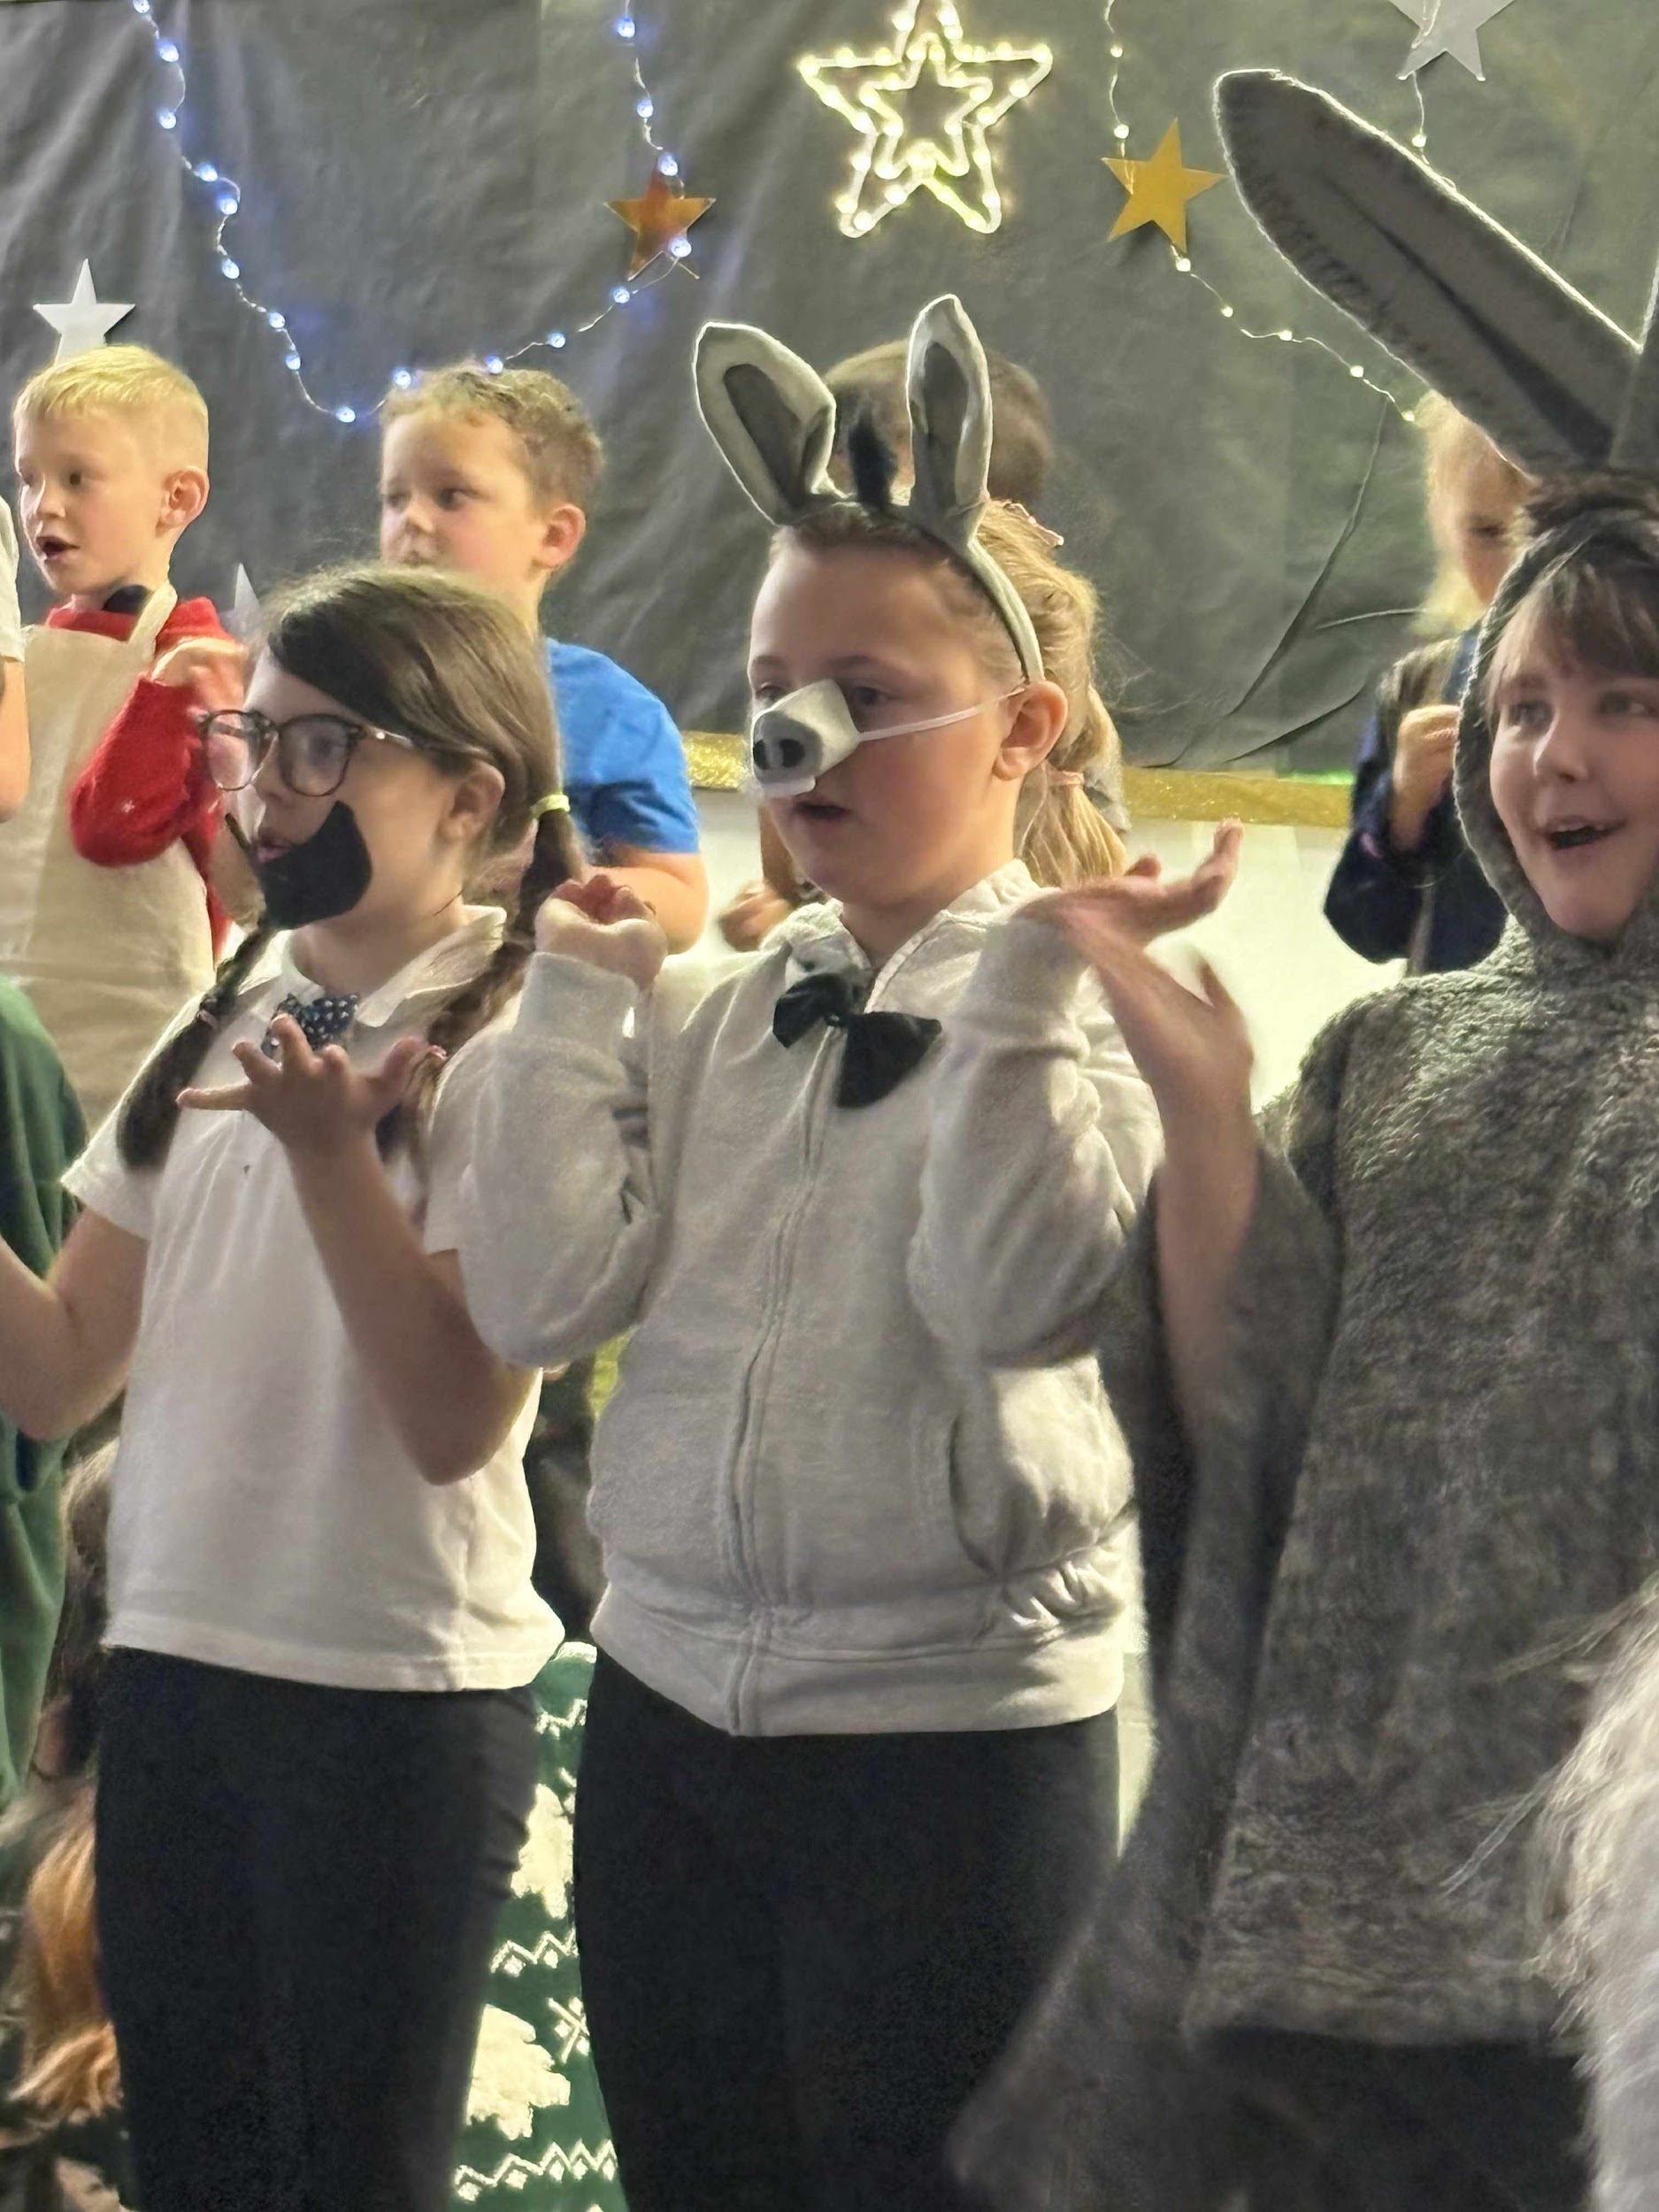
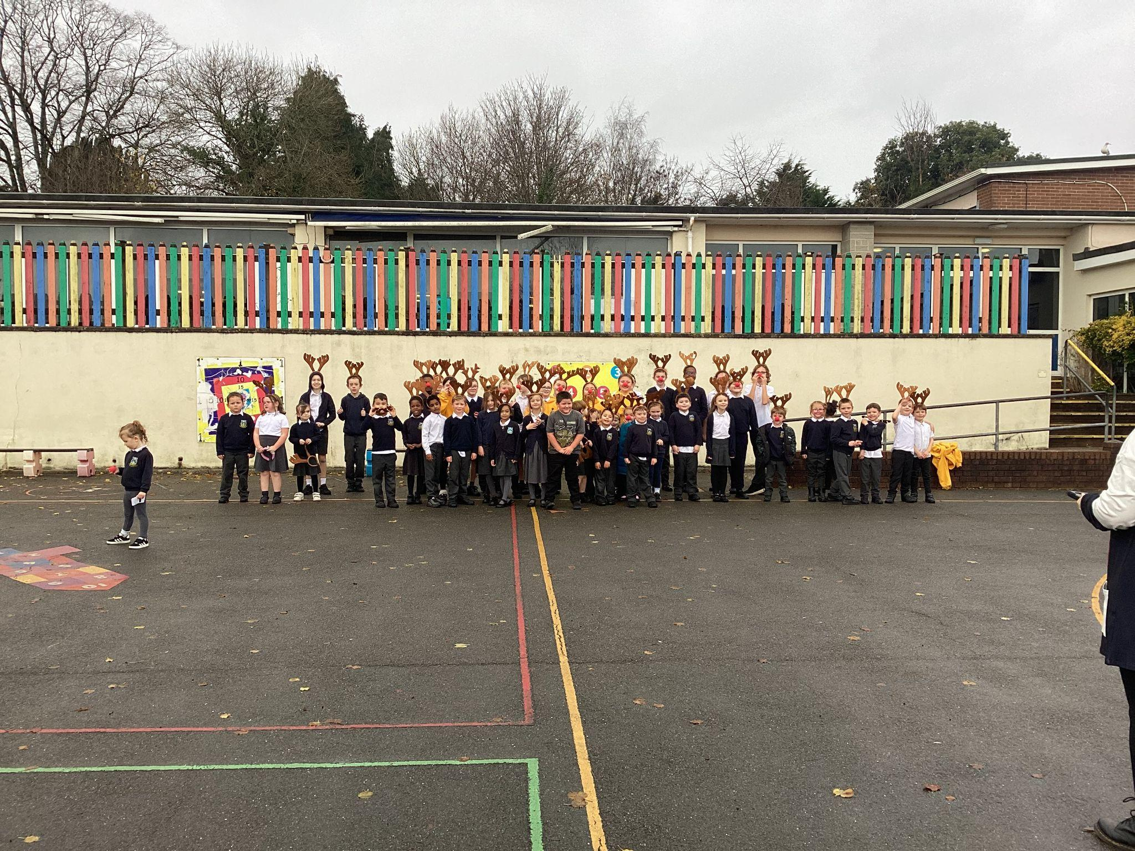
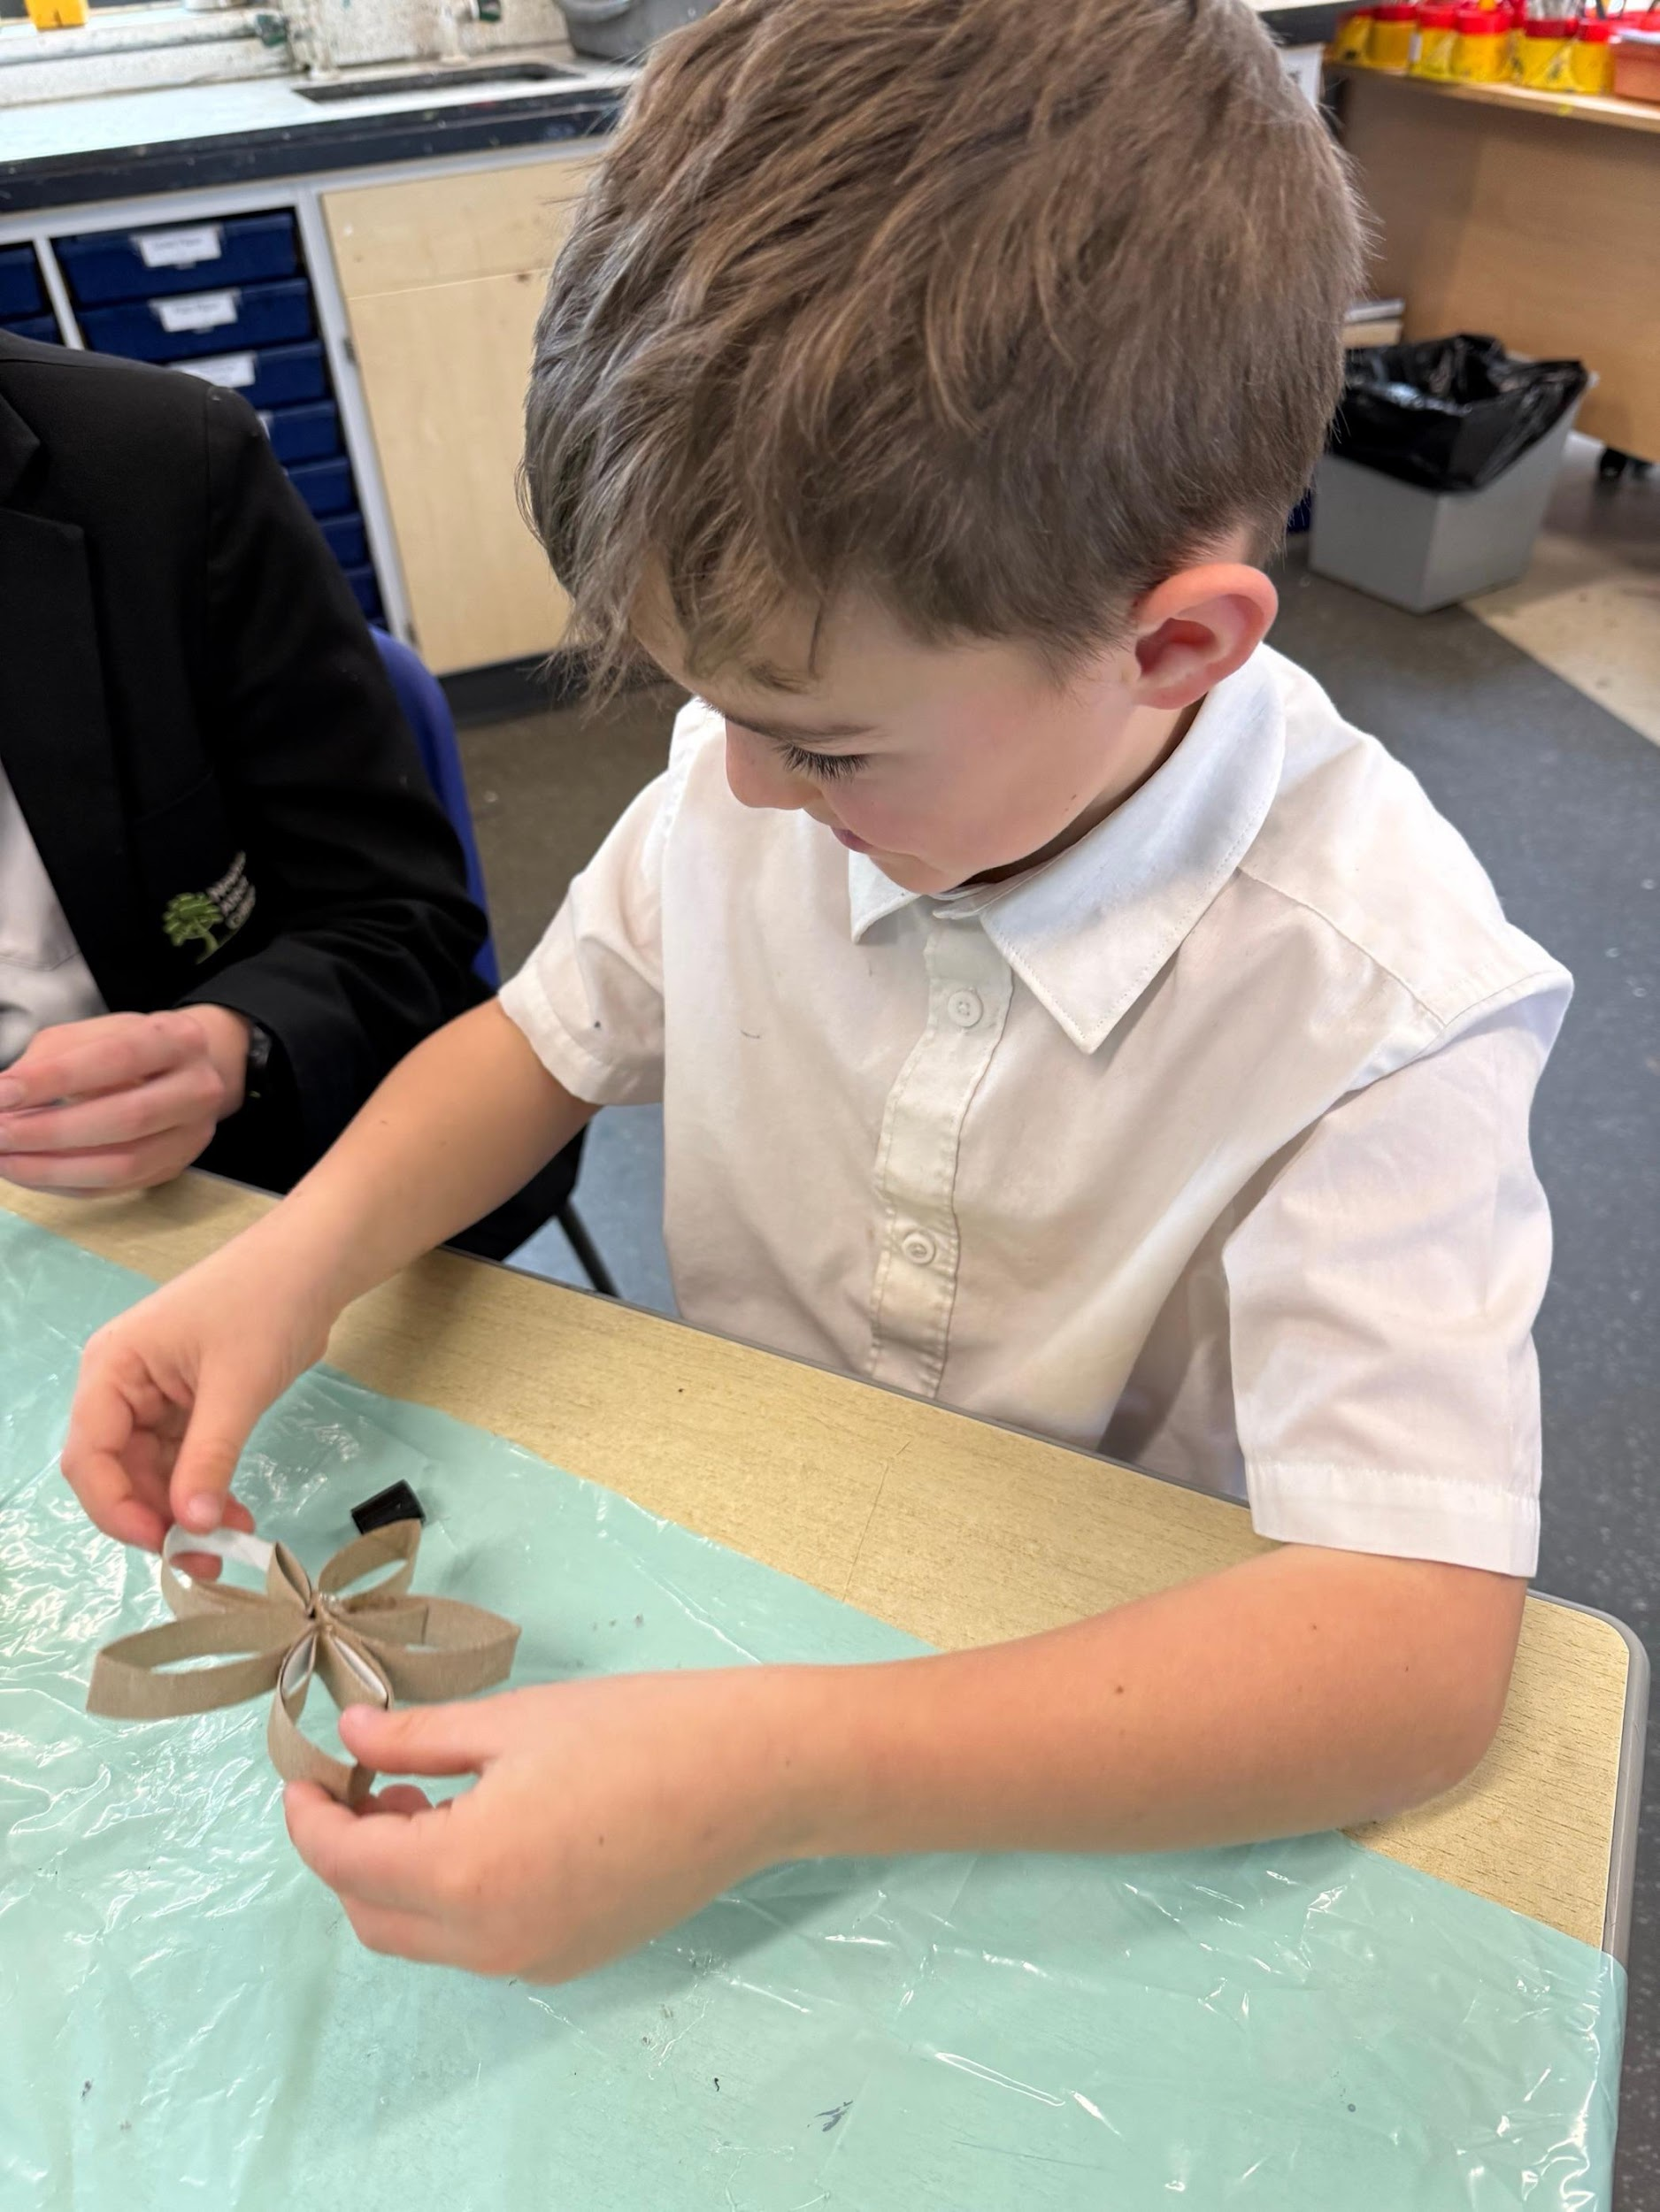
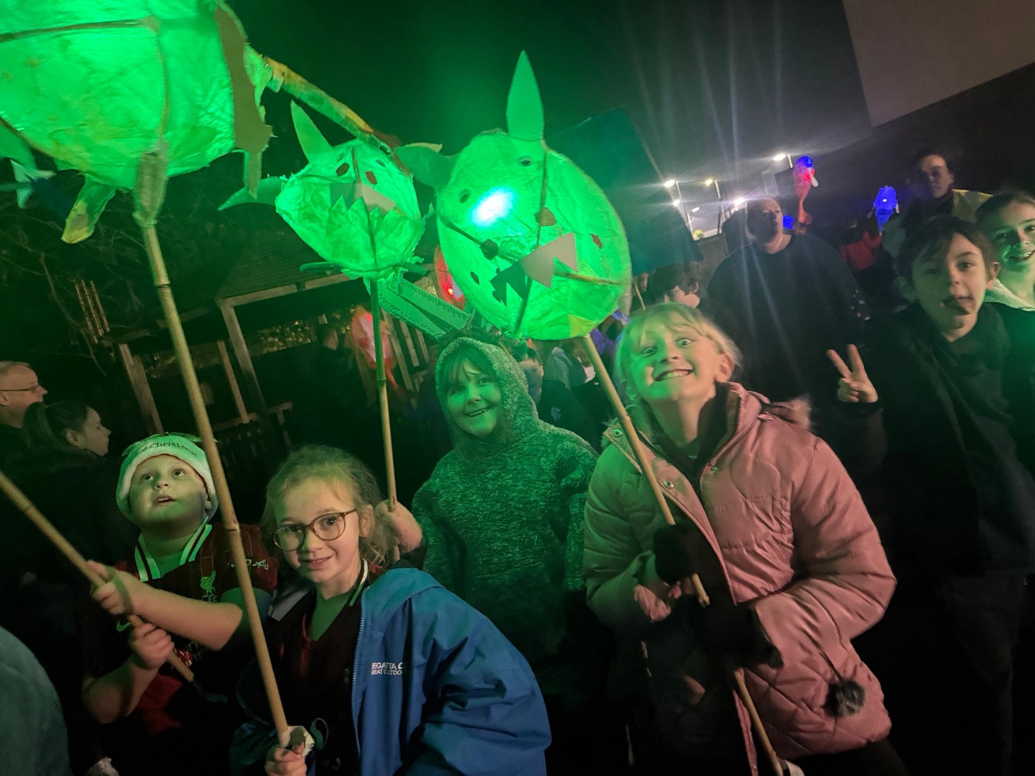
Christmas 2025

