Slide 1

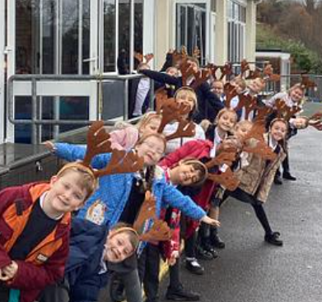
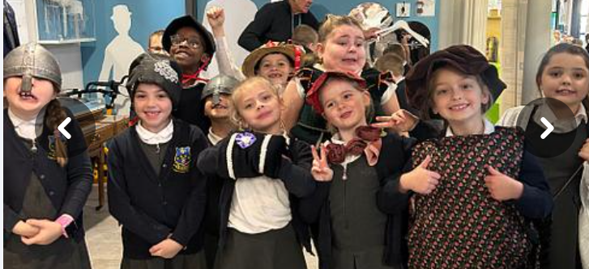
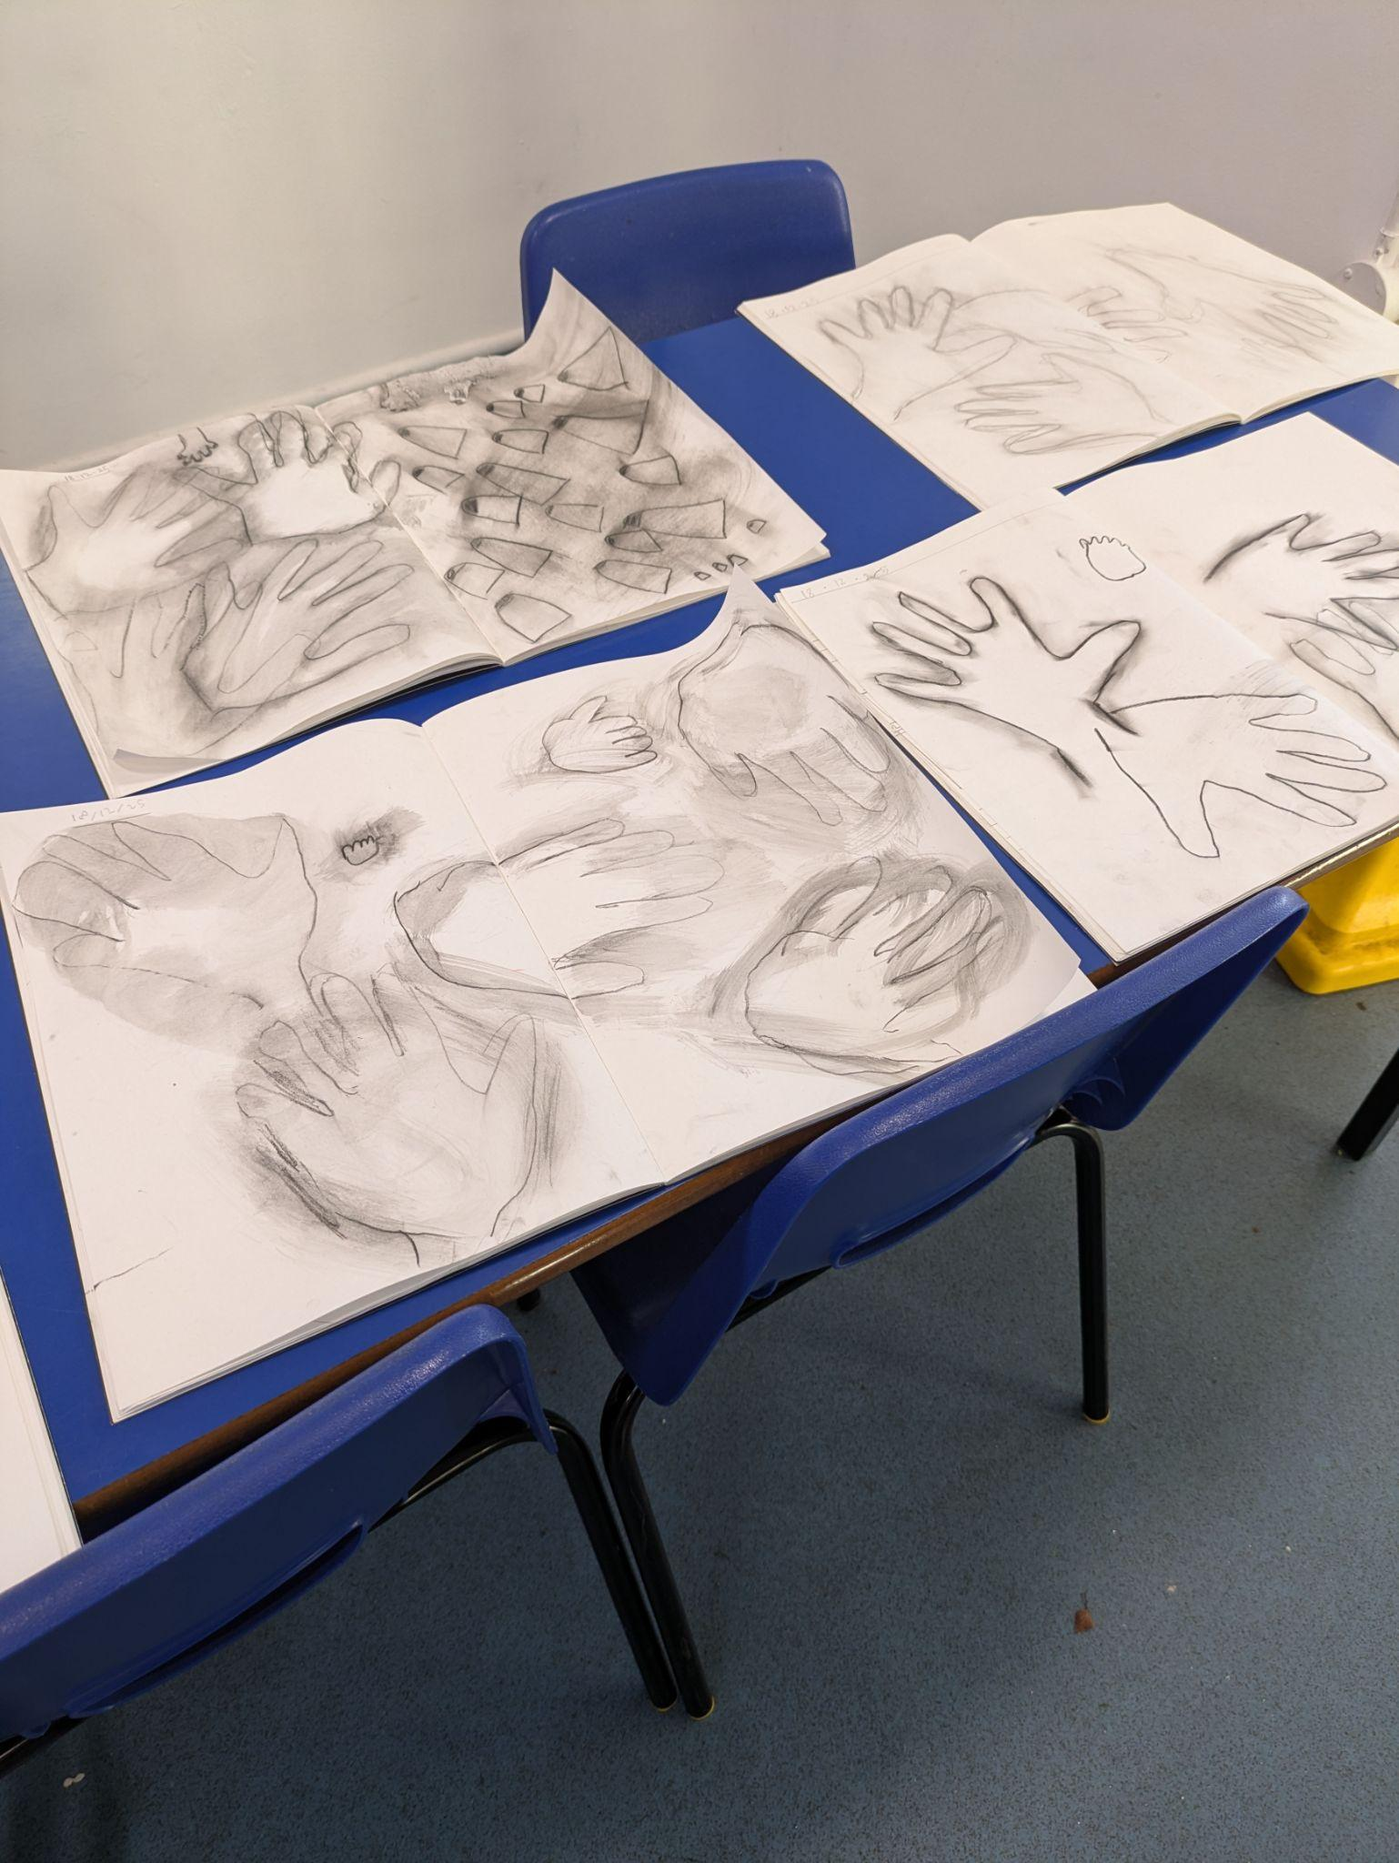
Curriculum Highlights
Exploring all the artefacts at our local museum in Newton Abbot town! We have been fascinated looking at how times have changed from the Stone age to Iron Age.
In Art we have been exploring charcoal. We studied the artists Julia Mckendry and Edgar Degas. We practised shading and learnt about Chiaroscuro, an Italian word meaning light-dark. We then used our skills and linked our learning to explore prehistoric cave art.
In RE and PSHE we have been discussing how we can play our part in society.
We are looking at different ways we can help others showing kindness to everyone.
Jesus taught us everyone should be treated equally and to treat others as we want to be treated ourselves.

Slide 2

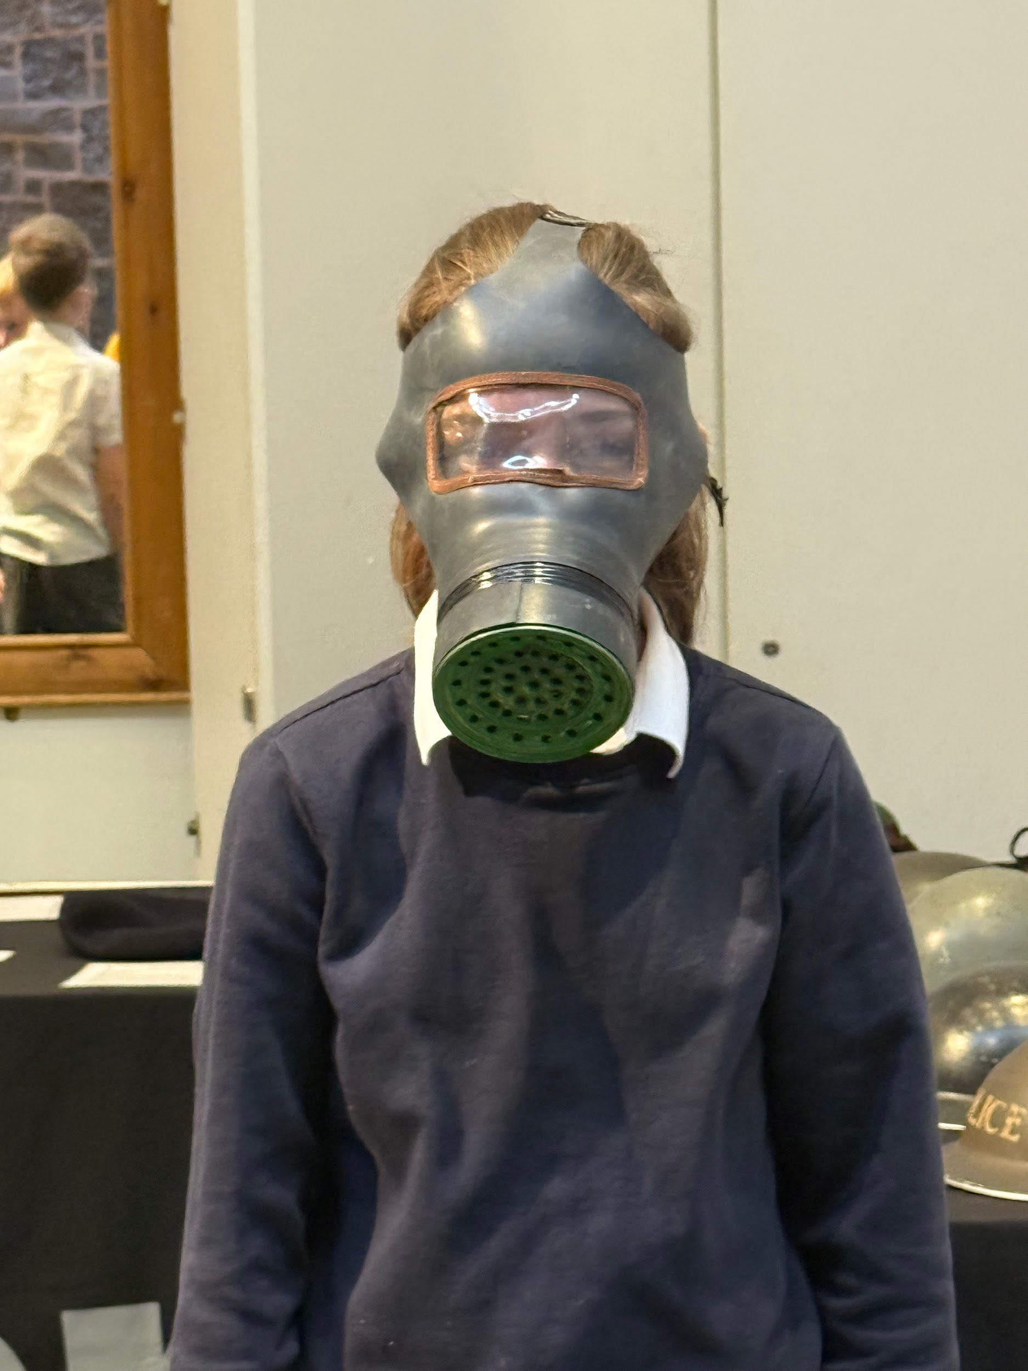
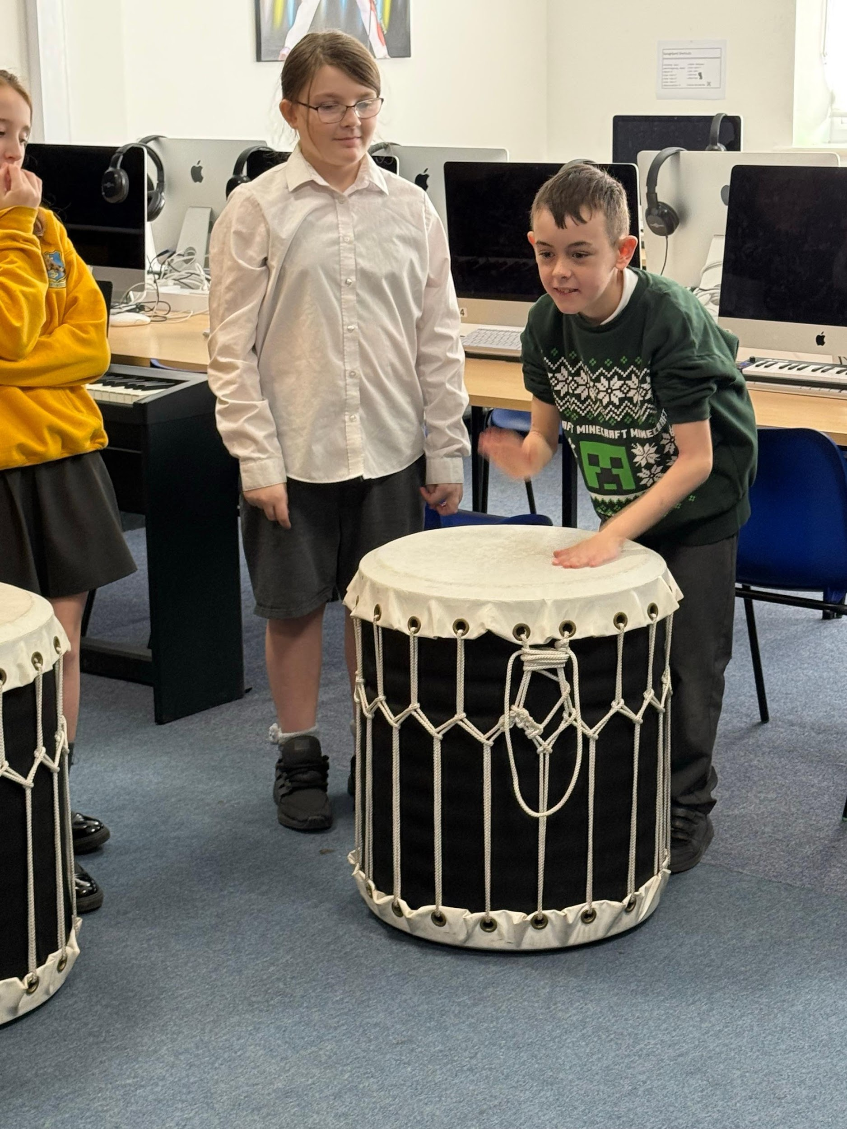
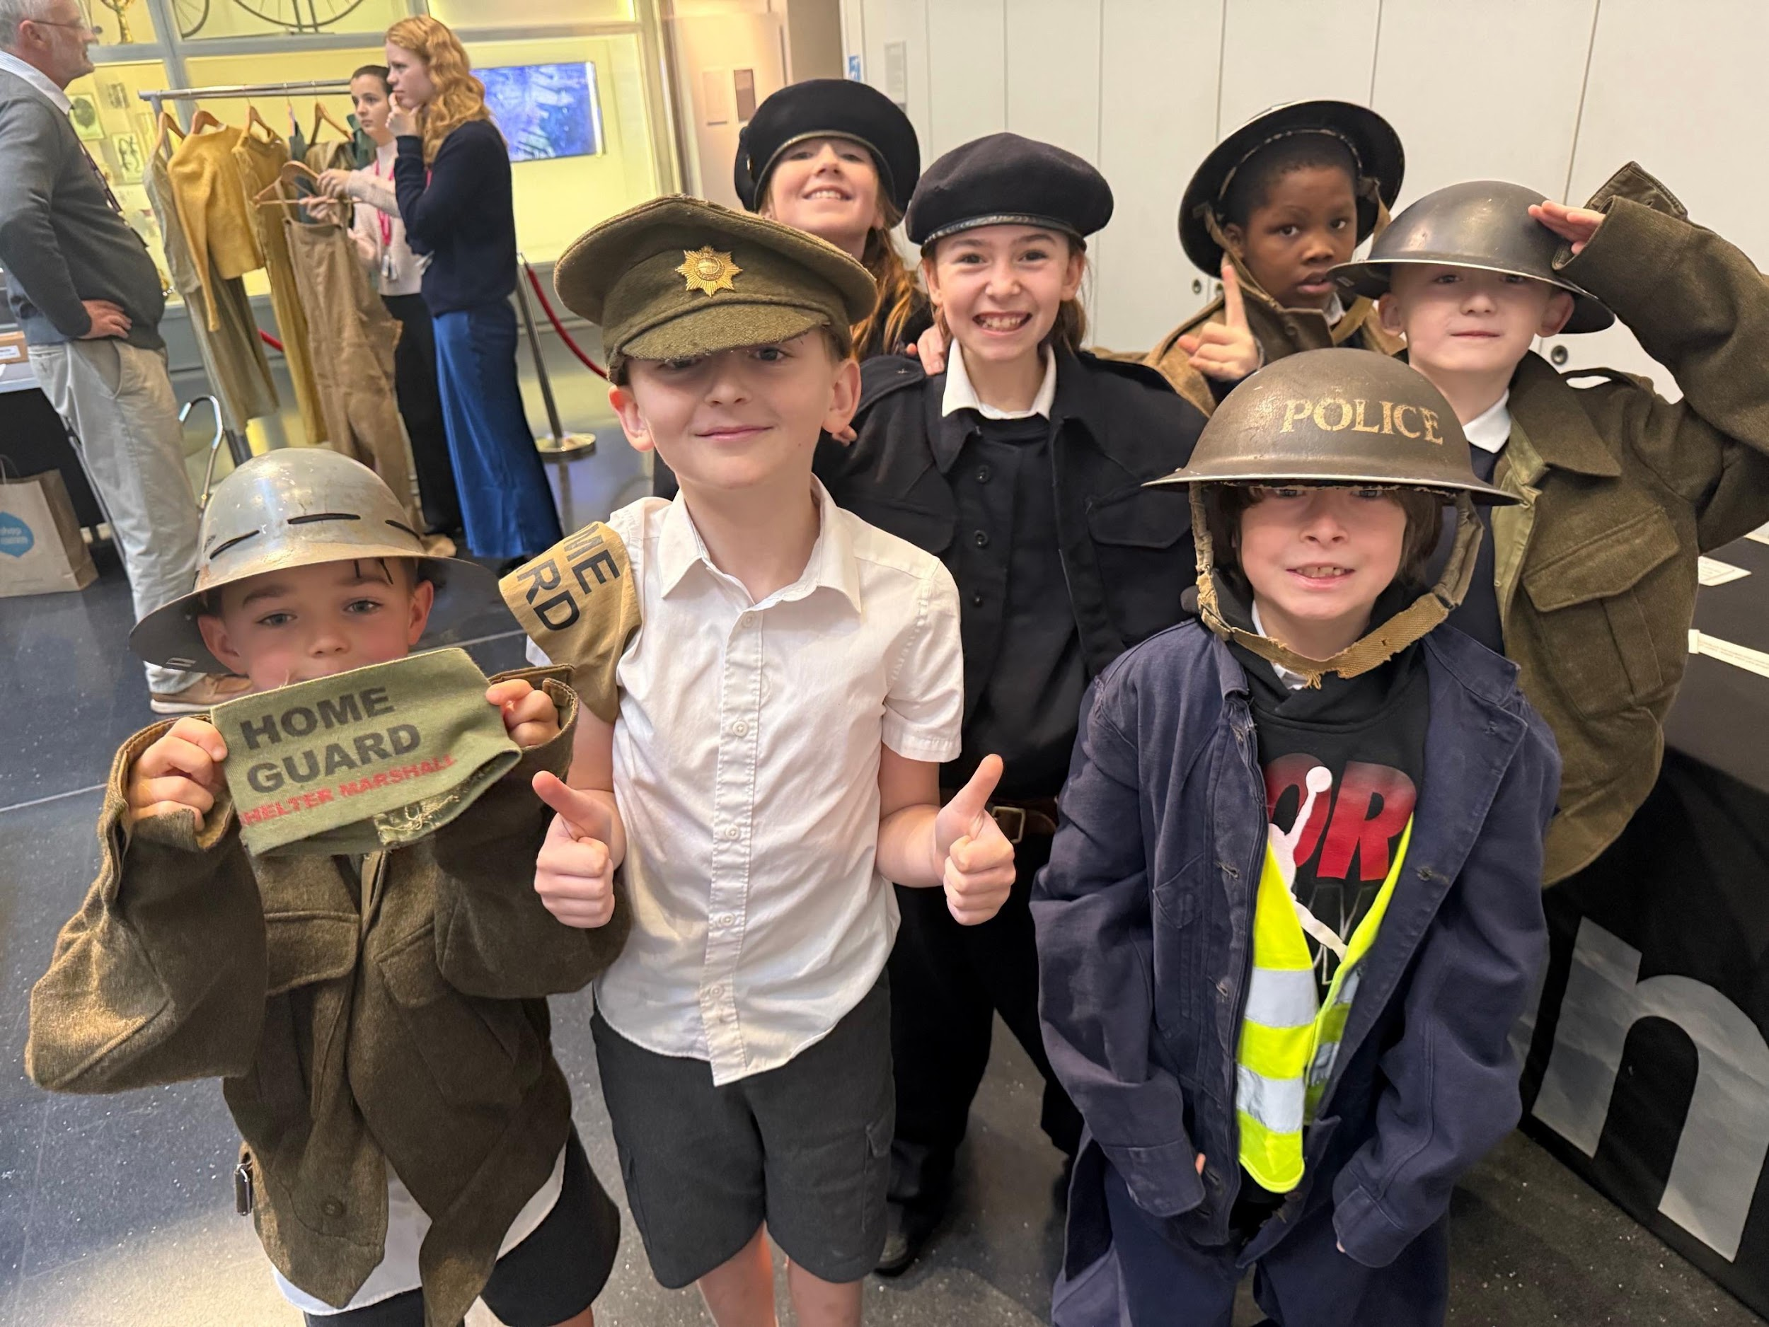
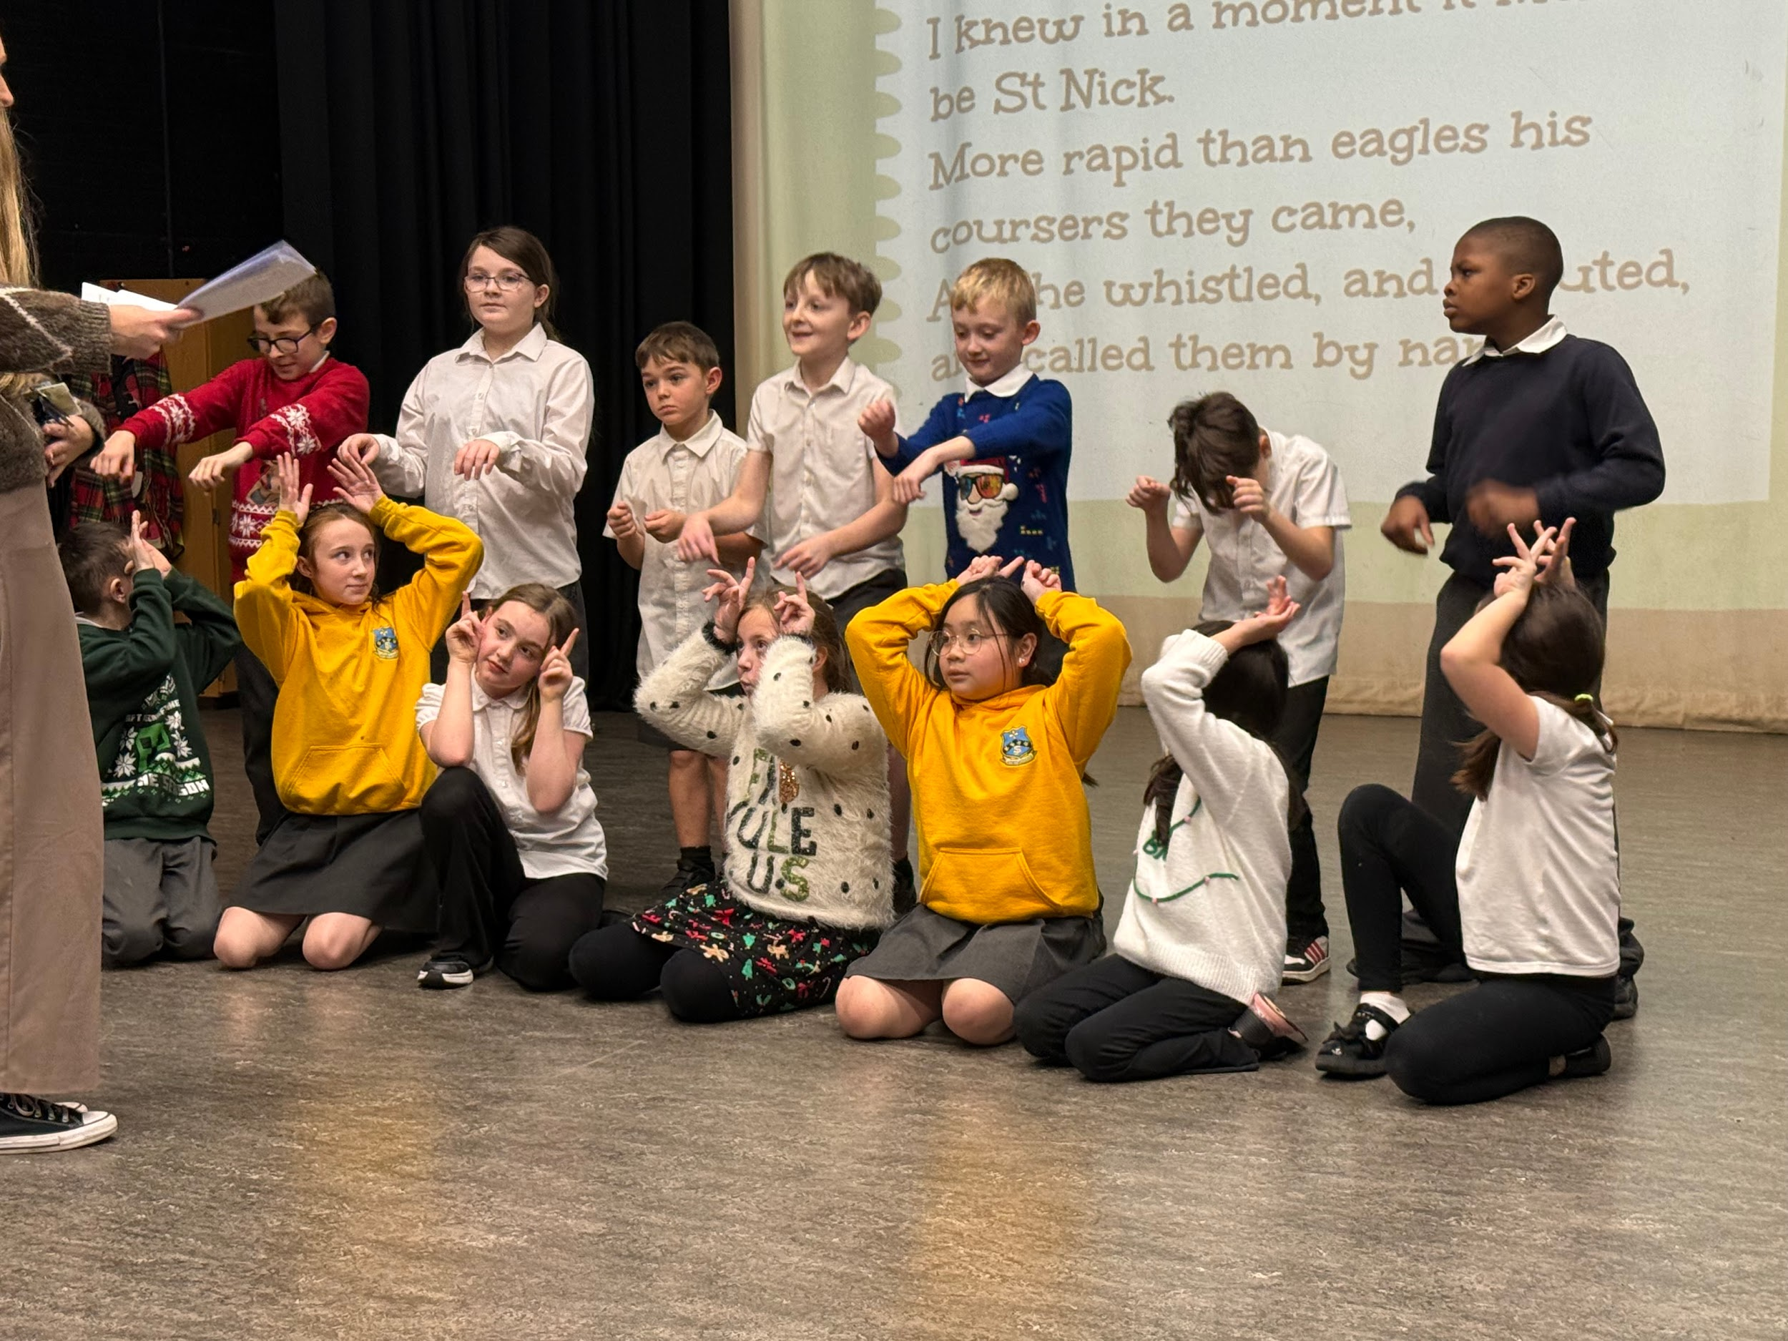
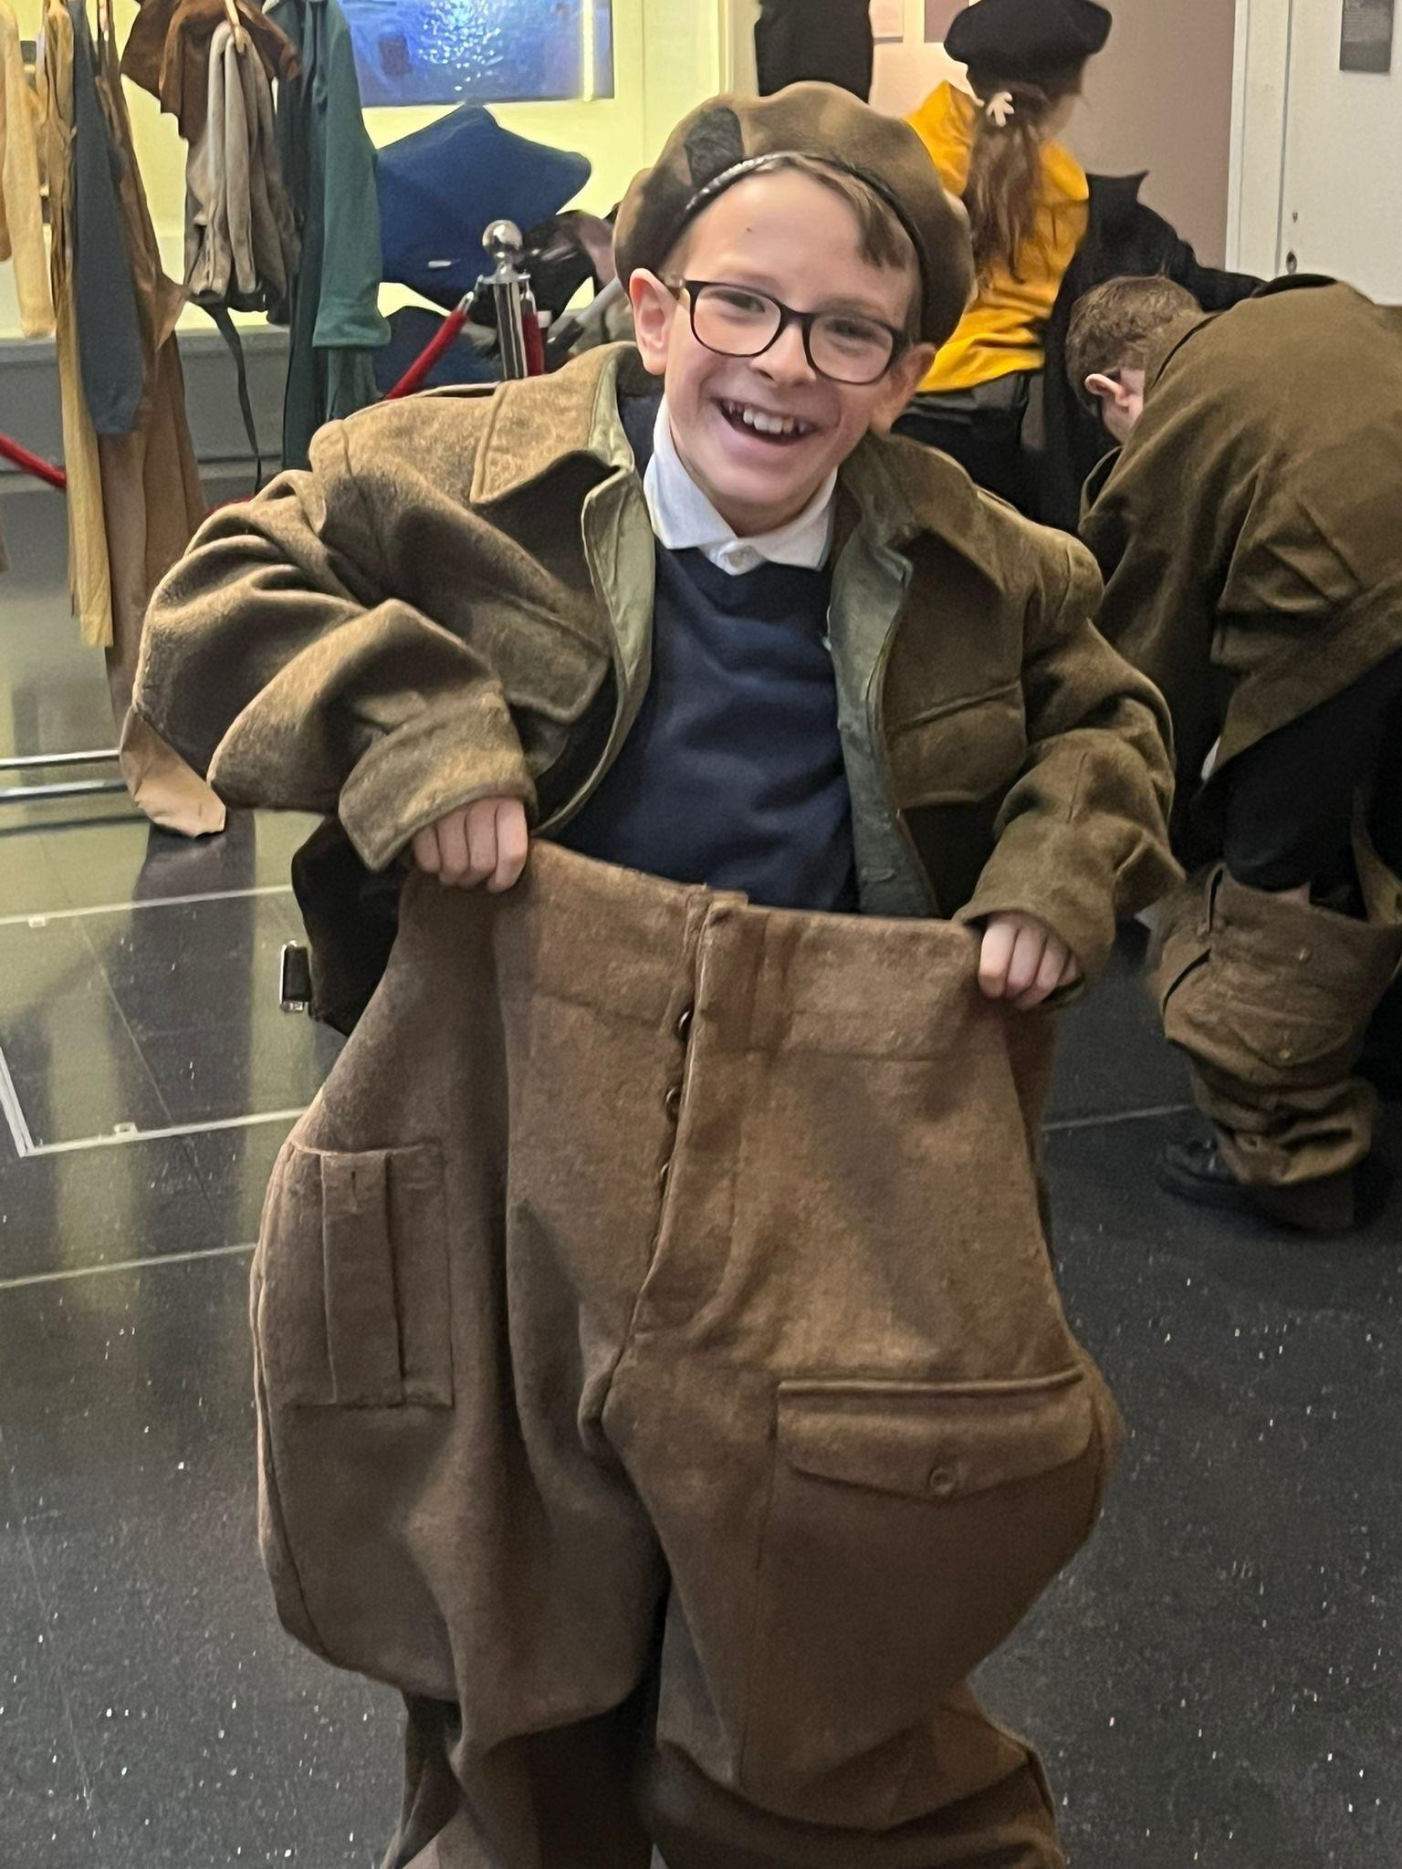
Curriculum Highlights
In SOR, we have continued our journey through the history of WWII. We took a trip to Exeter museum and found out about life during the war. We’ve now used this to help us to understand challenges faced and ways to keep peace
A busy half term with many visits out and about. We’ve taken a trip to Coombeshead to watch their pantomime and had a great day at NAC experiencing lots of creativity in English, Drama, Music, French and Art

Slide 3





Booking Information:
All bookings should be made via ParentPay prior to the session. For any last-minute bookings, please call the school office.
Breakfast Club
Available Monday – Friday from 8:00 AM
Cost: £4 per session
After School Club
Available Monday – Friday
Until 5:00 PM – £6.75
Until 5:30 PM – £10.00
Fridays close at 5:00 PM
After School Activities
Tuesday – Football
Important Notice:
Any accounts with arrears of £50 or more will not be permitted to use the Breakfast Club or After School Clubs until the balance is cleared.

Slide 4
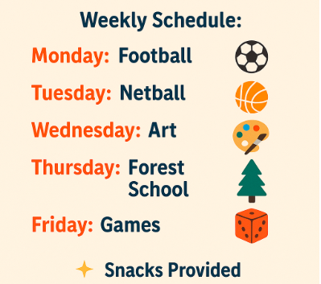
Breakfast and afterschool club activities

Slide 5
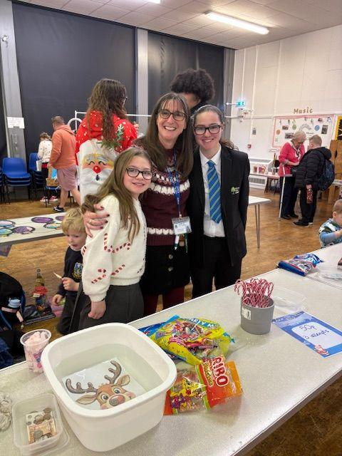
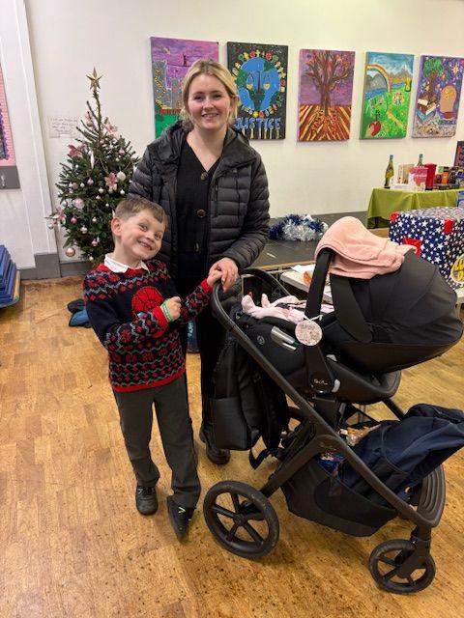
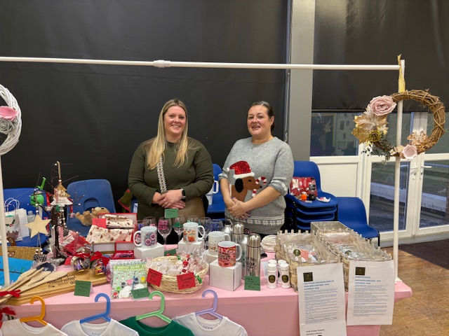
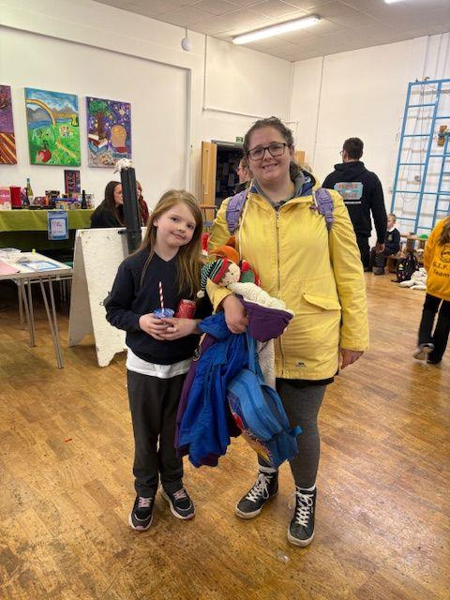
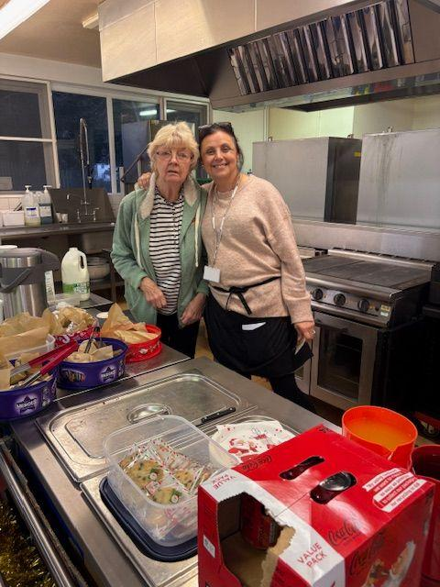
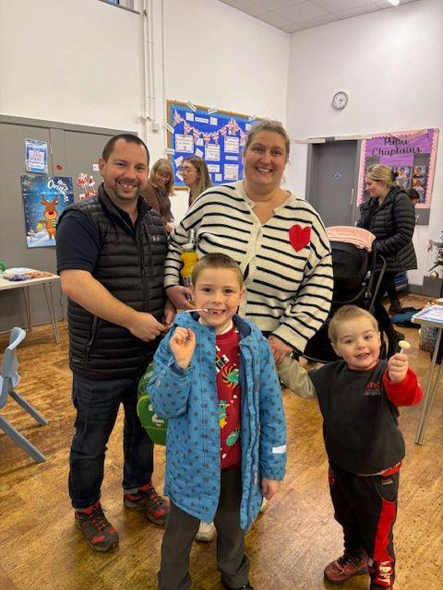
A Big Thank You to everyone who attended our Christmas Fayre last Friday. You all helped raise an incredible £420.00 for our lovely school.
Well done to our raffle winners. If you were a winner you will have been notified and have received your prizes.
Thank you to everybody who helped to make the Fayre a success. Those who ran games, helped to set up, donated prizes, made cakes, made things to sell and also to those who helped clear up at the end! I am so grateful to you all.
Wishing you all a Happy and Safe Christmas break.
Susi Mariadas
Chair of The Friends

Slide 6

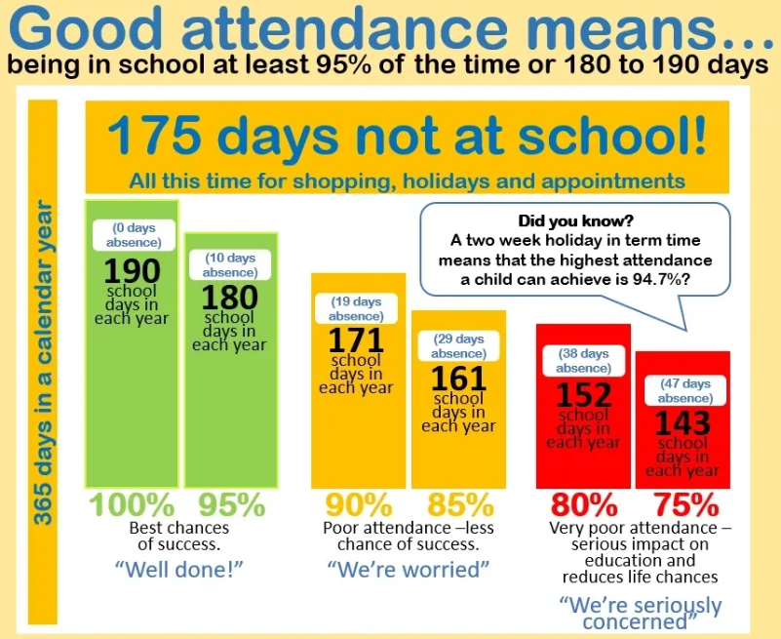


Attendance December
 | 80.00%
 | 90.00%
 | 88.80%
 | 94.09%
Important Notices & Reminders
If your child is late for morning registration, arriving late at school after 9am, please ensure you or their accompanying adult reports to the school office to ensure that they are registered.

Slide 7
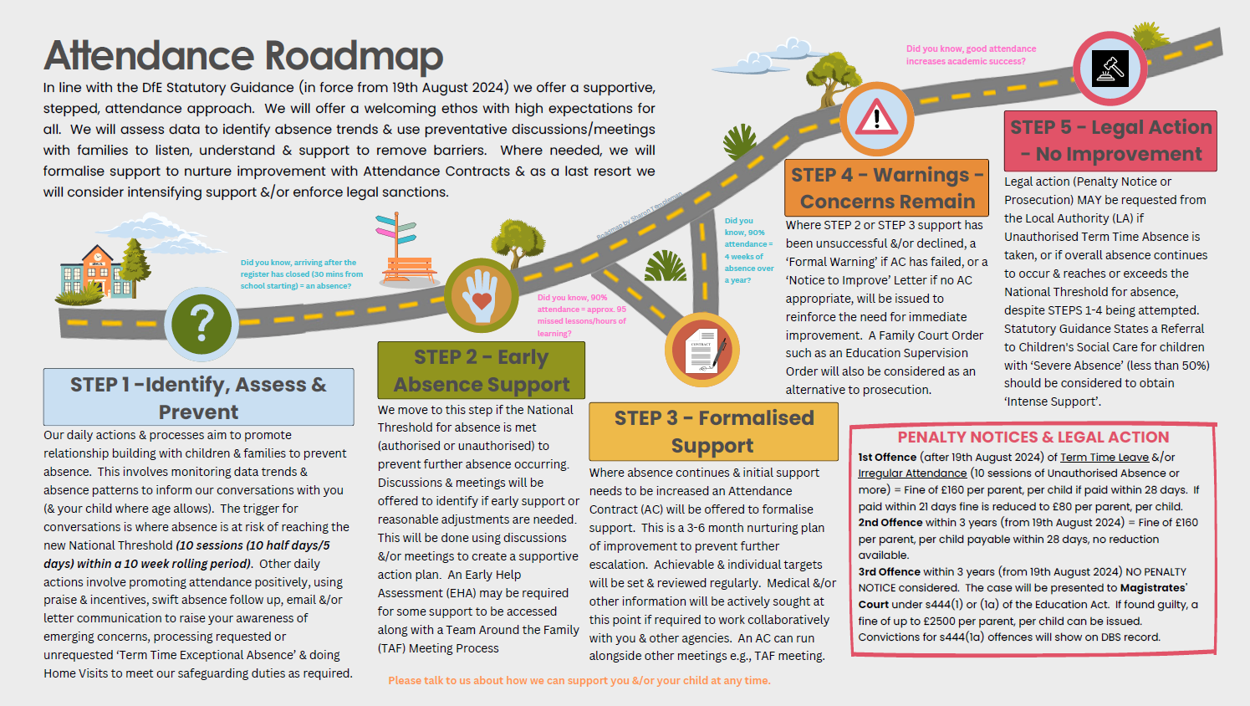

Slide 8
19.12.25 | Break up for Christmas Holidays | 13.02.26 | Break up for Half Term
05.01.26 | Back to School | 23.02.26 | Non Pupil Day
05.01.26 | Swimming starts for St Teresa class
06.01.26 | 1:30 - 2:30 - Epiphany Mass in the school Hall - Everyone Welcome
14.01.26 | Year 1 and 2 NAC - Sports Festival
20.01.26 | PE Impact Day - NAC in school to work with all classes
30.01.26 | Great Athletes Assembly
11.02.26 | KS1 SEND Festival at NAC
12.02.26 | St Oscar parents in for the Big Question

Slide 9
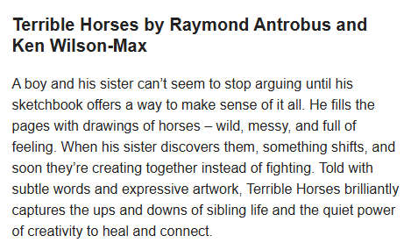


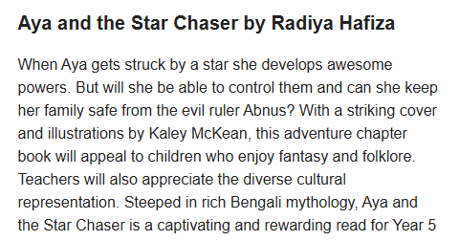
Book Recommendations
"Books are a uniquely portable magic."- Stephen King

Slide 10

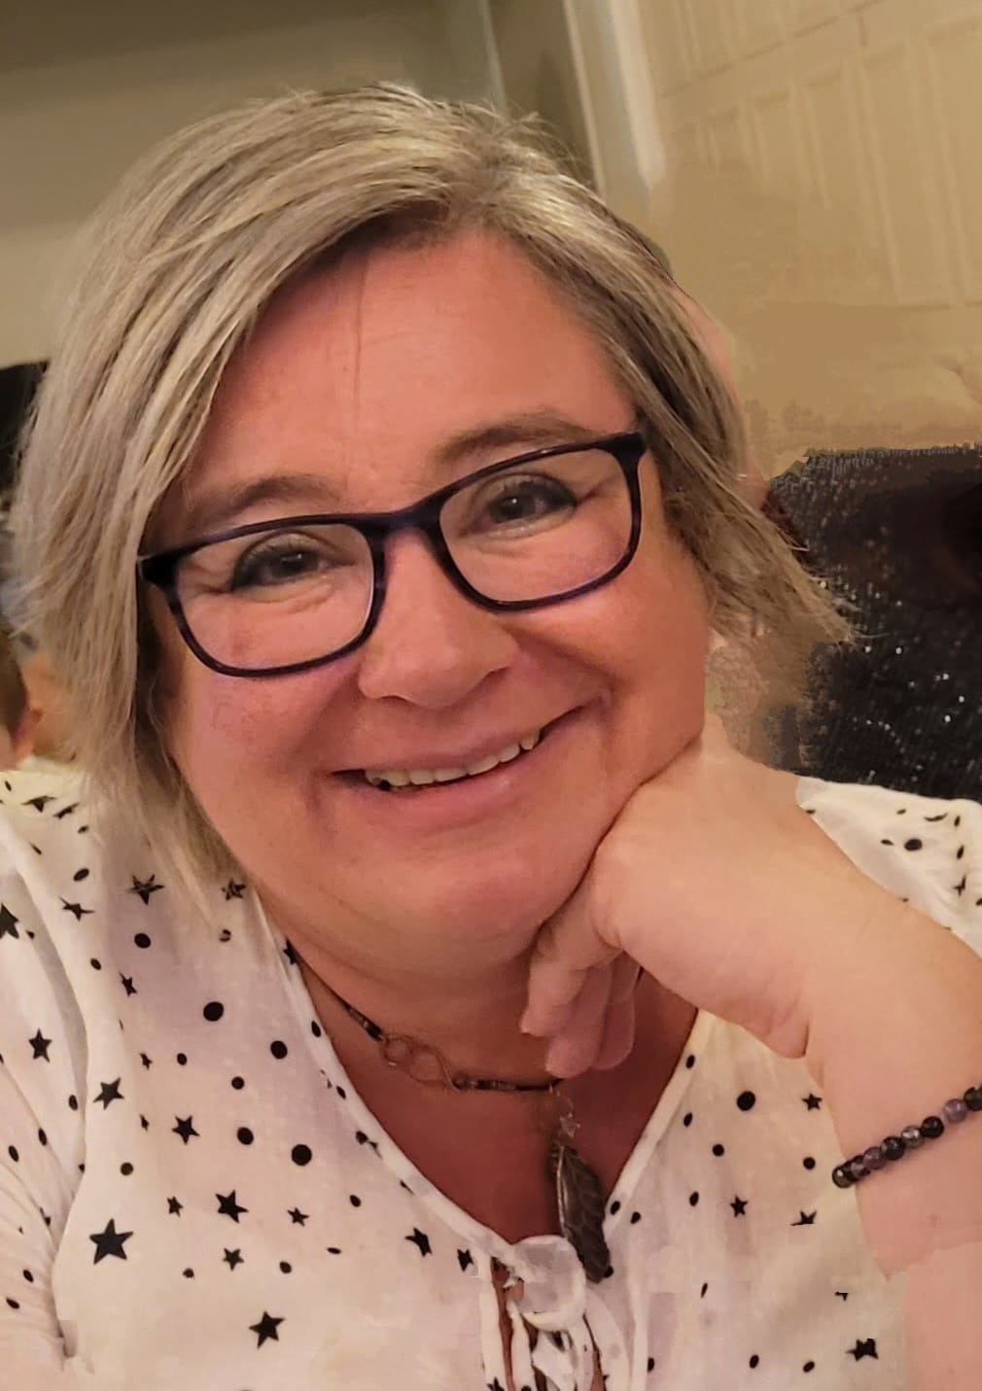

SAFEGUARDING
Safeguarding at St. Joseph’s is always a priority. Should you have any enquiries or concerns, please contact our Designated Senior Lead for Child Protection: Mrs Day or Mrs Pascoe on 01626 352559. Our named governor for child protection is Tim van Kroonenburg.
CPOMS and Operation encompass
WELFARE
Our Family Support Worker is Julie . Please let us know if you would like her to contact you for ANY support. Everyone needs a Julie in their lives!
At St. Joseph’s we use CPOMs as our system for recording information that we consider to be safeguarding information. Further information about the programme can be found here -
https://www.cpoms.co.uk/privacy-statement/
Operation Encompass is the reporting to schools, prior to the start of the next school day, when a child or young person has exposed to, or involved in, any domestic incident.
Operation Encompass will ensure that a member of the school staff, known as a Key Adult, is trained to allow them to liaise with the police and to use the information that has been shared, in confidence, while ensuring that the school is able to make provision for possible difficulties experienced by children, or their families, who have been involved in, or exposed to, a domestic abuse incident.
ATTENDANCE
Hi, my name is Natalie, I'm the Attendance and Welfare Officer here at St Joseph's. I monitor attendance regularly to ensure that, where possible, every child is in school on time every day. If you have any concerns around your child's attendance, please leave a message with the office and I will contact you.

Slide 11


Community Events & activities

Slide 12


Community Events & activities

