Slide 1

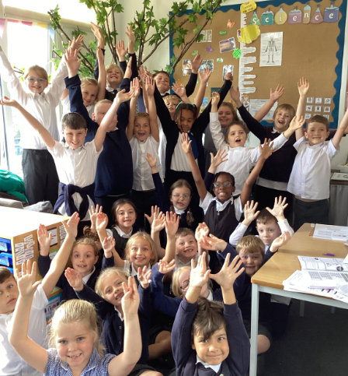
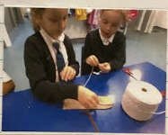
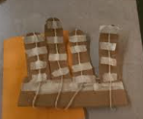
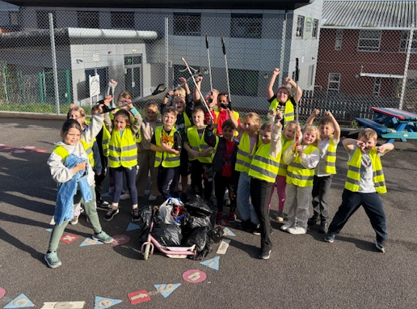
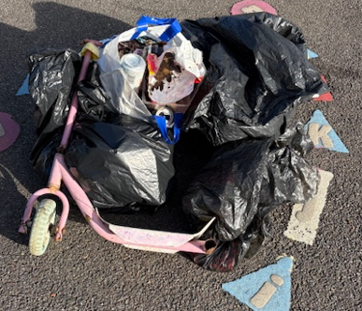
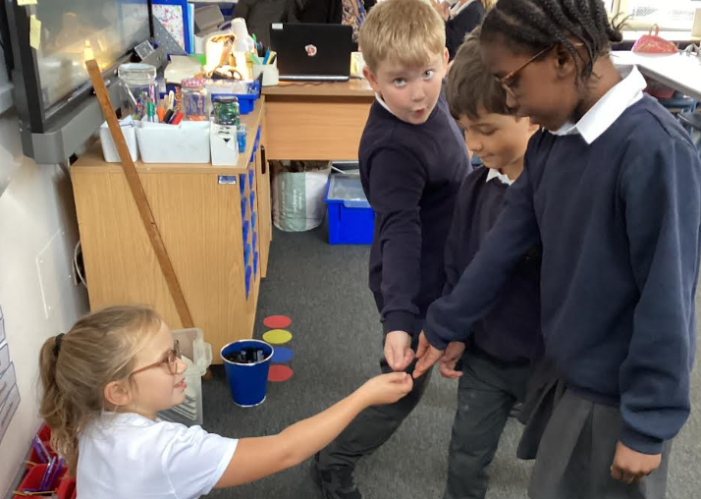
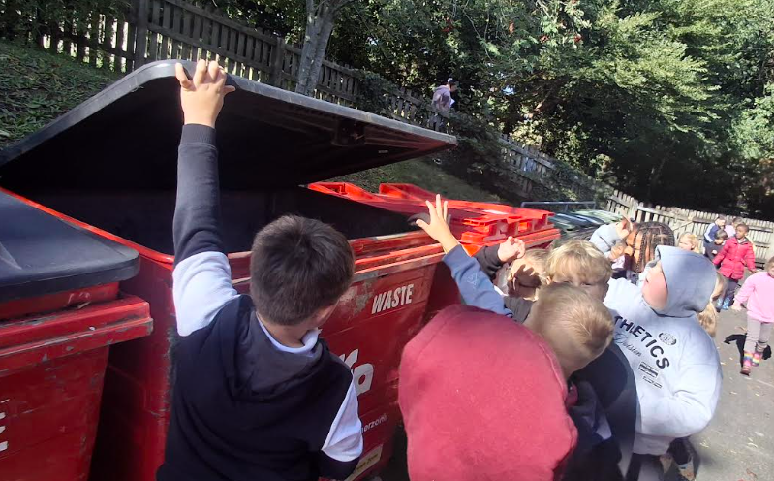
Curriculum Highlights
In RE we have been learning all about the importance of looking after God’s Creation.
We have discussed and role played ways that we can act as stewards and play our part at looking after our Common Home and each other!
How do you play your part?
As Scientists we have been busy learning about the importance of our bones and muscles and why we have a skeleton.
We practically investigated by designing and making a hand and arm and then scientifically explaining how the hand and arm moved.
The scientific language was really tricky!
Our Big Question this half term was ‘Who Should Look After Our World’. We decided that we are all responsible individually. However if we work together we can definitely make a difference. We ended our half term’s learning with a litter pick at our local park.Look how much we found!

Slide 2

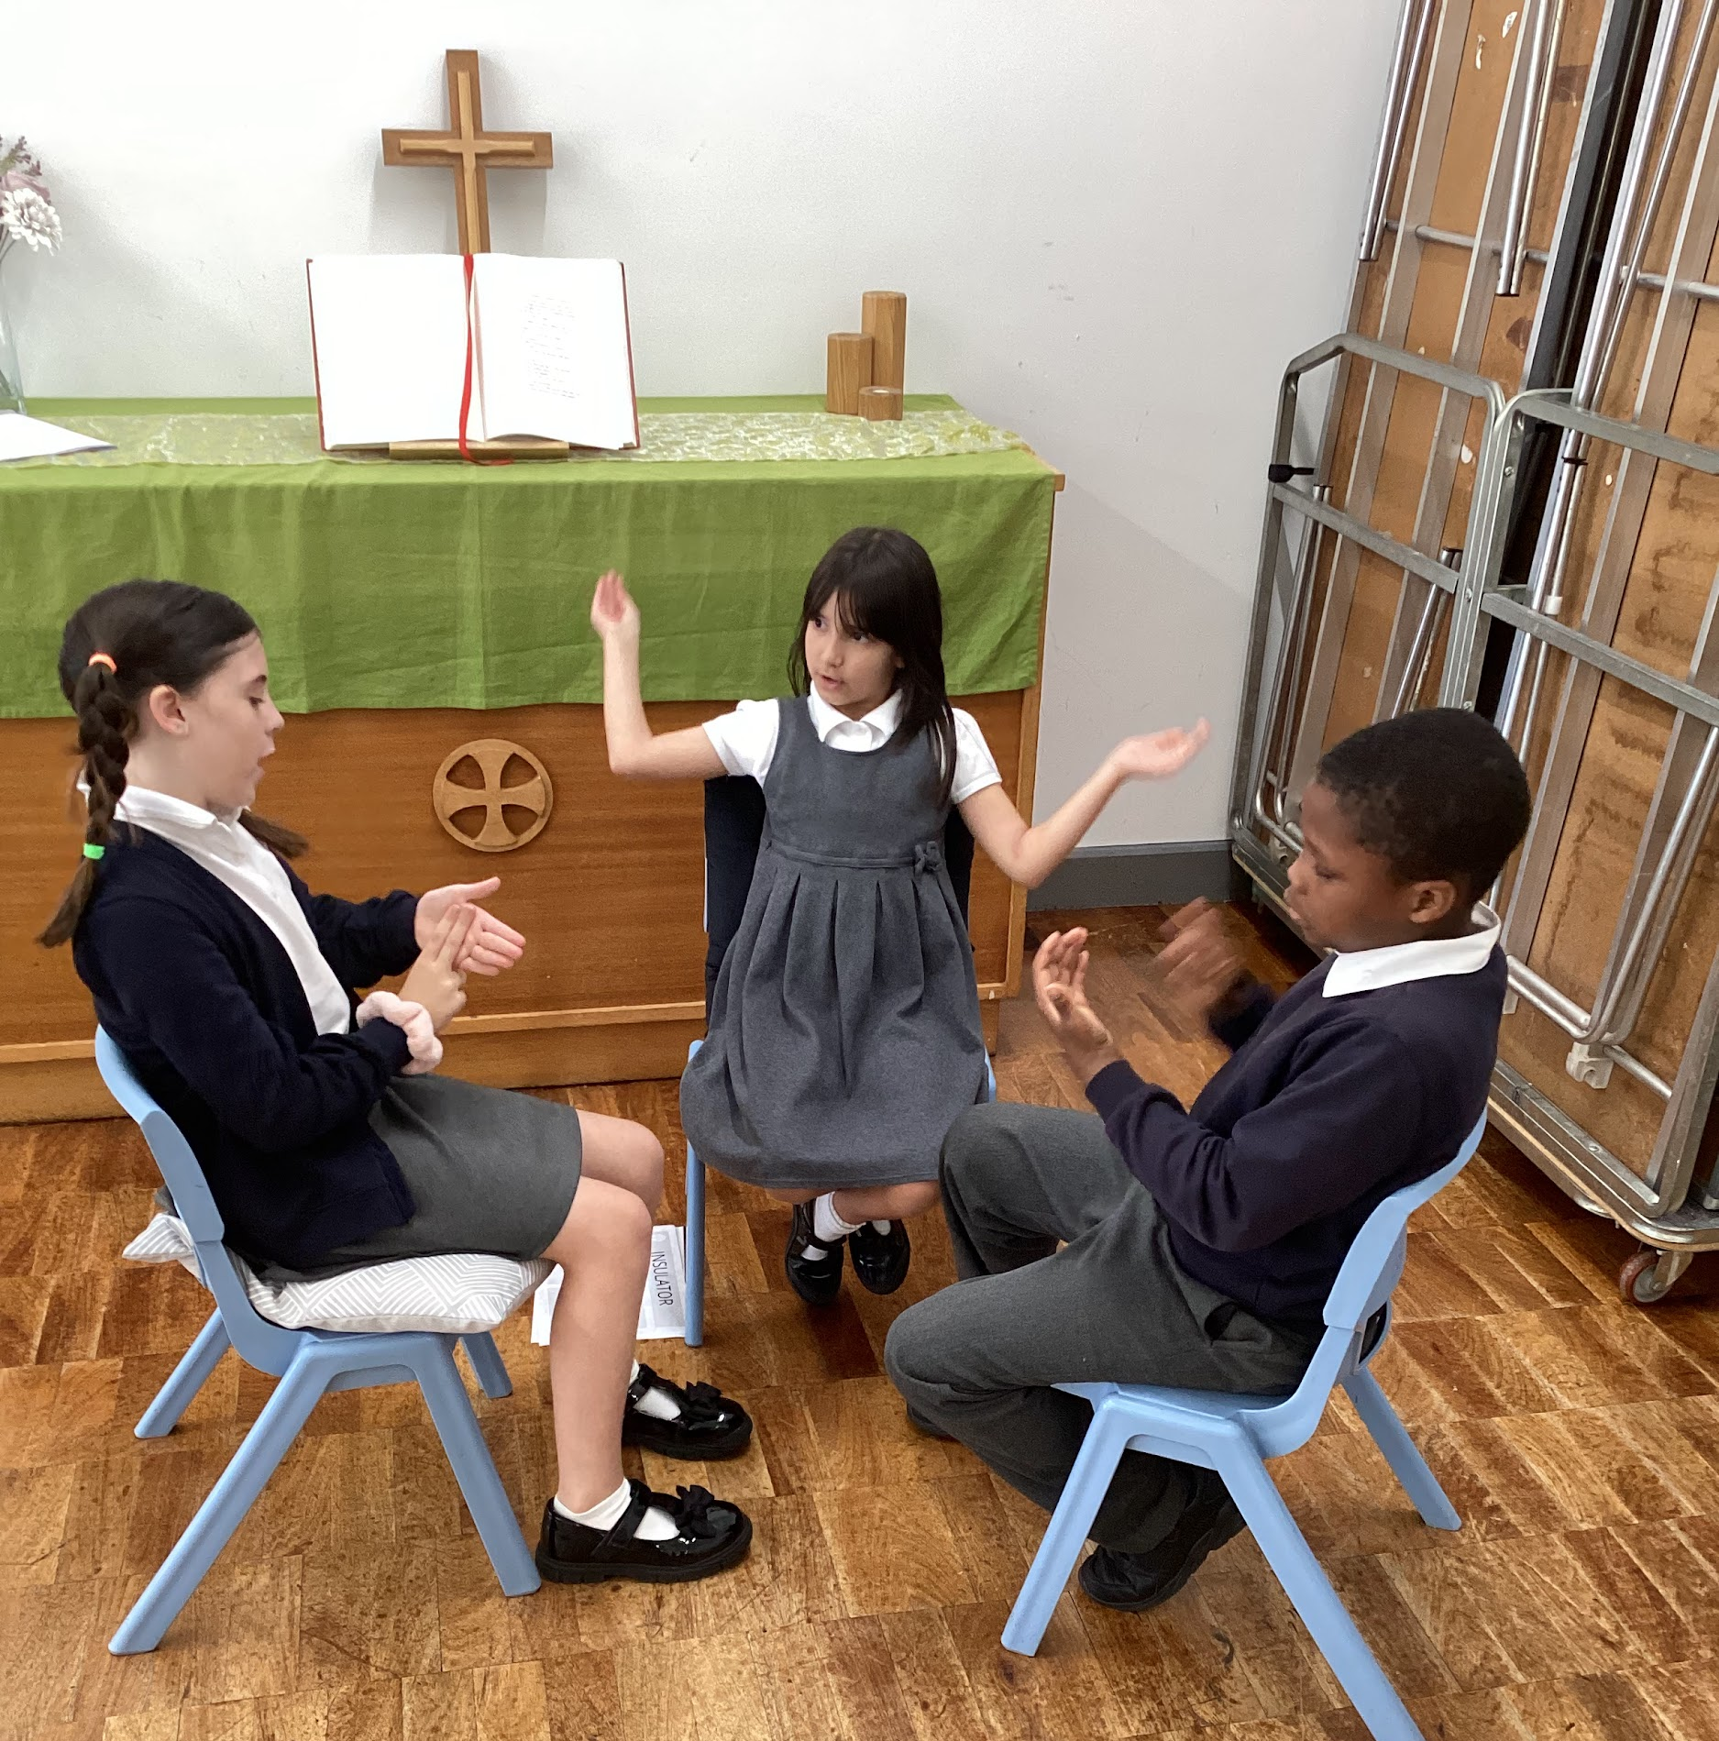
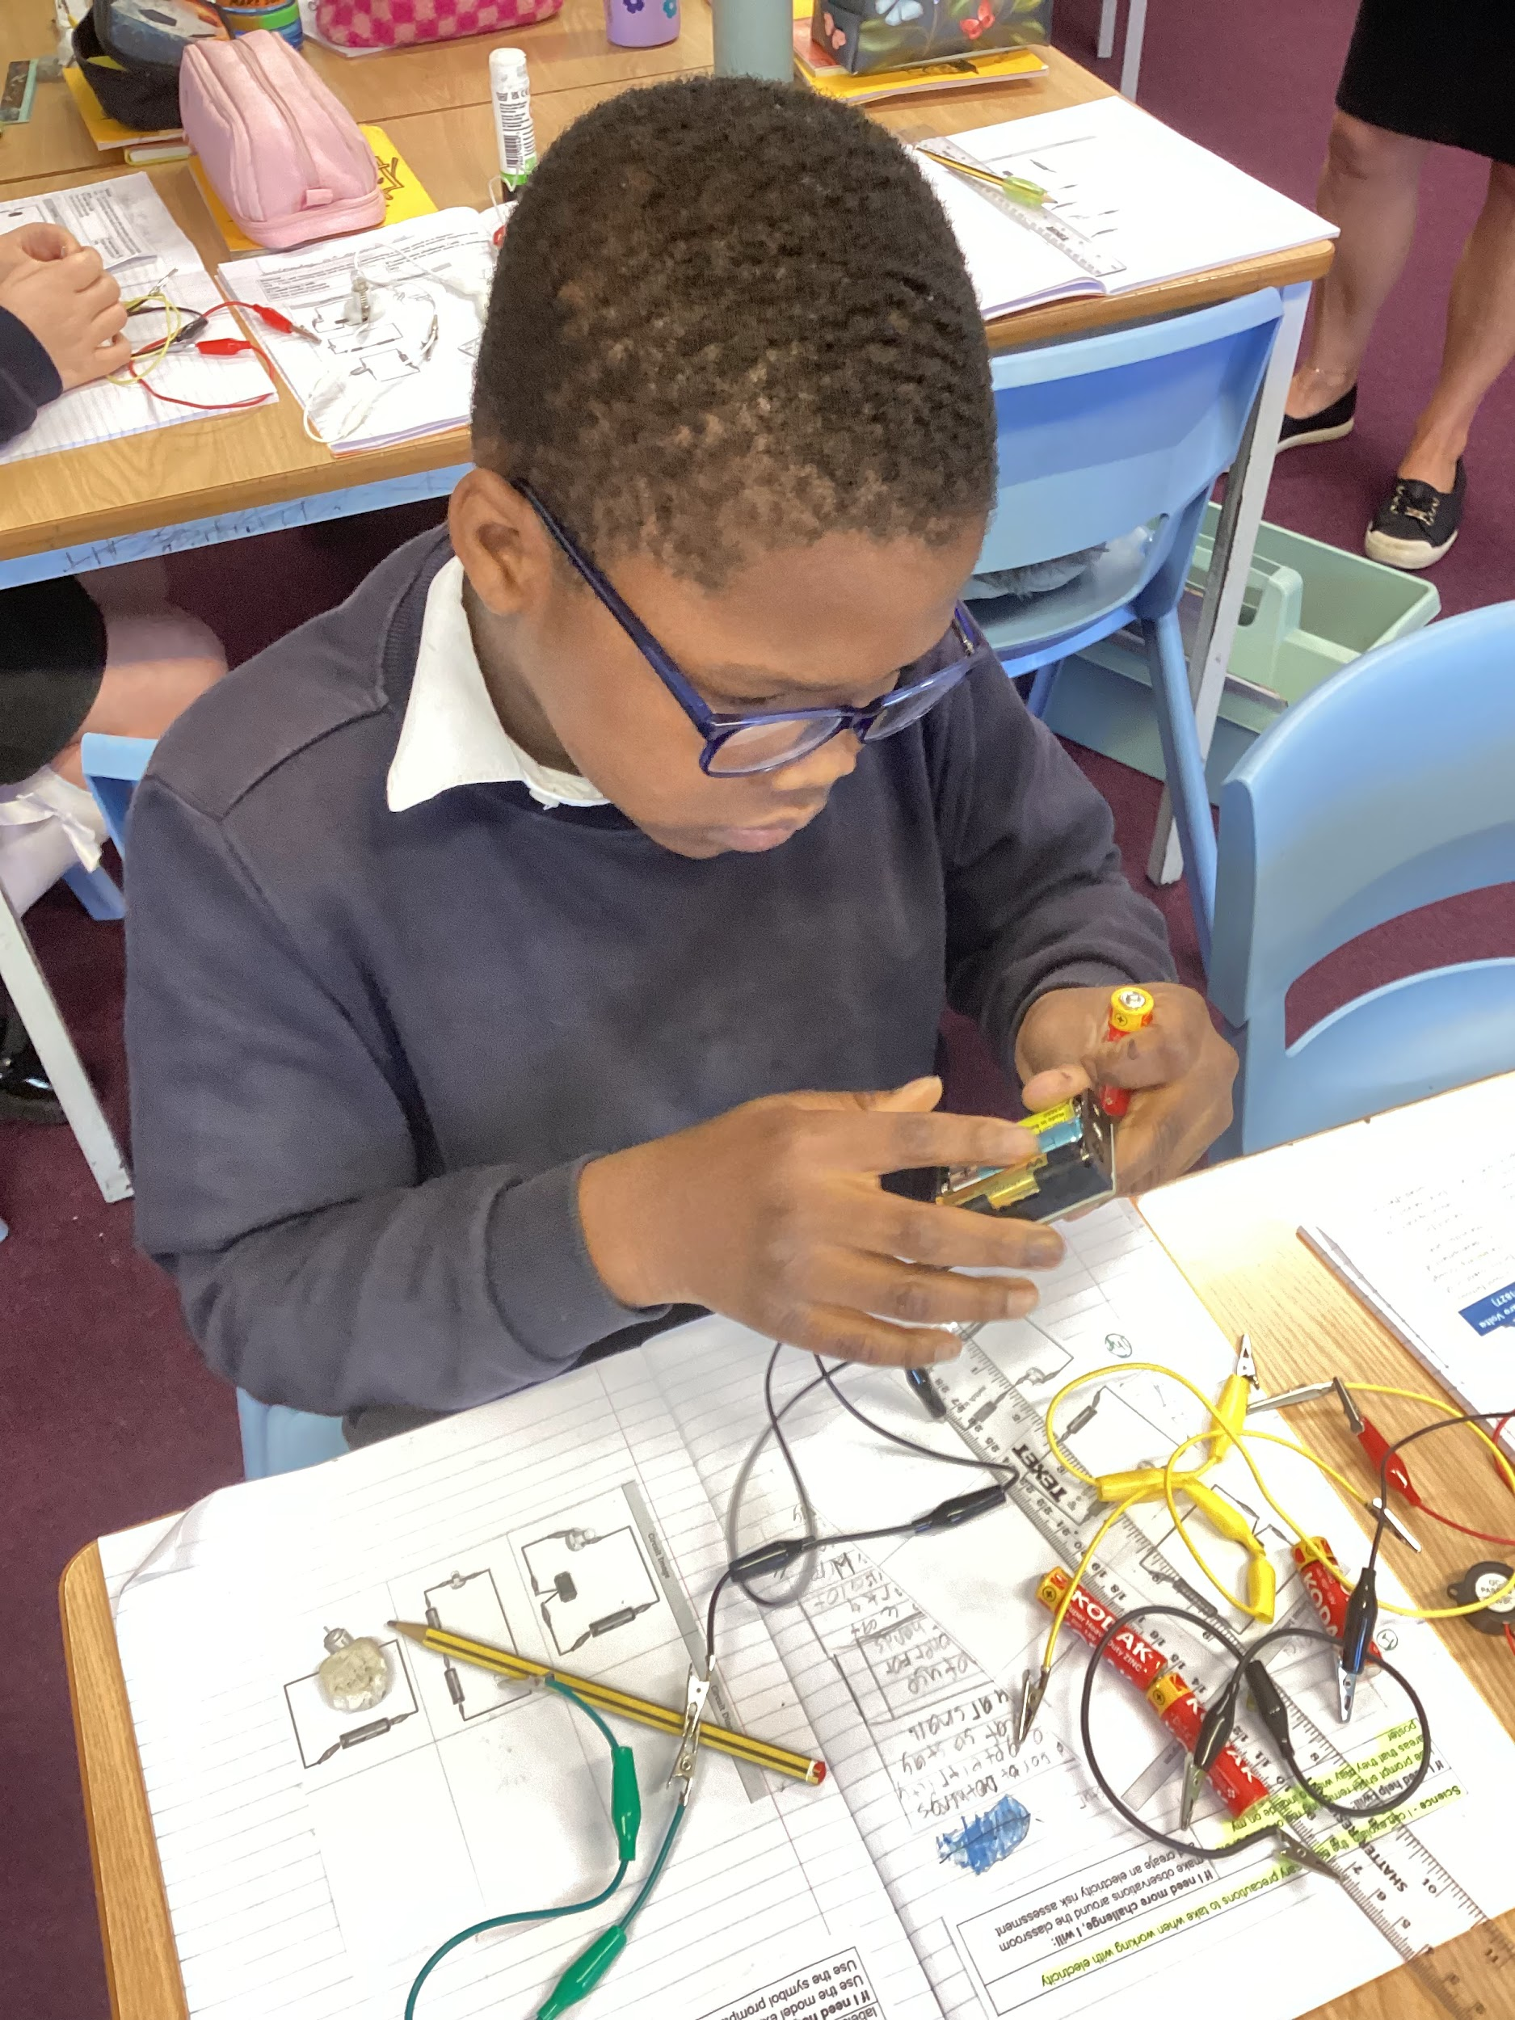
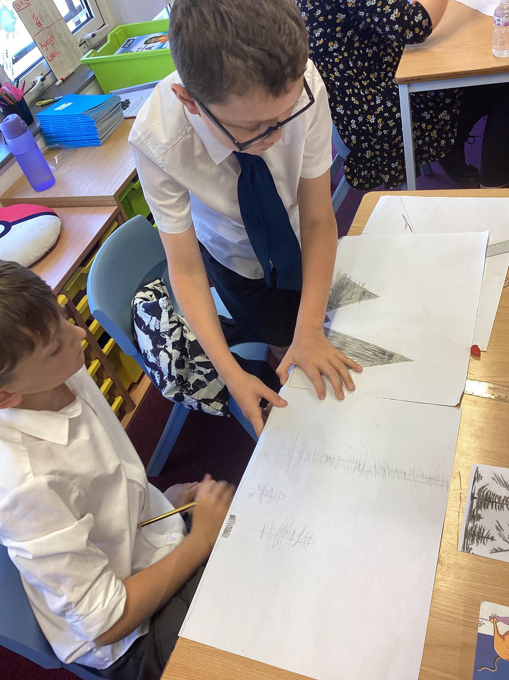
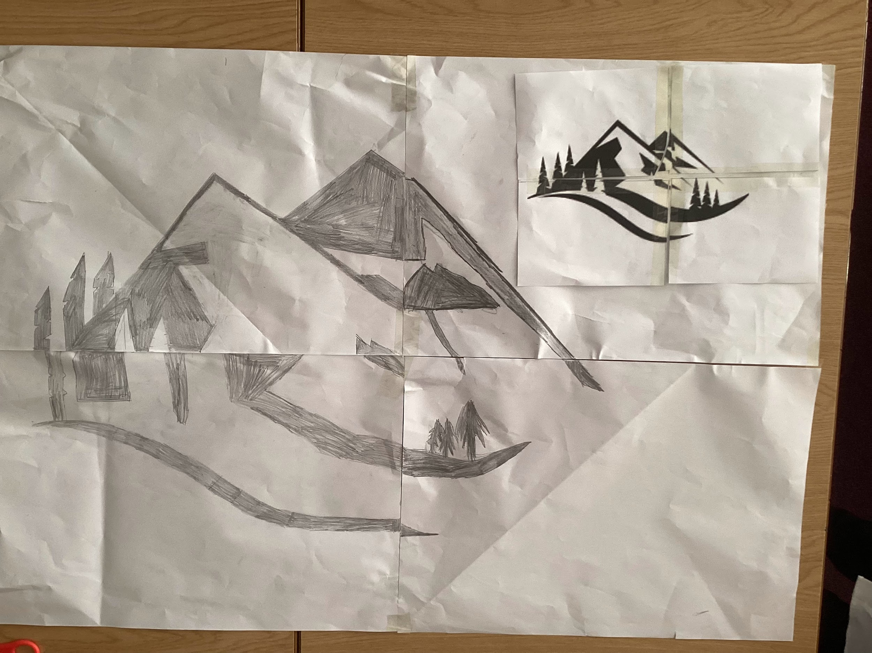
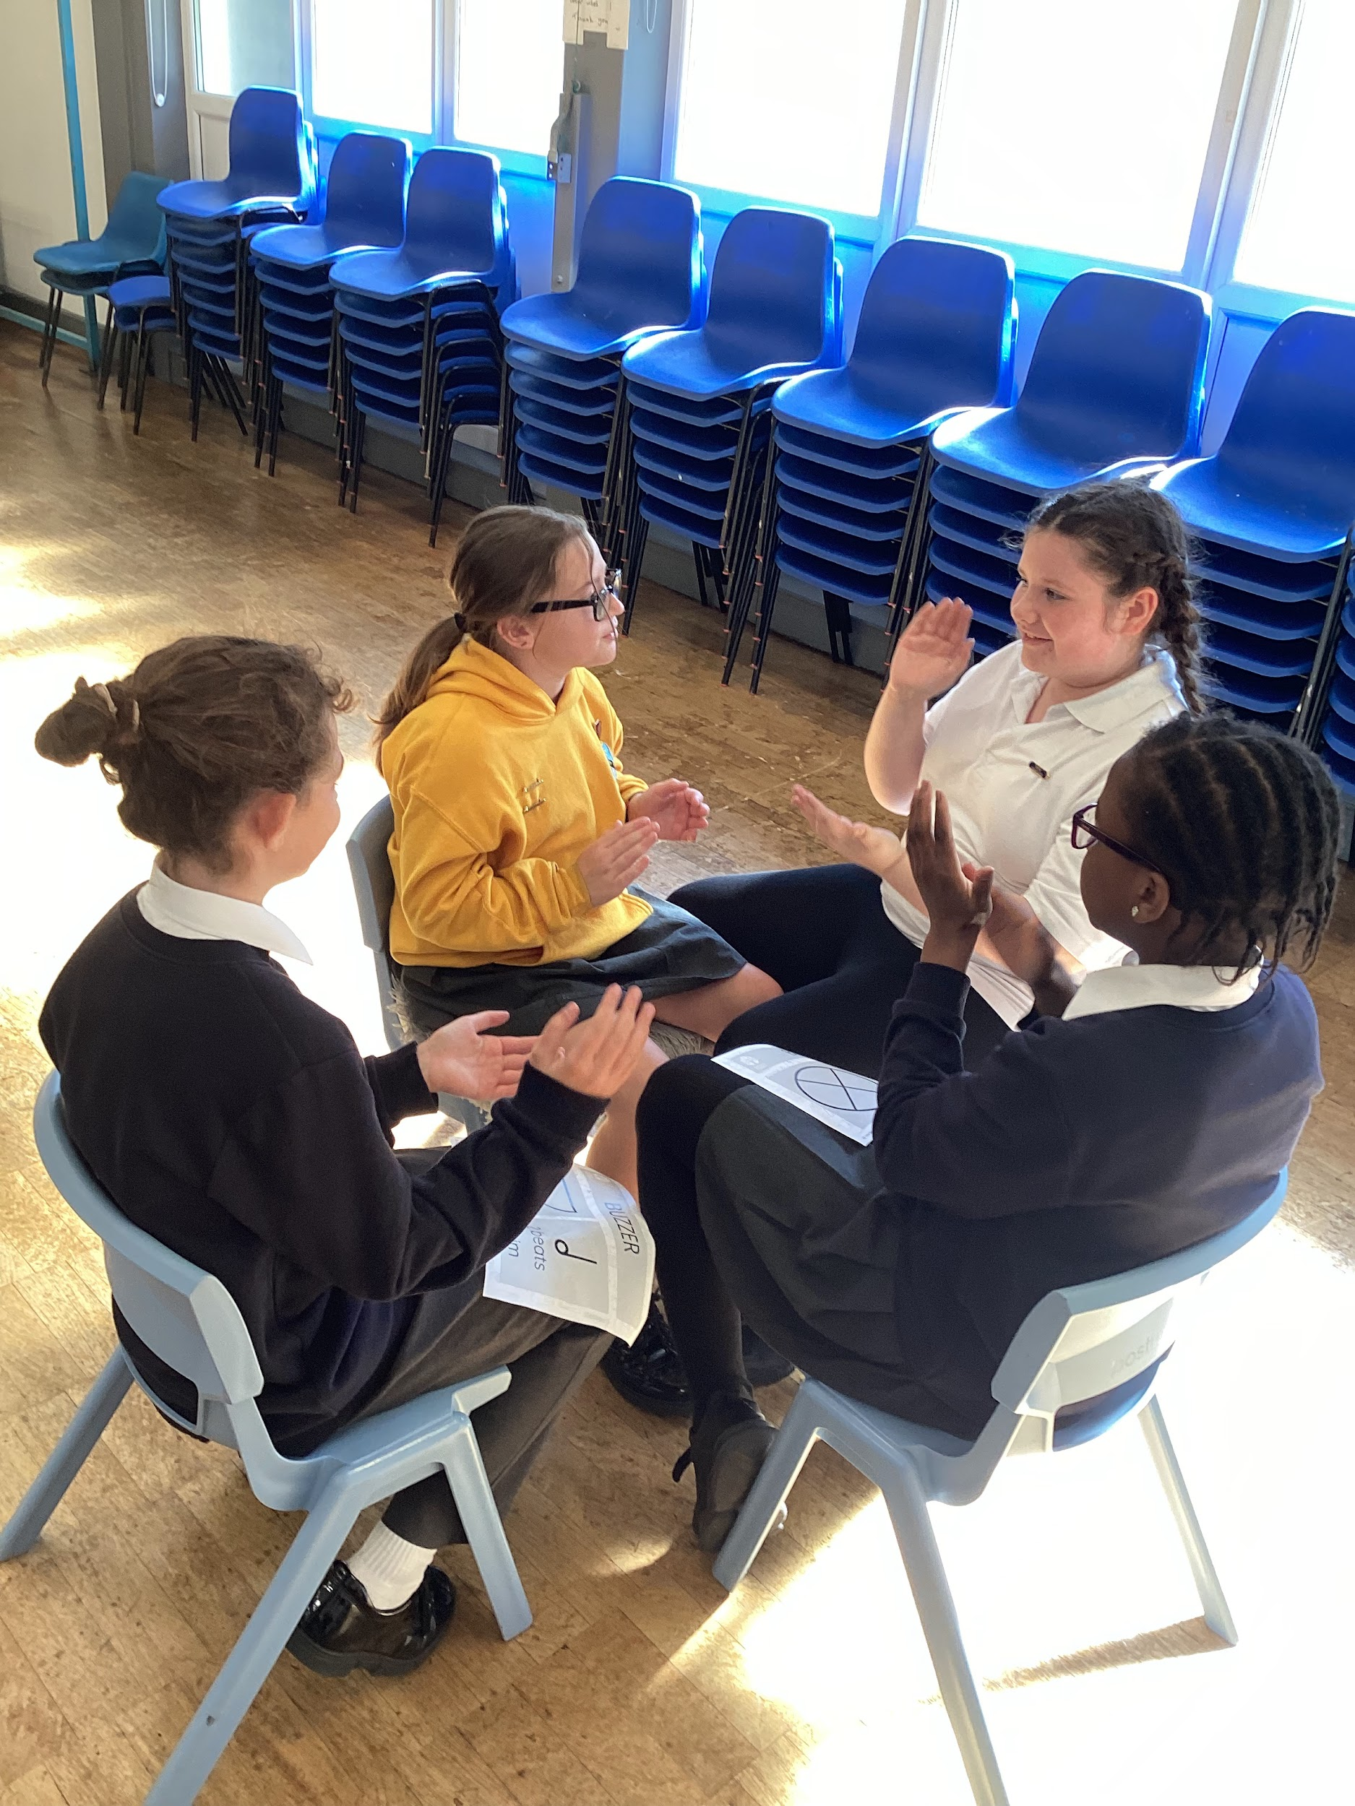
Curriculum Highlights
In music, we have continued the theme of ‘Electricity’ and are using this to help us learn about time signatures, pulse and the different music notation
What an amazing start to the year in St Oscar! Science has got off to a great start with us investigating and drawing circuit diagrams.
As artists, we have been learning the skill of enlargement (scaling up) so that we can turn 2D images into 3D sculptures. Fantastic resilience and teamwork being shown.

Slide 3





Booking Information:
All bookings should be made via ParentPay prior to the session. For any last-minute bookings, please call the school office.
Breakfast Club
Available Monday – Friday from 8:00 AM
Cost: £4 per session
After School Club
Available Monday – Friday
Until 5:00 PM – £6.75
Until 5:30 PM – £10.00
Fridays close at 5:00 PM
After School Activities
Tuesday – Football
Important Notice:
Any accounts with arrears of £50 or more will not be permitted to use the Breakfast Club or After School Clubs until the balance is cleared.

Slide 4
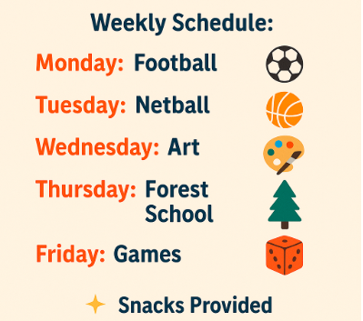
Breakfast and afterschool club activities

Slide 5


We have had a great response to our Lego keyring fundraiser. If you would like to order a keyring please follow the link. https://forms.gle/xB2aKCdC9Y9Mk1Mi9
Please pay for your keyring via ParentPay.

