Slide 1

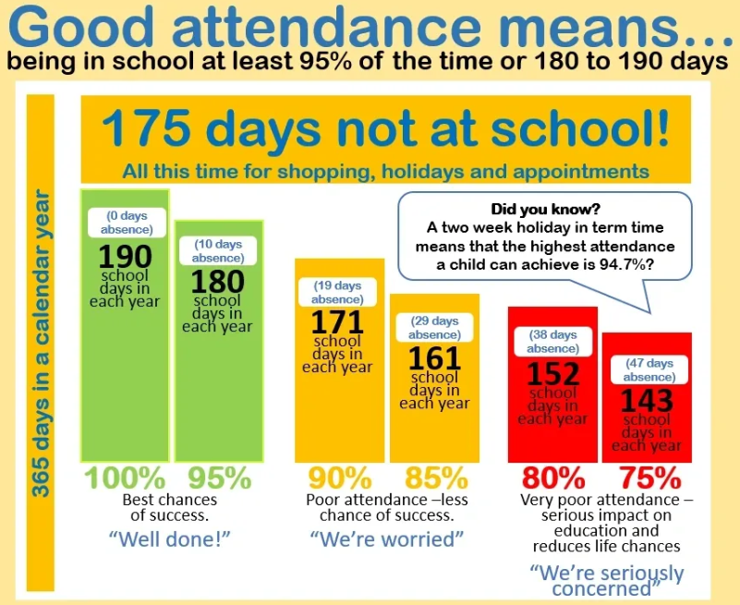




Attendance October
 | 98.61%
 | 93.75%
 | 92.00%
 | 91.67%
Important Notices & Reminders
If your child is late for morning registration, arriving late at school after 9am, please ensure you or their accompanying adult reports to the school office to ensure that they are registered.

Slide 2
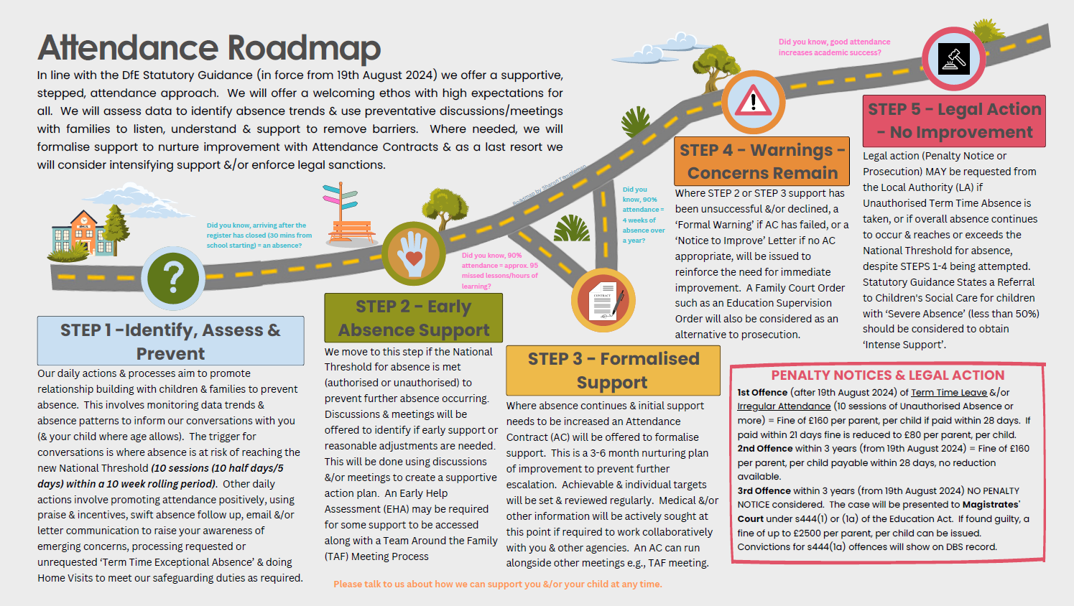

Slide 3
03.11.25 | Non Pupil Day | 03.12.25 | St Oscar trip to Exeter Museum
04.11.25 | Pupils back for Autumn 2 | 04.12.25 | Lantern making workshop
07.11.25 | Clay Workshops (Years 3-6) | 05.12.25 | Wreath Making Event for adults 7 - 9 in the school hall
10.11.25 | Swimming Lessons for St Oscar continue | 11.12.25 | Save the Children Christmas Jumper Day
14.11.25 | Children in Need - Come dressed in own choice of clothes/costume/PJs | 11.12.25 | Nativity 2 - 3pm
16.11.25 | Road Safety Week | 12.12.25 | Djembe Workshop - whole school
24.11.25 - 25.11.25 | Bikeability | 16.12.25 | Carol Service at Church
26.11.25 | KS2 SEND Festival @ NAC | 19.12.25 | Break up for Christmas Holidays
29.11.25 | Saturday Family Mass @ St. Joseph’s Parish church - all are welcome 10:00 - 11:00 | 05.01.26 | Back to School

Slide 4



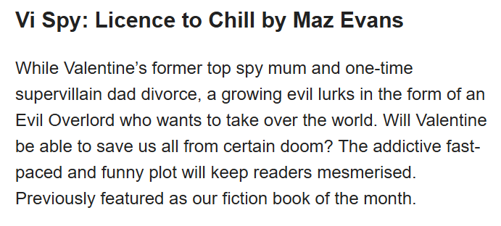
Book Recommendations
"Books are a uniquely portable magic."- Stephen King

Slide 5

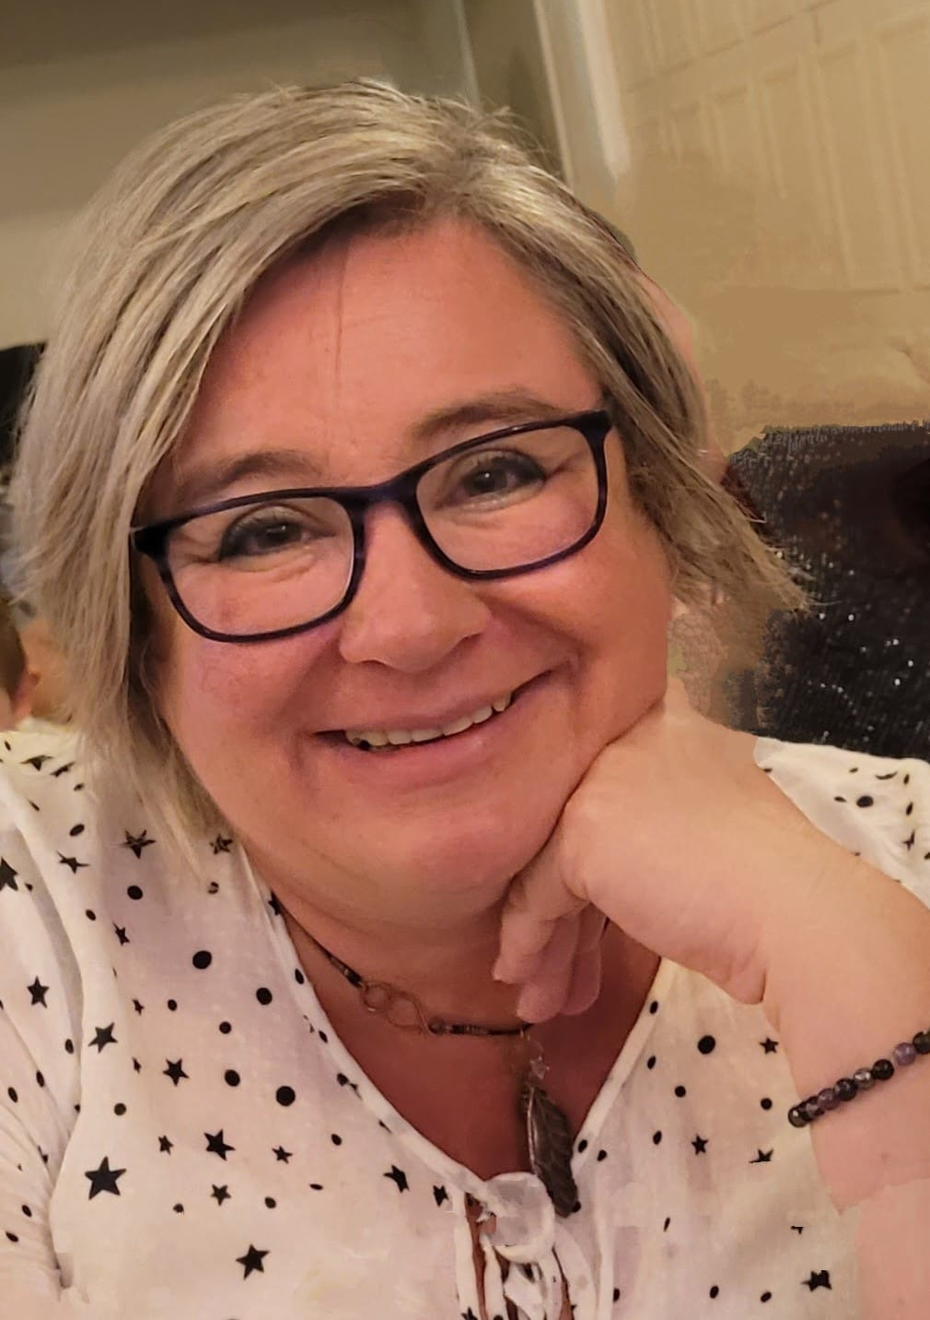

SAFEGUARDING
Safeguarding at St. Joseph’s is always a priority. Should you have any enquiries or concerns, please contact our Designated Senior Lead for Child Protection: Mrs Day or Mrs Pascoe on 01626 352559. Our named governor for child protection is Tim van Kroonenburg.
CPOMS and Operation encompass
WELFARE
Our Family Support Worker is Julie . Please let us know if you would like her to contact you for ANY support. Everyone needs a Julie in their lives!
At St. Joseph’s we use CPOMs as our system for recording information that we consider to be safeguarding information. Further information about the programme can be found here -
https://www.cpoms.co.uk/privacy-statement/
Operation Encompass is the reporting to schools, prior to the start of the next school day, when a child or young person has exposed to, or involved in, any domestic incident.
Operation Encompass will ensure that a member of the school staff, known as a Key Adult, is trained to allow them to liaise with the police and to use the information that has been shared, in confidence, while ensuring that the school is able to make provision for possible difficulties experienced by children, or their families, who have been involved in, or exposed to, a domestic abuse incident.
ATTENDANCE
Hi, my name is Natalie, I'm the Attendance and Welfare Officer here at St Joseph's. I monitor attendance regularly to ensure that, where possible, every child is in school on time every day. If you have any concerns around your child's attendance, please leave a message with the office and I will contact you.

Slide 6


Community Events & activities

